Slide 1
Pathogen Control and Public Health at Livestock Interactions
Megan Jacobs, Derek Foster, Ben Chapman
North Carolina State University

Slide 2
Introduction
Megan Jacob, MS, PhD
Assistant Professor, Clinical Microbiology
NC State

Slide 3
Prevalence of Foodborne Incidence at Livestock Interactions/Burden
Ben Chapman
Department of Agricultural and Human Sciences

Slide 4
2940 illnesses
60 outbreaks
since 1994

Slide 5
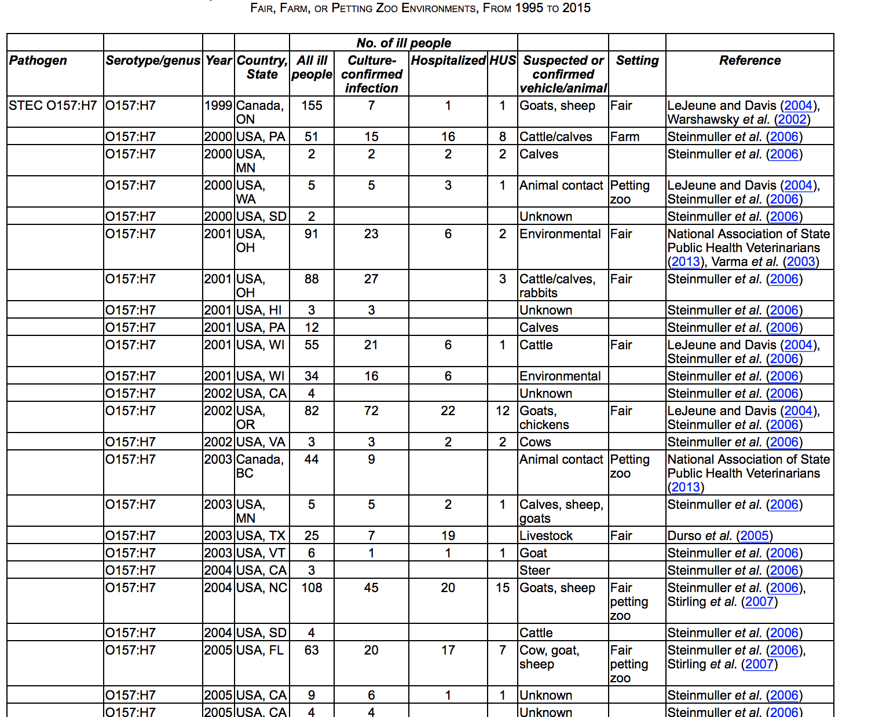
Farm Fairs and Petting Zoos: A Review of Animal Contact as a Source of Zoonotic Enteric Disease

Slide 6
Investigation of animal contact burden
Pathogens investigated
  Campylobacter species,
  Cryptosporidium species,
  Shiga toxin–producing Escherichia coli (STEC) O157,
  STEC non-O157,
  Listeria monocytogenes,
  nontyphoidal Salmonella species,
  Yersinia enterocolitica.
14% or 445,213 illnesses linked to animal interactions
(Hale et al., 2012)

Slide 7

NW Washington fair
25 confirmed cases
35 others suspected (symptoms)
6 Cases of HUS

Slide 8
Fall-out of NW Washington fair
Milk Maker’s Fest cancelled in 2016
Lawsuit filed against: Whatcom County Dairy Women, Northwest Washington Fair Association and the Lynden School District
Read more here: http://www.bellinghamherald.com/news/local/article66972247.html#storylink=cpy

Slide 9
NW Washington Fair
Washing or sanitizing their hands before eating lunch were less likely to become ill.
Children who reported always biting their nails were more likely to become ill.
Leaving animal areas without washing hands might have contributed to an increased risk of transmission.
Eating in animal areas might have contributed to an increased risk of transmission.

Slide 10
2003 study on prevalence
Prevalence of E. coli O157: H7 in livestock at 29 county and three large state agricultural fairs:
13.8 percent of beef cattle
5.9 percent of dairy cattle
3.6 percent of pigs
5.2 percent of sheep
2.8 percent of goats.
Over 7 per- cent of pest-fly pools also tested positive for E. coli O157:H7

Slide 11
Case Study on Incidence at Livestock Interactions
Nicole Lee
  Foodborne Epidemiologist
  Division of Public Health, Communicable Disease Branch
  North Carolina Department of Health and Human Services

Slide 12
Handwashing –efficacy and limitations
Ben Chapman

Slide 13
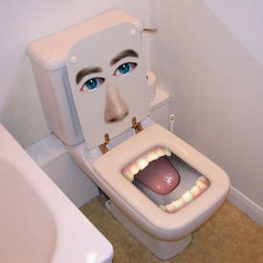
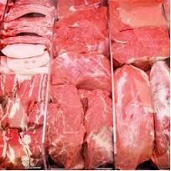
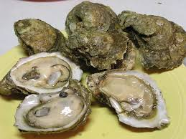

Sources of pathogens on hands
Toilet
Hepatitis A, norovirus, Shigella, Giardia, Salmonella
Source: Human feces has 10^7 pathogens per gram
Food
Salmonella, E. coli, Campylobacter, Vibrio
The food surface has at most 20,000 pathogens per ml

Slide 14
Hand hygiene research
3 petting zoos in Kansas and Missouri, hand hygiene compliance of 574 visitors was observed
Only 37% of visitors attempted any type of hand hygiene.
Importantly, visitors were 4.8 × more likely to wash their hands when a staff member was present (
Hand hygiene compliance was also observed at 36 petting zoos in Ontario, Canada
A compliance of 0–77% was observed (mean value 30.9%). Increased hand hygiene compliance was observed when hand-washing stations were located near the exit (Weese et al., 2007).

Slide 15
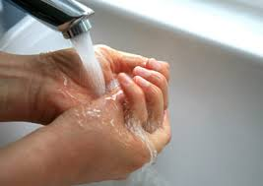
Step 1: Rinse
Rinse hands under clean, running water
Wash off any large particles that could inhibit effectiveness of disinfection steps, if used
Water temperature does not matter for pathogen removal
  Plays other roles (loosening soil, preference)
(Boyce & Pittet, 2002; Michaels et al., 2002)
Notes:
Talk about how temperature doesn;’t matter, a study was done that found that different temperatures (ranging from 40 F to 120 F) had no discernable impact on the reduction of microbes or contaminants on hands

Slide 16
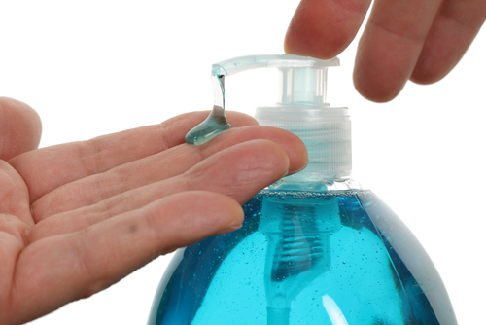
Step 2: Soap
Apply hand soap
Soap makes it easier to rinse off things, likes fats and oils, because it makes them more soluble in water
Soap has better activity at warmer
(Boyce & Pittet, 2002)
Notes:
Regular soap versus antimicrobial soap is not important, antimicrobial soaps have been found to be only marginally more effective than regular soaps (and will talk about why in a second); liquid soap is preferable

Slide 17
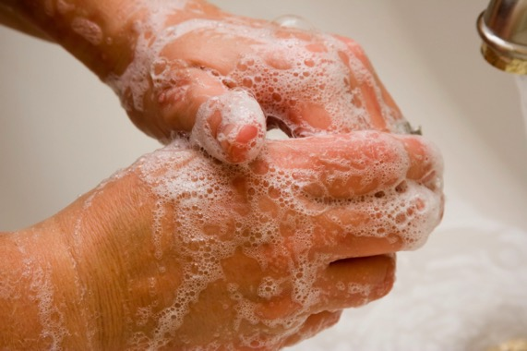
Step 3: Scrub
Rub together for 10 to 15 seconds, pay particular attention to fingernails
Mechanical removal of contaminants and microbes from hands is crucial in proper hand hygiene
Scrubbing physically gets rid of these (and a nail brush helps)
It is important to be thorough around fingernails, as it has been found that these harbor very high amounts of organisms
(Lin et al., 2003; Price P., 1938)

Slide 18
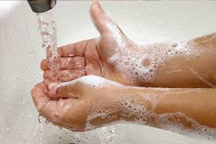
Step 4: Rinse
Thoroughly rinse hands under clean, running water
This aids in the mechanical removal of microbes and contaminants from your hands
(Boyce & Pittet, 2002; Michaels et al., 2002)

Slide 19
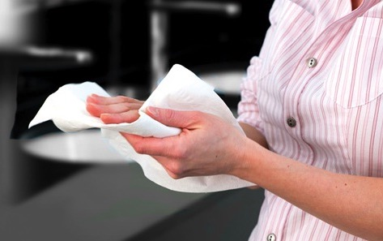
Step 5: Dry
Rinse hands under clean, running water
Mechanical drying is the last step in physically removing microbes and contaminants from hands – 1 log reduction
Disposable paper towels are desirable as they dry efficiently, remove bacteria effectively, and can cause less contamination in the washroom
(Huang, Ma, & Stack, 2012)

Slide 20
Reduction of Microbes from Hand Washing
Proper hand washing has been found to reduce microbes on hands between 99 and 99.9%
It is estimated that the microbial population on hands ranges from 40,000 and 4,600,000
This could leave anywhere between 100 to 5,000 microbes behind
(Boyce & Pittet, 2002; FDA, 2009; Green et al., 2007)
Notes:
Not all of these microbes are going to be disease causing, but some diseases need as few as ten particles to infect. Take home message: wash your hands but also be cautious of what you touch with bare hands *Note: this is only if proper technique is followed, literature has found that glove use without hand washing is not effective

Slide 21

Handwashing compliance
It is known that hand washing compliance tends to be very poor, around 40%
  One study found that 73% of restaurant workers failed to use proper hand washing
  Other have found similar results, with about 30% of food handlers displaying correct hand washing practices
(Green et al., 2007; Voss & Widmer, 1997)

Slide 22
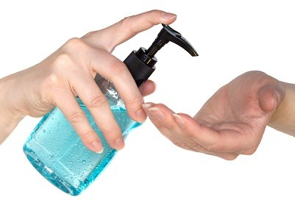
Hand Sanitizers: Fact or Fiction?
The composition matters
Fact
For most pathogens a hand sanitizer with an alcohol concentration of at least 60% is needed
(Boyce & Pittet, 2002; FDA, 1994)

Slide 23
Hand Sanitizers: Fact or Fiction?
Can prevent disease caused by all agents
Fiction
Most hand sanitizer is not effective for all agents of disease, especially Norovirus
(Liu, Yuen, Hsiao, Jaykus, & Moe, 2010)

Slide 24
Why clean? Why sanitize?
Reduce risk of biological contamination
Reduce bacterial multiplication – food particles removed
Protect food from contamination
Avoid attracting pests
Maintain safe environment

Slide 25
Establishing Effective Cleaning and Disinfection Programs
Ben Chapman

Slide 26
Locations for cleaning and sanitizing
Manure bunker
Hay maze area
Bleachers by east wall
Bleachers by west wall

Slide 27
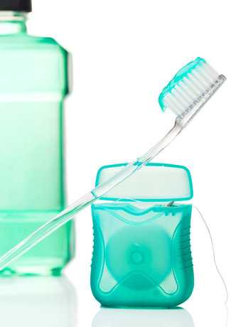
What is the Difference?
Cleaning – the removal of soil (food) from surfaces of equipment and utensils.
Sanitizing – reduces the number of disease-causing microorganisms on equipment and utensils to acceptable public health levels.
It’s like brushing your teeth (clean),
then using mouth wash (sanitize)

Slide 28
Five Steps
Pre-flush and pre-scrape
Wash
Rinse
Sanitize
Air dry

Slide 29
When to Clean
All surfaces need to be cleaned and rinsed at regular intervals
Follow the master cleaning schedule
Use clean as you go strategy
  maintain and safe and clean environment
  Minimize amount of cleaning when finished

Slide 30
Hand Contact Surfaces
Rails/barriers
Handles
  doors, refrigeration equipment, freezers, cupboards, drawers, etc
Faucets, soap and paper towel dispensers

Slide 31
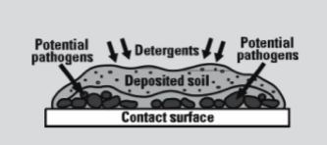
How Does Cleaning Work?
Washing helps to loosen soils and detergent and scrubbing help break adhesion of soil and microorganisms
Iowa State University Extension

Slide 32
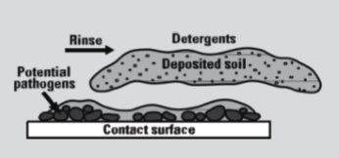
How Does Cleaning Work?
Rinsing removes loosened soil and detergent from the surface. This is important because they can make sanitizers less effective
Iowa State University Extension

Slide 33
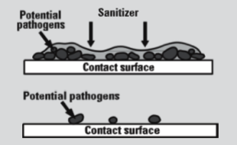
How Does Sanitizing Work?
Applying sanitizer to a clean surface provides a “kill” step to reduce the number of microorganisms to a safe level.
Note: We don’t sterilize in food service, it isn’t reasonable or necessary
Iowa State University Extension

Slide 34

How does a sanitizer work?
Disruption of the cell wall barrier by reactions of chlorine with target sites on the cell surface
release of cell insides
Doesn’t allow cell to function
It blows it up
Notes:
Chlorine effectively kills a large variety of microbial waterborne pathogens, including those that can cause typhoid fever, dysentery, cholera and Legionnaires' disease. Chlorine is widely credited with virtually eliminating outbreaks of waterborne disease in the United States and other developed countries. And Life magazine recently cited the filtration of drinking water and use of chlorine as "probably the most significant public health Health officials began treating drinking water with chlorine in 1908. Previously, typhoid fever had killed about 25 out of 100,000 people in the U.S. annually, a death rate close to that now associated with automobile accidents. Today, typhoid fever has been virtually eliminated.

Slide 35
Chemical Sanitation
Chlorine – effective against most microorganisms, in hard/soft water, relatively cheap, may corrode
Quaternary Ammonium Compounds - odor free, non-corrosive, do not work well in hard water, not effective against all microorganisms. pH, temperature, concentration, contact time are important
Iodine – works rapidly, may stain some metals

Slide 36
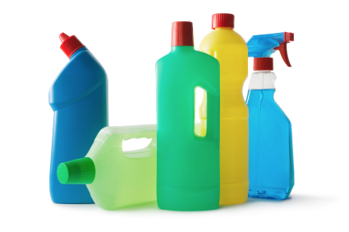
Chemical Sanitation
Chlorine
  Use 25-100 ppm depending on pH and water temperature
  Contact time of seven seconds
Quaternary Ammonium Compounds
  100-200 ppm, water at 75F-120F
  Contact time of 30 seconds
Iodine
  12.5-25 ppm, water at 68F
  Contact time of 30 seconds

Slide 37
Environmental Control and Considerations for Human Pathogens in Animals
Megan Jacob, MS, PhD
Assistant Professor, Clinical Microbiology

Slide 38
What are zoonotic pathogens?
Microorganisms from animals that can be shared and cause disease in people
  Viruses
  Bacteria
  Fungi
  Parasites
Very common (6 of 10 infectious diseases in people)
Animals do not necessarily appear sick when carrying zoonotic organisms

Slide 39
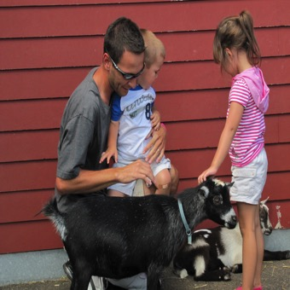

How are zoonotic pathogens shared?
Direct contact with an animal
Indirect contact
  Ingestion of contaminated food or water
    Raw milk
    Drinking water
  Ingestion after contact with environment
    Fence rails
    Door knobs
    Equipment
    Serving utensils
    Animal bedding
    Contaminated clothing or shoes

Slide 40
Role of environmental survival of pathogens
Organisms that persist in the environment extend the time that people may be at risk for acquiring a zoonotic pathogen
Organisms that survive in the environment can be disseminated to new areas
  Insect vectors
  Rainwater runoff
  Physical movement
  Dust
Some microorganisms remain stable in the environment, others proliferate

Slide 41
How well do zoonotic organisms survive in the environment?
Highly variable between and even within different organisms
  Influenza virus – short - minutes
  Shiga toxin-producing E. coli (STEC) – reported > 300 days in sawdust
  Salmonella – months in manure or wooden fencing
  Cryptosporidium - stage dependent; oocyte can survive months in water environment

Slide 42
Factors that influence environmental survival of zoonotic pathogens
Presence of biological material (manure)
Temperature
Humidity/Moisture
Acidity
Type of microorganism

Slide 43
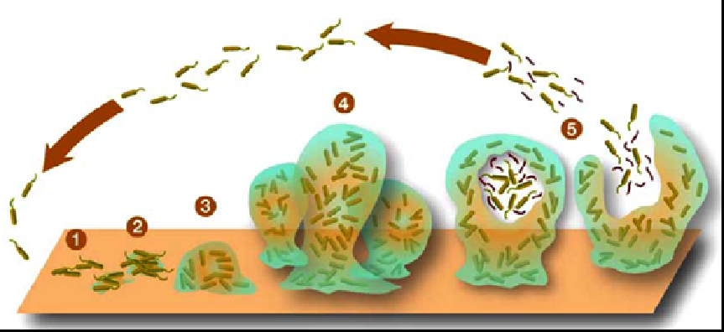
Bacterial biofilms
Biofilms are a group of microorganisms that stick to each other and usually to a surface. They are embedded in an extracellular matrix and behave differently then they would outside of the community

Slide 44
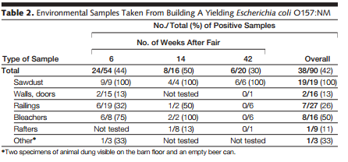
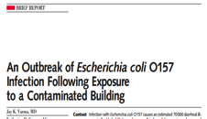
Examples of environmental persistence

Slide 45
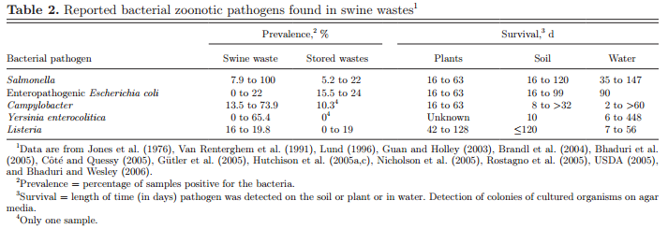
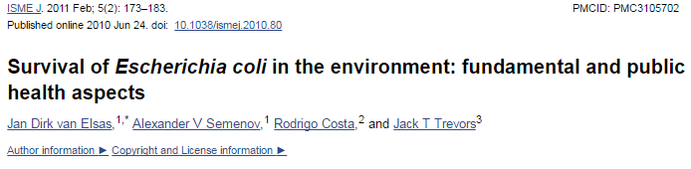
Examples of environmental persistence

Slide 46
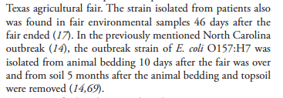




Slide 47
Current recommendations to control zoonotic pathogens in the environment
Control shedding of organisms from animals
  Control strategies?
  Testing strategies?
  Management strategies
    Stress, handling, transportation, season, age of animal
Proper manure disposal
Facility design
Disinfect areas as possible
Provide ventilation
Limit animal use space for community events

Slide 48
Environmental persistence
Cannot be predicted by organism
Multi-factorial
Can be controlled with management strategies

Slide 49
Questions?
Megan Jacob
Department of Population Health & Pathobiology
1060 William Moore Dr.
Raleigh, NC 27607
Megan_Jacob@ncsu.edu
(919) 513-6236

Slide 50
Zoonotic Pathogens and Interactions with Animal Health
Derek Foster, DVM, PhD
Assistant Professor of Ruminant Medicine

Slide 51
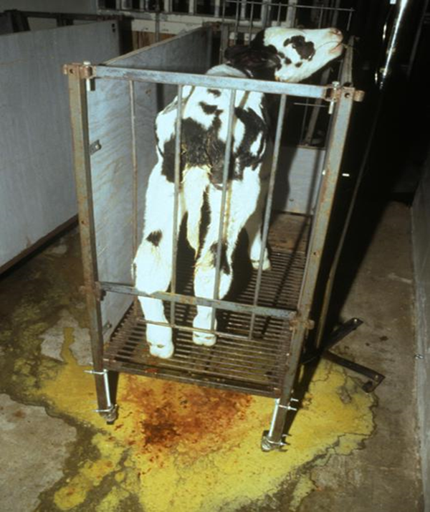
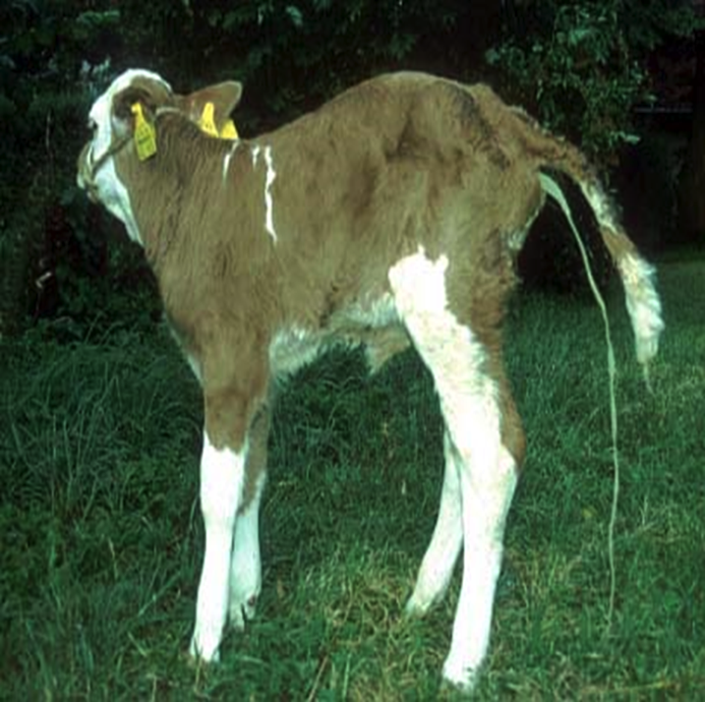
Zoonotic Pathogens
Salmonella—cattle, poultry
  Can cause disease
  Also found in healthy animals
Cryptosporidium—calves
  Can cause disease
  Also found in healthy animals
Campylobacter—cattle, poultry
  Rarely causes disease in animals
E. coli O157—Cattle, sheep and goats
  Does not cause disease in animals

Slide 52
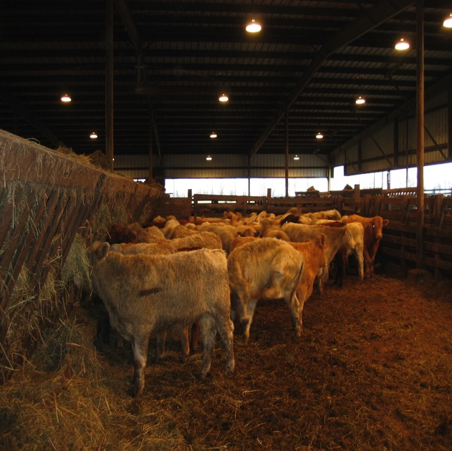
Risk Factors for Shedding in Healthy Animals
“Stress”
  Weather changes
  Overcrowding
  Transportation
  Adding animals
  Nutrition
    Diet changes
    Underfeeding
  Giving birth
Young animals

Slide 53
Interventions and current recommendations
Major pathogens can be found in feces of healthy animals
Shedding is not consistent
  Fecal cultures can accurately say an animal is positive
  Fecal cultures CANNOT say an animal is negative
Routine cultures may be useful for some pathogens
  Salmonella, E. coli O157:H7
  Prior to purchase
  Prior to exhibition
  Any animals with diarrhea
  Annually?

Slide 54
Interventions and current recommendations
Avoid stress that can increase shedding
Raise replacement animals
  Only buy new animals from “clean farms”
  National Poultry Improvement Program
Isolate animals with diarrhea

Slide 55
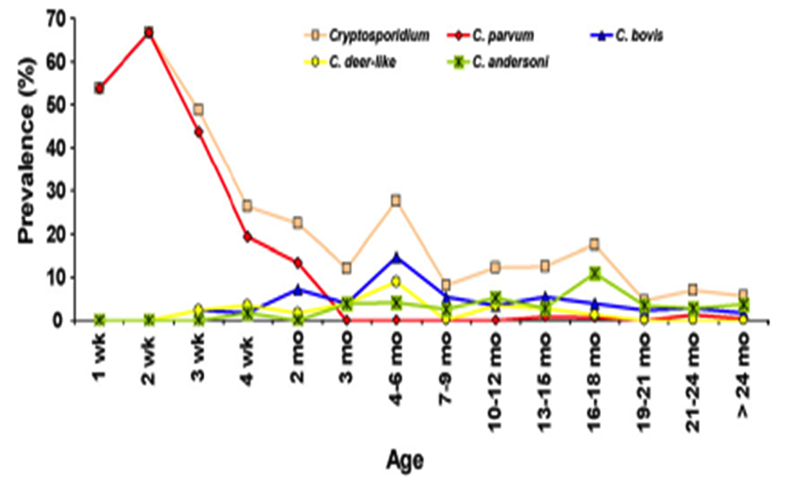
Interventions and current recommendations
Avoid high risk animals
  Animals that have recently given birth
  Very young (Cryptosporidium)

Slide 56
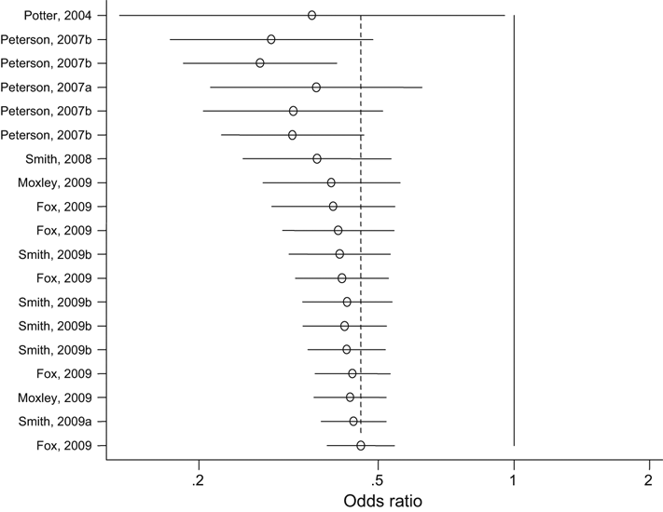
What’s being explored?
Use of vaccination to control shedding
  E. coli O157:H7 vaccine reduces odds of shedding by half in feedlot cattle
Varela et al., 2012

Slide 57
What’s being explored?
Swift et al, 2017.

Slide 58
What is being explored?
Use of vaccination to control shedding
  Salmonella vaccine does not reduce shedding in healthy adult animals
  Cannot be given to young calves
Heider et al, 2008.

Slide 59
What is being explored?
Smith, et al., 2014

Slide 60
Conclusions
Pathogens can be shed by healthy animals
No perfect testing or vaccination strategy
  Discuss options with your veterinarian
Decrease likelihood of shedding by reducing stress
Provide adequate barriers and handwashing

Slide 61
Questions?
Derek Foster
1060 William Moore Drive
NC State University
College of Veterinary Medicine
Raleigh, NC 27606
derek_foster@ncsu.edu
919-513-6128

Slide 62
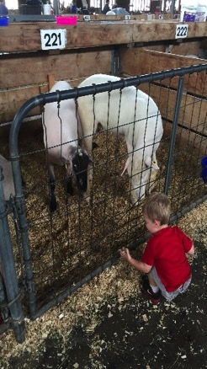

Are Naïve Human Populations at Increased Risk for Zoonoses?
Megan Jacob, MS, PhD
Assistant Professor, Clinical Microbiology

Slide 63

Who’s at risk for zoonoses?
Young children (< 5 years old)
Adults > 65 years old
Immunocompromised
  Infectious diseases
  Immune system dysfunction
  Cancer patients receiving chemotherapy
Pregnant women

Slide 64
Who’s at risk for zoonoses?
Young children (< 5 years old)
Adults > 65 years old
Immunocompromised
  Infectious diseases
  Immune system dysfunction
  Cancer patients receiving chemotherapy
Pregnant women
15-20% of population in developed countries

Slide 65
Others?
Malnutrition
Use of antacids (proton pump inhibitors)
Increased circulating iron
Ingestion of fatty foods
Ingestion of large volumes of water
Transplant recipients

Slide 66
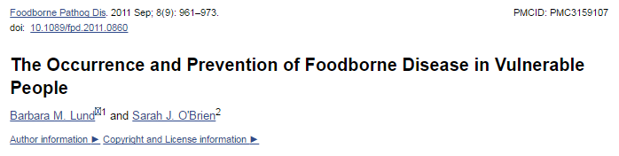
Reasons for decreased immunity
General immunosuppression
  Primary deficit in immune system, or using drugs that target immune system
→ reduction in the number of organisms needed to cause disease and increase the severity of illness

Slide 67
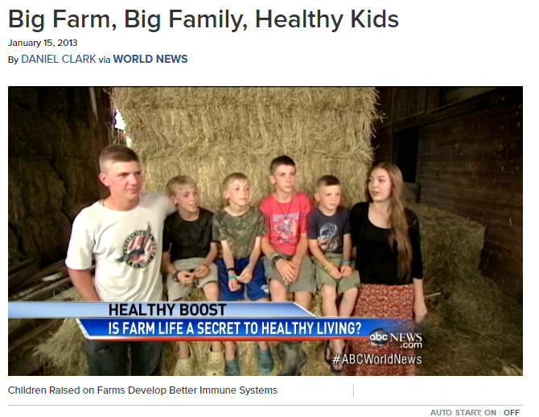
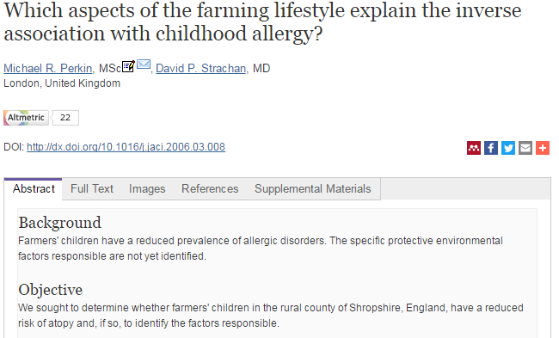
Is there more?

Slide 68
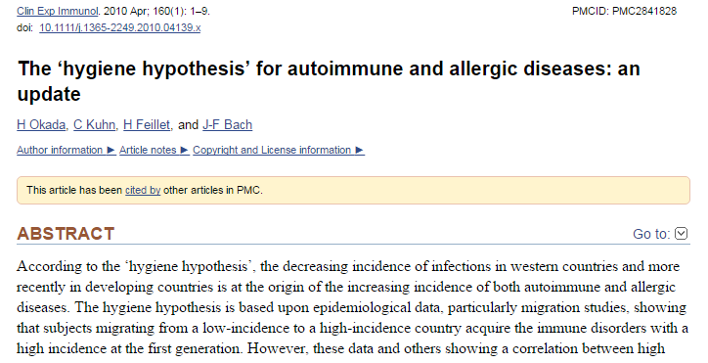
Hygiene Hypothesis

Slide 69
“Conclusions”
Strong evidence ties the immune status with susceptibility to foodborne pathogens and zoonoses
Evidence that immune system function differs between those exposed to farm environments often and at an early age
Increasing amounts of immunocompromised people may be visiting livestock interaction facilities

Slide 70
Questions?
Megan Jacob
Department of Population Health & Pathobiology
1060 William Moore Dr.
Raleigh, NC 27607
Megan_Jacob@ncsu.edu
(919) 513-6236

Slide 71
Round Table questions

Slide 72
Do you conduct any animal health testing or is testing something you have considered?

Slide 73
Do you have a relationship with a veterinarian and do you maintain vaccination protocols?

Slide 74
Have you considered adding additional barriers between the animals and the public?

Slide 75
Do you practice any kind of insect control and have you considered insect control as part of your biosafety plan?

Slide 76
Do you encourage visitors to touch the animals?
How do you handle explaining risks of touching animals?

Slide 77
If feeding by visitors is allowed, how are animals fed?

Slide 78
Do you manage your exhibit/petting zoo/facility different when it rains? How do you handle run-off?

