Slide 1
Revisions to EPA’s Agricultural Worker Protection Standard
NC Department of Agriculture & Consumer Services
Structural Pest Control & Pesticides Division
Pesticides Section

Slide 2
Background: Who is Covered by WPS?
Who is responsible for providing the protections?
Agricultural employers on crop-producing establishments
Commercial pesticide handling establishment employers
Who is protected?
Farmworkers – work in the fields to harvest and cultivate
Pesticide handlers – mix, load, and apply pesticides for use on crops
Other persons during pesticide applications

Slide 3
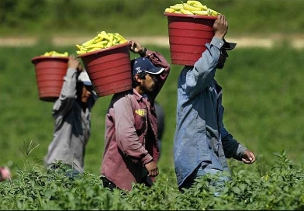
Background: Goals of WPS?
Inform workers and handlers about potential exposure to pesticides
Protect workers, handlers and other people from exposure to pesticide
Mitigate any pesticide exposures that workers or handlers receive

Slide 4
WPS Revisions

Slide 5
Goals of the Revised WPS
Improve occupational protections for agricultural workers and handlers to make them comparable to those for workers in other industries covered by OSHA
Reduce acute occupational pesticide exposures and incidents

Slide 6
Compliance Dates
Compliance with most new requirements by Jan 2, 2017
Except:
New Training Material
New Safety Poster
AEZ (Application Exclusion Zone)
Compliance with all requirements by Jan 2, 2018

Slide 7
Definitions
Added definitions to rule for the following terms:
Application exclusion zone, designated representative, employ, enclosed space production, outdoor production, and safety data sheets
Revised the following key definitions:
Agricultural establishment, agricultural plant, handler, immediate family and worker

Slide 8
Definitions (170.305)
Application exclusion zone
Application exclusion zone means the area surrounding the application equipment that must be free of all persons other than appropriately trained and equipped handlers during pesticide applications.

Slide 9
Definitions (170.305)
Employ
Employ means to obtain, directly or through a labor contractor, the services of a person in exchange for a salary or wages, including piece-rate wages, without regard to who may pay or who may receive the salary or wages. It includes obtaining the services of a self-employed person, an independent contractor, or a person compensated by a third party, except that it does not include an agricultural employer obtaining the services of a handler through a commercial pesticide handler employer or a commercial pesticide handling establishment.

Slide 10
Definitions (170.305)
Designated representative:
any persons designated in writing by a worker or handler to exercise a right of access on behalf of the worker or handler to request and obtain a copy of the pesticide application and hazard information required by § 170.309(h) in accordance with § 170.311(b) of this part.

Slide 11
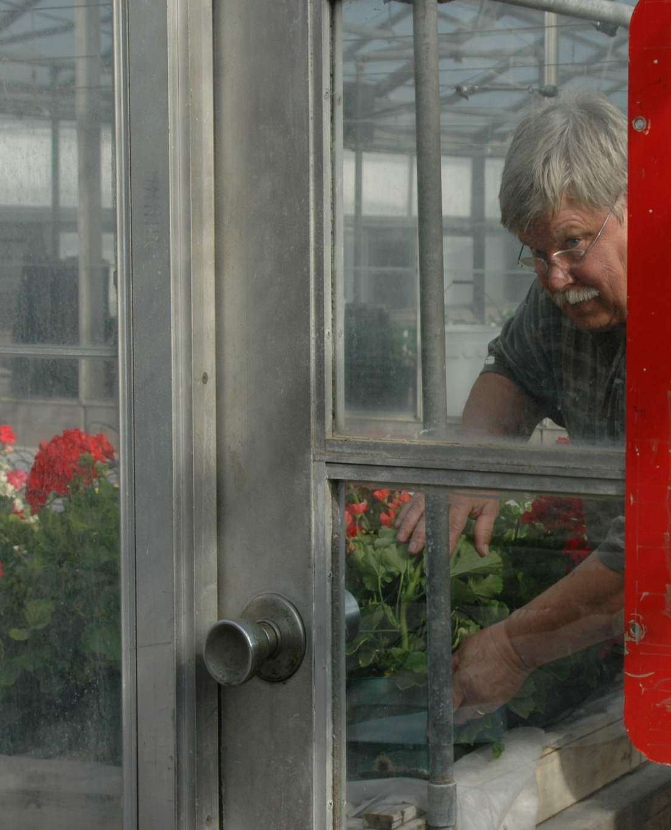
Definitions (170.305)
Enclosed space production
Enclosed space production means production of an agricultural plant indoors or in a structure or space that is covered in whole or in part by any nonporous covering and that is large enough to permit a person to enter.

Slide 12
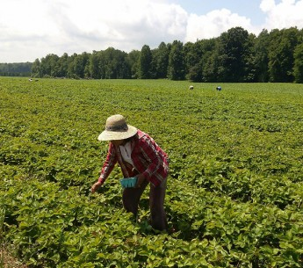
Definitions (170.305)
Outdoor production
Outdoor production means production of an agricultural plant in an outside area that is not enclosed or covered in any way that would obstruct the natural air flow.

Slide 13
Definitions
Immediate family is limited to the spouse, parents, stepparents, foster parents, father-in-law, mother-in-law, children, stepchildren, foster children, sons-in-law, daughters-in-law, grandparents, grandchildren, brothers, sisters, brothers-in-law, sisters-in-law, aunts, uncles, nieces, nephews, and first cousins. “First cousin” means the child of a parent’s sibling, i.e., the child of an aunt or uncle.

Slide 14
Pesticide Safety Training
Current
Pesticide safety training every 5 years
Revision
Pesticide training every year
Expand training content [Delayed implementation]
Require recordkeeping of training for 2 years
Provide worker or handler a copy upon request
No “grace period”
Train-the-trainer programs must be approved by EPA and are available on line.
All resources available - Pesticide Education Resource Collaborative http://pesticideresources.org//index.html

Slide 15
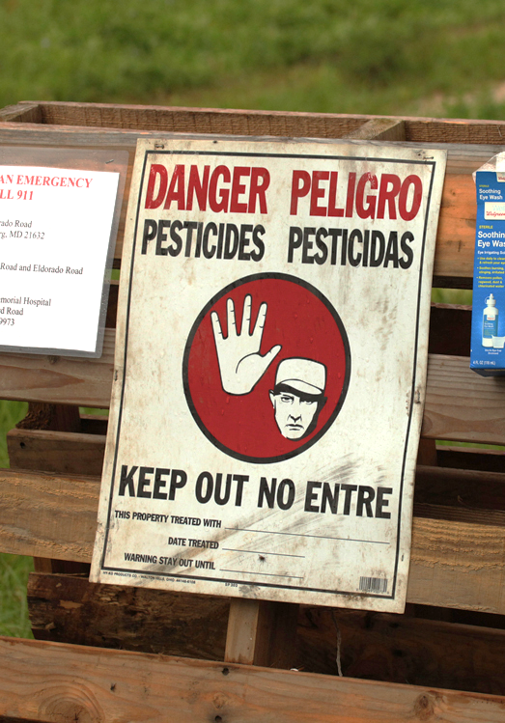
Notification
Current
Oral or posted notification of outdoor treated areas unless labeling requires both
Workers entering when restricted-entry interval (REI) in effect (early-entry workers) must receive PPE
Revision
Post outdoor treated areas when REI is greater than 48 hours
Early-entry workers must be provided PPE & oral notification of:
information about the pesticide application
specific task to be performed
amount of time that the worker is allowed to remain in the treated area
the PPE required by the label

Slide 16
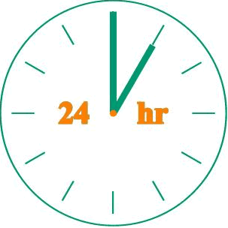
Hazard Communication
Current
Post application-specific information at central display until 30 days after REI expires
Available to worker or handler only during display period
Revision
Hazard information includes the application-specific information and the pesticide safety data sheets (SDSs)
Must be posted within 24 hours of the application or prior to worker entry

Slide 17
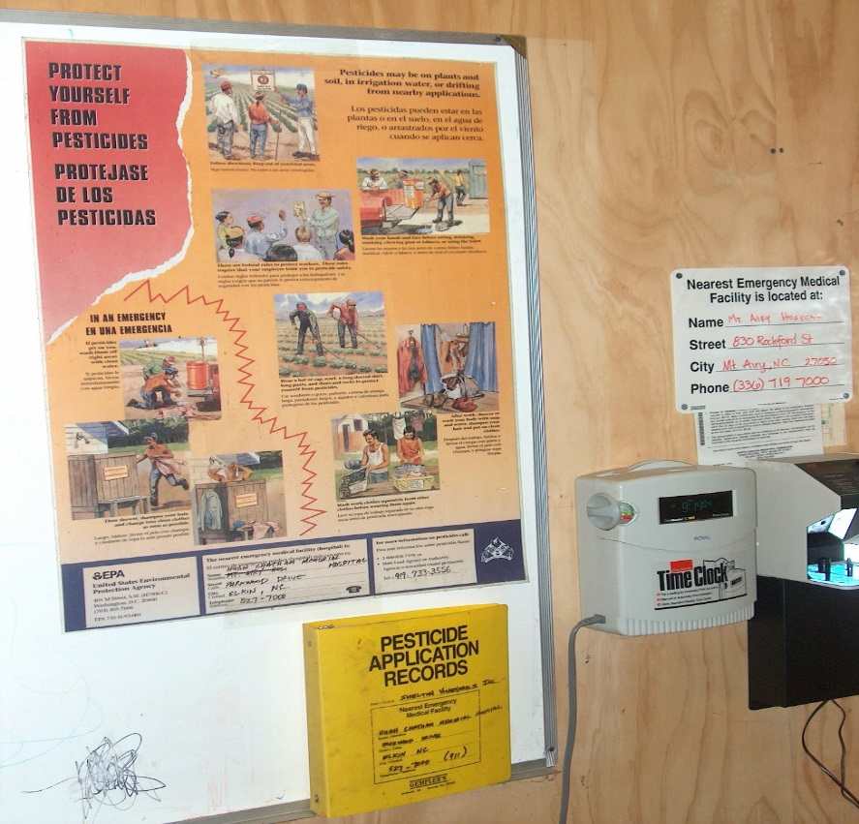
Hazard Communication
Revision
Post hazard information at central display for 30 days after REI expires and retain for 2 years
Access available from display period through retention to:
Employee (upon oral or written request)
Treating medical personnel and persons working under their supervision (oral or written request)
Designated representative (written request only)

Slide 18
Pesticide Safety Information
Current
Safety poster displayed at central location
Emergency Medical Facility
Revision
Safety information displayed at central location and permanent decontamination sites and decontamination supplies for 11 or more workers
Additional information required on display – State Lead agency Contact Information
[Delayed implementation]

Slide 19
Minimum Age for Handlers and Early-Entry Workers
Current
No minimum age
Revision
Requires a minimum age of 18 for pesticide handlers and early entry workers
Members of owner’s immediate family are exempt from this requirement
No minimum age in WPS for workers entering field after REI expires

Slide 20
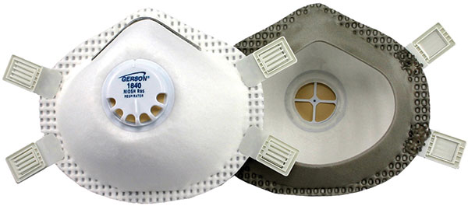
Respirators
Current
Employers must provide Personal Protective Equipment (PPE) required by labeling & ensure respirator fits correctly
Revision
Adopts by reference a subset of OSHA’s standard for respirators if required by label (including filtering facepieces) - fit test, medical evaluation, training

Slide 21
Application Exclusion Zones in Outdoor Production
Current
During pesticide applications, workers and others are prohibited from being in:
The treated area - for farms and forests
The treated area and areas adjacent to treated areas (entry-restricted areas) – for nurseries
 | Treated area (green)
Entry-restricted area (purple)

Slide 22
Application Exclusion Zones in Outdoor Production
Revision
Establishes application exclusion zones (AEZ) based on distance from the application equipment for farms, forests, and nurseries
Agricultural employers must keep workers and other persons out of the treated area & AEZ that are WITHIN the boundary of the establishment owner’s property
Handler must suspend application if persons are in AEZ. Requirement to suspend application is NOT limited by the boundary of the establishment owner’s property [Delayed implementation]
 |  |  |  | Treated area
 |  |  |  | (green)
Application exclusion zone
(purple)

Slide 23
New Protections During Applications in Outdoor Production
Application Exclusion Zone (AEZ):
Requirement (170.405(a)(1))
The WPS establishes AEZ distances in outdoor production of 25 or 100 feet around the application equipment based on application method
AEZ
(Red)
Target Area (Blue)

Slide 24
Application Exclusion Zone in Outdoor Production
When the application is concluded, the AEZ no longer exists.
Field
AEZ
Spray Area
Treated Area (REI Area)

Slide 25
AEZs in Outdoor Production (170.405(a)(1))
100 foot AEZ
Applied aerially, by air blast or with a spray quality smaller than medium
Applied as a fumigant, smoke, mist or fog
25 foot AEZ
Applied other than above & sprayed from a height of >12 inches from planting medium with spray quality of medium or larger
No AEZ
Applied otherwise

Slide 26
AEZs in Outdoor Production (170.405(a)(1))

Slide 27
AEZs in Outdoor Production (170.405(a)(1))
NO!

Slide 28
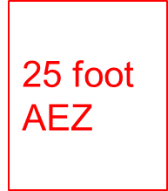
Droplet Size and Relation to AEZ ASABE Standard S-572.1
Sidebar 4. Spray quality categories
ASABE Standard S-572-1ª
Category (symbol)^{b} | Color Code^{c}
Extra Fine (XF) | Purple
Very Fine (VF) | Red
Fine (F) | Orange
Medium (M) | Yellow
Coarse (C) | Blue
Very Coarse (VC) | Green
Extra Coarse (XC) | White
Ultra Coarse (UC) | Black

Slide 29
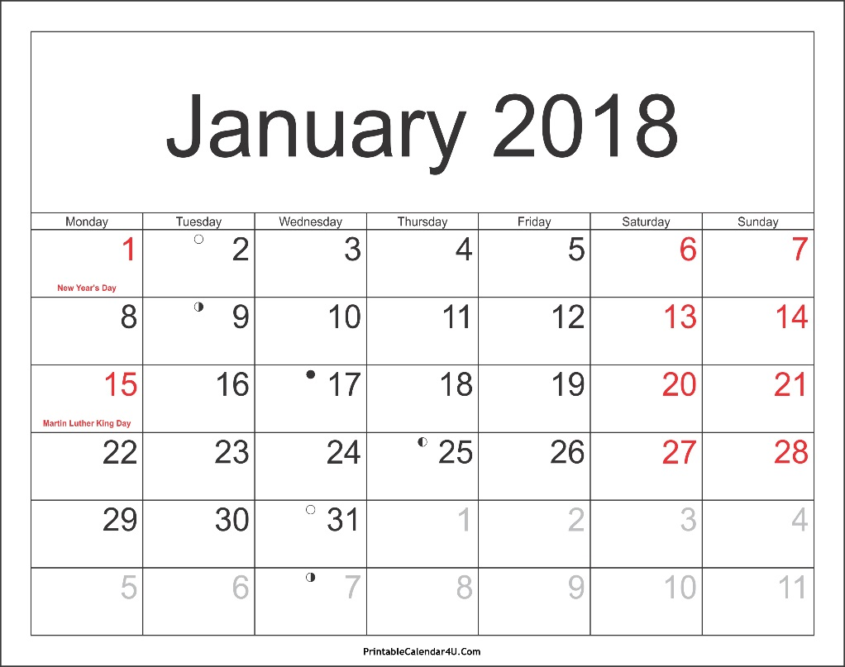
New Protections During Applications in Outdoor Production
Handlers’ AEZ requirements are NOT effective until January 2, 2018
Key Issue: What does “suspend a pesticide application” mean for the purposes of the WPS and the AEZ requirement?

Slide 30
New Protections During Applications in Outdoor Production
Summary of the WPS interpretive policy to clarify AEZ requirements and the meaning of “suspend a pesticide application”:
If the AEZ extends beyond the boundary of the property of the agricultural establishment, and a worker or other person is within the AEZ, the applicator must temporarily suspend the application, and may not proceed until the applicator can ensure that the pesticide will not contact persons in the AEZ

Slide 31
AEZs on Field Borders
EVALUATE!
Can you ask the workers to move somewhere else until you are done with the application?
Proceed with caution.
SUSPEND!
There are workers from the neighboring field in the AEZ!
When the application is finished the AEZ no longer exists.
Yes, they agreed to move!
Neighboring Field
Your Field
31

Slide 32
AEZs on Field Borders
WIND
When the application is finished the AEZ no longer exists.
EVALUATE!
Can you ensure these workers won’t be contacted through drift?
SUSPEND!
There are workers from the neighboring field in the AEZ, and they refuse to move!
Proceed with caution.
Yes, the wind is blowing away from the workers and I can ensure that my application will not contact the workers in the other field.
Neighboring Field
Your Field
32

Slide 33
Decontamination Supplies
Current
Employers must provide “sufficient amount of water so that the workers/handlers may wash thoroughly”
Revision
Provide 1 gallon of water for each worker and 3 gallons for each handler and each early-entry worker
HANDLERS & EARLY ENTRY WORKERS
WORKER

Slide 34
Decontamination Supplies
Current
If handler is using a product that requires eye protection, one pint of water must be immediately available to each handler
Revision
If handler is mixing/loading a product that requires eye protection, eyeflush water must be immediately available at the mix/load site for handler eye flushing.
If applicator is using a product that requires eye protection, one pint of water must be immediately available to each applicator.

Slide 35
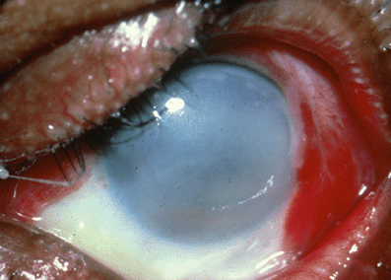
What Irreversible Eye Damage Looks Like

Slide 36
Emergency Eye-Flush
One system per mix/load site (not based on number of handlers)
Immediately available to handler
Eye-flush must be:
System capable of delivering gently running water at 0.4 gal/min for at least 15 min OR
At least 6 gallons of water in containers suitable for providing a gentle eye-flush for about 15 min

Slide 37
Emergency Assistance
Current
Employers must provide “prompt” transportation to an emergency medical facility for workers or handlers who may have been exposed to pesticides
Upon request, employers must provide certain information, if available, to the exposed person or medical personnel
Revision
Retain “prompt” for provision of transportation
Require employers to provide for each product the SDS and specific information about the product, as well as the circumstances of the application and exposure, to treating medical personnel

Slide 38
Key Changes between Proposed and Revised Final Rule
Proposed rule
Grace period for training: 2 days
Certified applicator can’t train workers
Minimum age: 16
Entry restricted area
Eyewash water for handlers at permanent mixing loading sites
Hazard communication: application information, product labels and SDS
Central location eliminated for hazard communication
Immediate family: add in-laws, grandparents & grandchildren
Authorized representative identified orally or in writing; no requirements
Equivalency granted on a case-by-case basis by policy
Revised rule
Eliminate grace period
Certified applicator can train workers
Minimum age: 18
Application exclusion zone
Eyewash water for handlers at all mix/load sites
Hazard communication: application information and SDS
Central location retained for hazard communication
Immediate family: also add aunts, uncles, nephews, nieces & first cousins
Designated representative identified in writing; other requirements
Equivalency option for states and tribes

Slide 39
No Major Changes between Proposed and Revised Final Rules
Safety training – annual
Recordkeeping for safety training – 2 years
Expanded content in safety training
Post treated areas with REI > 48 hours
Oral notification for early-entry workers
Respirator fit test, medical evaluation, training (same requirement; scope changed)

Slide 40
Resources
Pesticide Education Resource Collaborative http://pesticideresources.org//index.html
WPS Revisions – EPA https://www.epa.gov/pesticide-worker-safety/revisions-worker-protection-standard
NC Dept. of Agriculture & Consumer Services
Structural Pest Control & Pesticides Division
Pesticides Section
http://www.ncagr.gov/SPCAP/

