Slide 1
Rules, food safety, small businesses
Dr. Ben Chapman
NC State University

Slide 2
You get a call from a community member
A customer of a 4-H club fundraiser alleges that someone got sick from some jelly
The local health department receives three more calls
What do you do? What are the questions going through your mind?

Slide 3
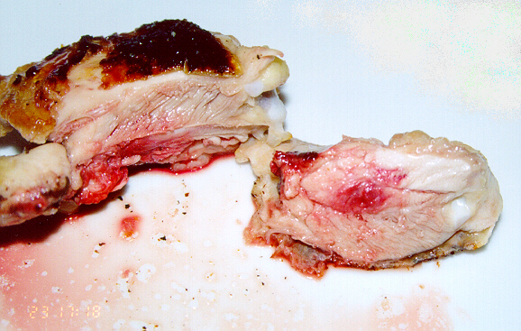

Slide 4
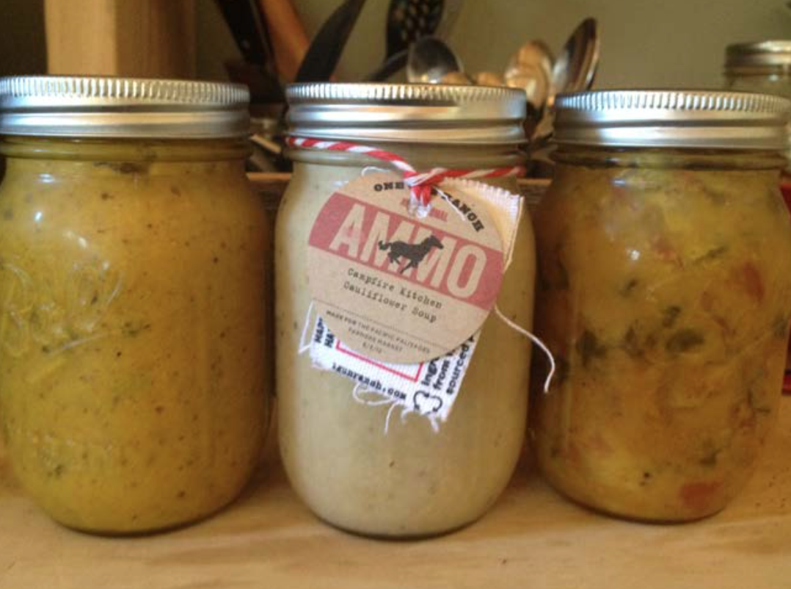

Slide 5
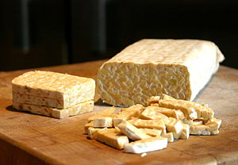

Slide 6
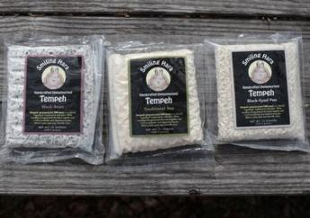
Smiling Hara Tempeh
Salmonella Paratyphi B
71illnesses
9 hospitalizations
Linked to starter culture

Slide 7
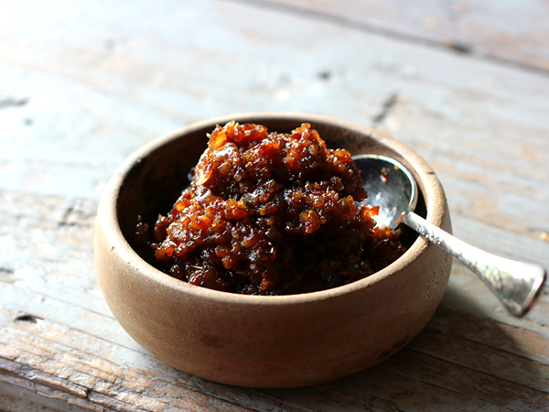

Slide 8
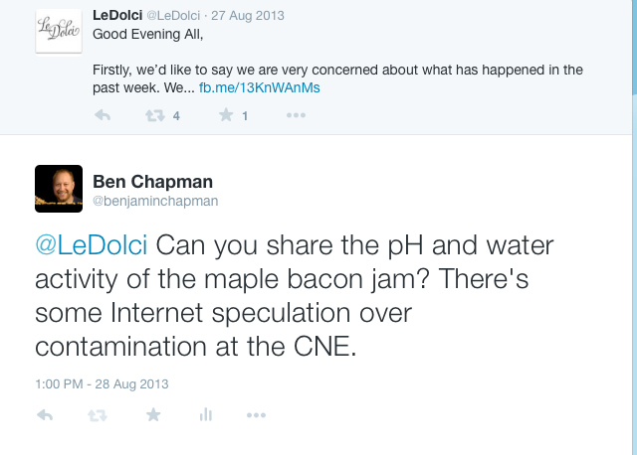

Slide 9
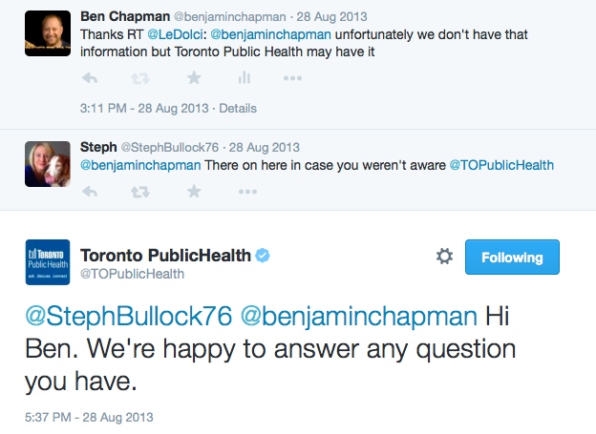

Slide 10
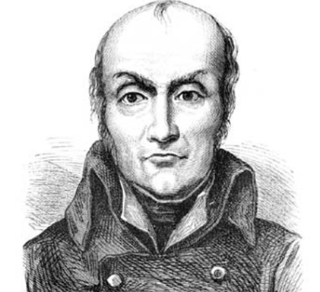
Nicholas Appert
12,000 francs, in 1809 when he submitted his method of “food in glass bottles.”

Slide 11
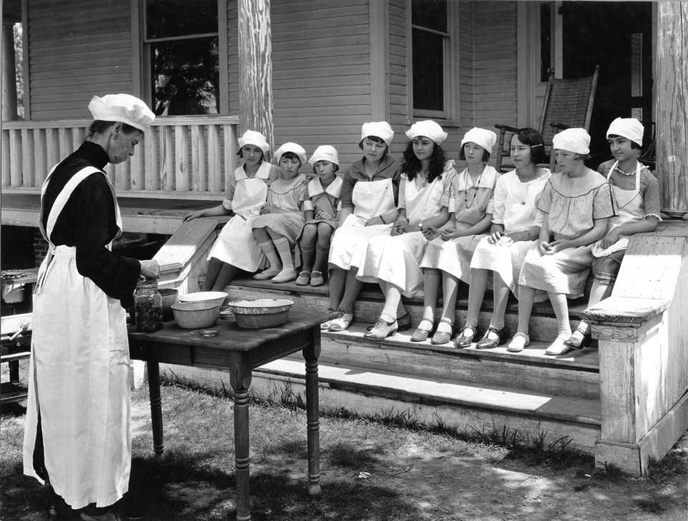
Acidic/acidified foods heat sufficient to destroy vegetative microorganisms
Foods packed into sealed, or airtight containers.
Low acid canned foods are heated under pressure at temperatures of 240-250°F (116-121°C).

Slide 12
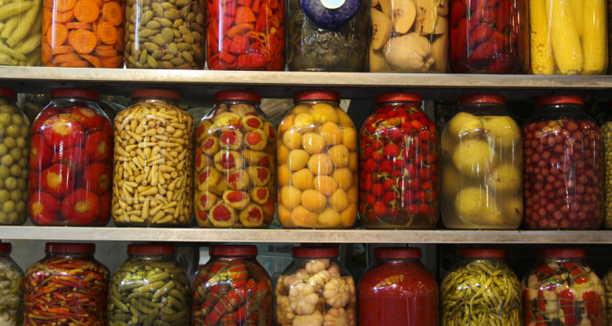
Majority of home canners have reported not following science-based home preservation methods
Receive much of their home preservation information through friends and family
Only 45% of respondents thought that home canned foods could be spoiled without obvious signs of spoilage

Slide 13
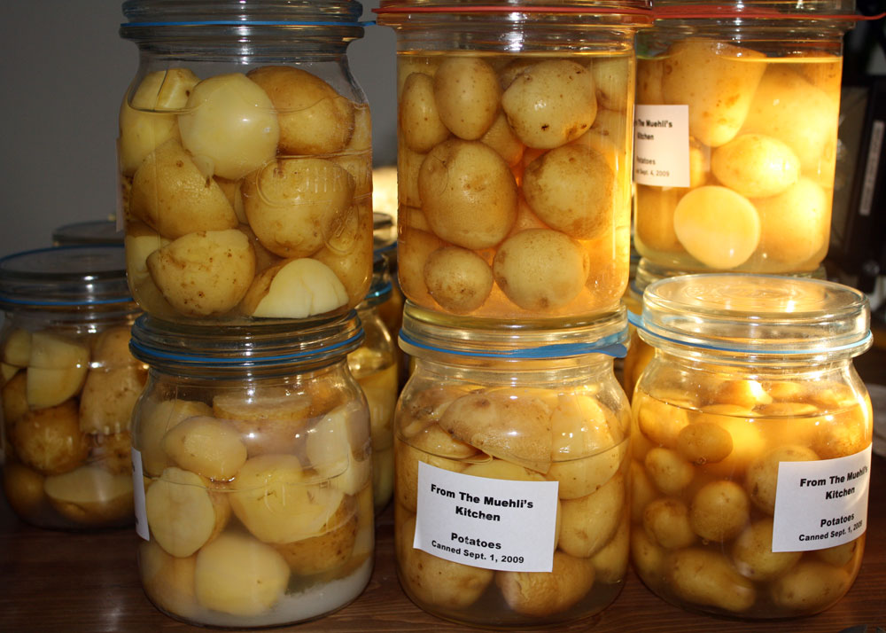
Clostridium botulinum
Lancaster, Ohio
One death and 24 illnesses
Linked to a church potluck
Canned potatoes in potato salad

Slide 14
At least 19 people reported becoming ill after attending an ACES-hosted luncheon at Bridge Builders Church on Beltline Road on May 30, 2014. A private lab has confirmed three cases of E. coli and salmonella in the ongoing investigation.

Slide 15
So you have a club that wants to sell food. Or you have an ECA group that wants to sell food. Or you want to sell food as a fundraiser

Slide 16
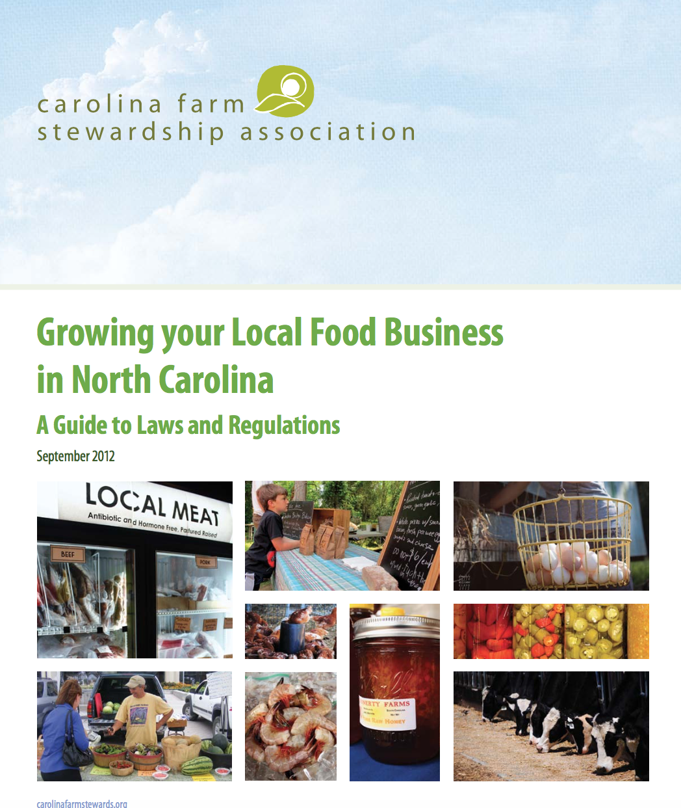

Slide 17
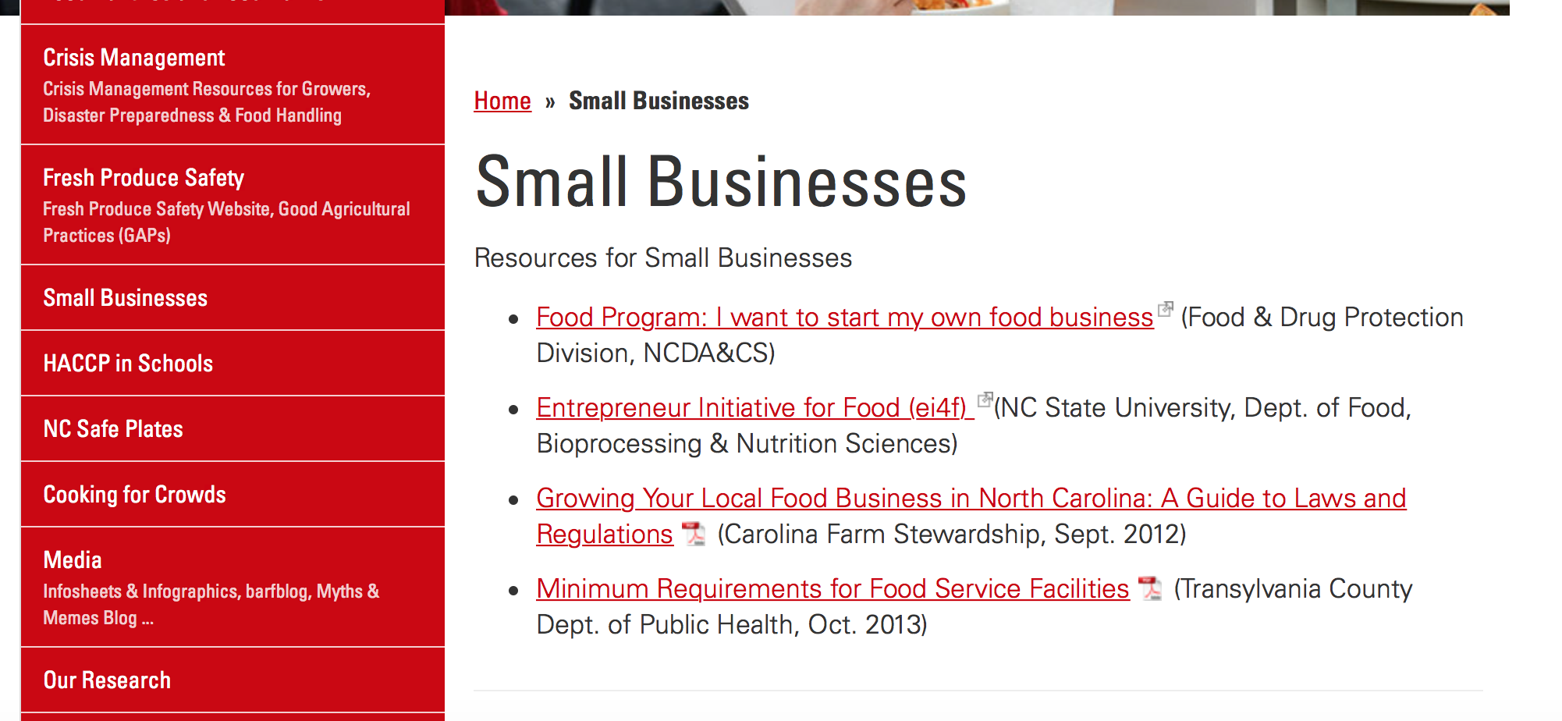
foodsafety.ces.ncsu.edu/small-businesses/

Slide 18
What you need to have a commercial kitchen
On-site water and sewage approved for commercial use
Refrigerated food storage.
Frozen food storage.
Storage areas and shelving for equipment
Dishwashing facility

Slide 19
What else you need (continued)
Can wash facility for garbage cans and mops.
Separate handwashing sink
Restroom(s) for employees and customers.
Storage of wastes (garbage, recyclables, etc.) inside and outside.
Construction must meet requirements (floors, walls, ceilings, lighting, plumbing, etc.).
Adequate hot water heating facilities.

Slide 20
All food processors in North Carolina, without exemption, are required to comply with the Good Manufacturing Practice requirements set forth in federal regulations
Eliminating conditions that would provide breeding grounds for pests,
properly maintaining waste treatment and disposal facilities,
using protective coverings, providing adequate lighting in handwashing and food preparation areas
providing adequate ventilation, and properly cleaning, sanitizing, and maintaining equipment.

Slide 21
Depending on the food
A recipe evaluation may be required
A process authority may need to
The processor may need to attend acidified foods/better process control school
A variance to the law may be necessary

Slide 22
Hazard analysis
A written document that identifies known or reasonably foreseeable hazards
Each type of food at the facility
Microbiological, physical, chemical and radiological

Slide 23
Preventive Controls
How do you minimize or prevent hazards identified in the analysis
(1) process controls – this is largely a client responsibility
(2) food allergen controls,
(3) sanitation controls, and
(4) a recall plan

Slide 24
Monitoring
Procedures that provide assurances that the above controls are consistently performed.
Sanitation process logs
Sanitizer level in a wash water system

Slide 25
Corrective actions
Facilities would be required to correct problems and minimize the likelihood of reoccurrence, evaluate the food for safety and prevent affected food from entering commerce when necessary
Answers the question of “so the monitoring showed that the preventive control was not being carried out consistently, what do I do.”

Slide 26
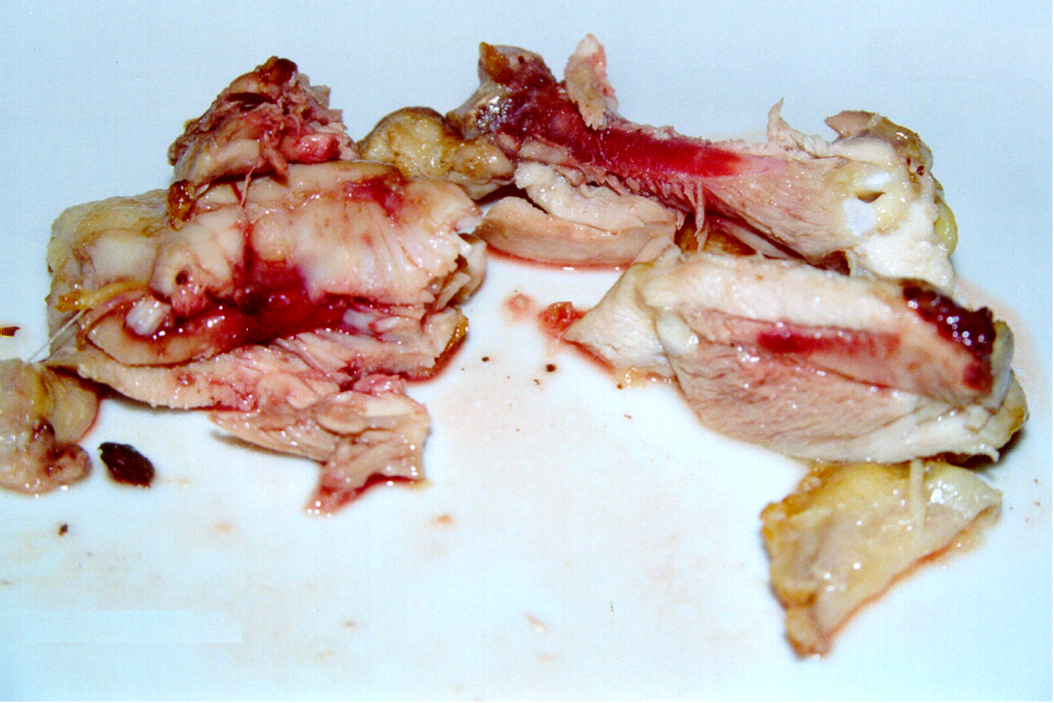

Slide 27
Verification
It’s not enough to pick a random preventive control
The most science-based part of the proposed rules are that a chosen preventive step needs to be verified as appropriate for the specific hazard/situation
Validation studies
And the proposed rule suggests that a facility needs to reassess all verification every three years to ensure it is still up to date.

Slide 28
Overview
Map of layout of kitchen facility and equipment
Stuff that is covered in GMPs
Trainings and objectives
Equipment Provided
Maintenance
Calibration
Validation
Pest Control
Sanitation
Chemicals used
Cross contamination between clients
Glass breakage, chemical spills
Allergen control
Stuff that isn’t in GMPs
Usage logs
Numbers of people in the kitchen at one time
Client evaluation
Crisis management
Customer complaint system

Slide 29
Other things
A qualified individual must manage the above items
To be qualified, an individual would be required to successfully complete training in accordance with a standardized curriculum or be otherwise qualified through job experience to develop and apply a food safety system.
Revisions to current CGMP are proposed
Allergens
Mandating training for employees

Slide 30
Visitor/client logs
Name
Business Name
Address, Phone number, Email address
Copy of label and recipe on file
Lot numbers to be used for current processing day

Slide 31
Equipment
Maintenance
Monthly schedule
Unless reported issues
Calibration (authorized personnel)
Procedures for calibration
Records of calibration
Validation

Slide 32
Pest Control
Log to report any pest sightings or issues
Map of facility
Traps inside
Bait stations outside building (loading docks)
Disposal procedures
Weekly logs to check traps and properly working bait stations

Slide 33
Restroom Facilities
Properly stocked with hand soap, paper towels, toilet paper on a daily basis
Cleaned on a regularly scheduled basis
Available for all signed up customers using kitchen

Slide 34
You get a call from a community member
A customer of a 4-H club fundraiser alleges that someone got sick from some jelly
The local health department receives three more calls
What do you do? What are the questions going through your mind?

