Slide 1
Module 7: Cross Contamination

Slide 2
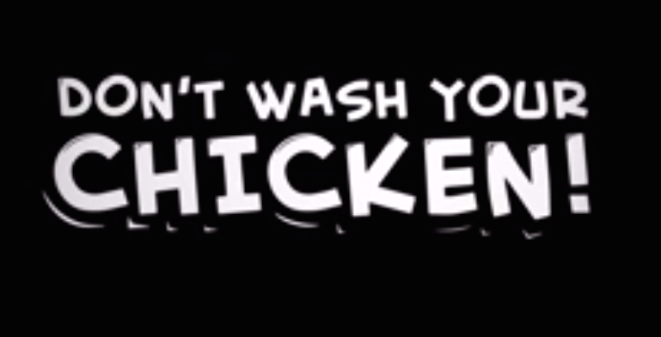
Notes:
Click picture to play video

Slide 3
Wilson, NC October 2006
The Wilson Daily reported about a Campylobacter outbreak among Wilson, NC residents. According to the article, an investigation into the outbreak was ongoing.
Health Department employees investigated the food poisoning cases and visited two Wilson restaurants.
Notes:
http://www.campylobacterblog.com/campylobacter-watch/campylobacter-outbreak-in-north-carolina/#.VHYOo76Jndk
Campylobacter- 99% poultry-related, also cleaning/sanitizing related, cross-contamination can be a factor

Slide 4
What Happened?
Hospital workers reported the food poisoning cases to the Health Department.
Health Department investigated two restaurants.
County Environmental Health said the report was received after the incident occurred.
7 individuals sick
Couldn’t identify the cause
Notes:
Not all outbreaks are solved

Slide 5
How Could it Happen?
Neither of the restaurants were linked to the food poisoning
Foodborne illnesses can be tough to pin down, especially if it was a single cross contamination event
Campylobacter is often connected with raw chicken…
What do you think the cause could have been?

Slide 7
Learning Objectives
Explain reasons for cleaning and sanitizing to control food safety
Identify the methods of sanitizing
List the steps for proper cleaning and sanitizing
Describe when, where and how to clean and sanitize

Slide 8
Learning Objectives
Define:
Contamination
Cross-contamination
Food-contact surface
Hand-contact surface
Explain the importance of Safety Data Sheet (SDS) materials
Describe the procedure to measure sanitizer concentration
Explain the use of a master cleaning schedule to reduce foodborne illness

Slide 9
Key Terms
Clean – make something free from dirt, food soil or residue
Sanitize – reduce number of pathogens to safe levels
Sterilize – process of killing all microorganisms
Master Cleaning Schedule – details of cleaning to be carried out by specified people at specified intervals and times
Notes:
Best Practice – clean as you go

Slide 10
Key Terms (continued)
Detergent – chemical that helps dissolve grease and remove dirt
Sanitizer – heat or chemical that destroys pathogenic microorganisms to safe levels
Contact (exposure) time - period of time sanitizer must be in contact to work properly
Test strips – used to monitor concentration of chemical sanitizer and pH

Slide 11
Key Terms (continued)
Clean-as-you-go - cleaning procedures carried out as you work
Food-contact surface – surfaces that touch food
Hand-contact surface – surfaces that touch hnds
Impervious – doesn’t let water through
Durable – doesn’t wear or damage easily over time

Slide 12
Campylobacter
Estimated to affect 1.3 million people annually
Symptoms:
Diarrhea (often bloody), abdominal pain, nausea, fever
Onset time – 48-60 hours
Foods:
Raw poultry, raw meat, raw milk
Control:
Cook poultry to 165°F
Prevent cross contamination
Do not drink raw milk
Notes:
Salmonella and Campylobacter - #1&2 causes of food-borne illnesses

Slide 13
Shigella (Bacillary Dysentery)
Transferred fecal-oral route
Symptoms:
Diarrhea (sometimes bloody), fever, abdominal pain, dehydration
Onset in 1-7 days
Sources:
Infected food handler, did not wash hands
Contaminated equipment, untreated water
Raw vegetables, salads
Control:
Personal hygiene
Treated water
Exclude infected employees
Notes:
Shigella- often spread through cross-contamination and cross-contact - only infects primates (humans and monkeys). So it likely comes from an infected person, sometimes through water.
It’s a problem in day care because of all to dirty dippers and bathroom accidents.
Causes dysentery - Dysentery: Inflammation of the intestine, with pain, diarrhea, bloody stools, and often a fever above 101'F. The causes of dysentery include bacteria (such as Shigella), protozoa (such as amebae), parasitic worms (such as schistosomes), and viruses. Dysentery can be fatal because it can cause severe dehydration.

Slide 14
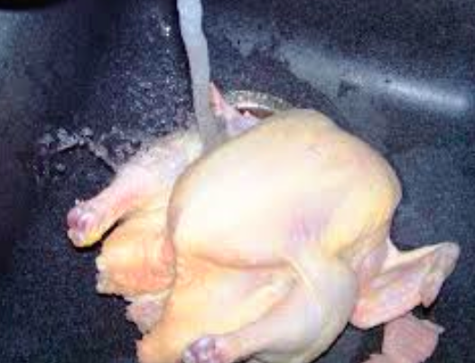
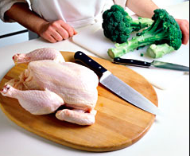
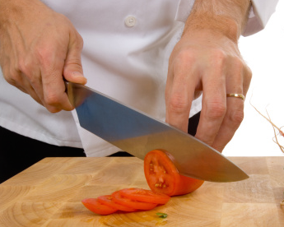
How can cross-contamination be a factor in illness from Campylobacter?
Notes:
Relates this causative agent back to the narrative and introduces the prevention and control aspects.
Every touch step can increase the # of pathogens 10-fold. (touching a light switch, then RTE) Even a dry cutting board can have pathogens if not properly washed and sanitized.
It only takes about 20 cells to make a person sick.

Slide 15
Risk Factor 1: Source
Remember Module 1 Purchasing and Suppliers?
Approved suppliers
Verify supplier practices
Prerequisite programs
Notes:
Queso fresco

Slide 16
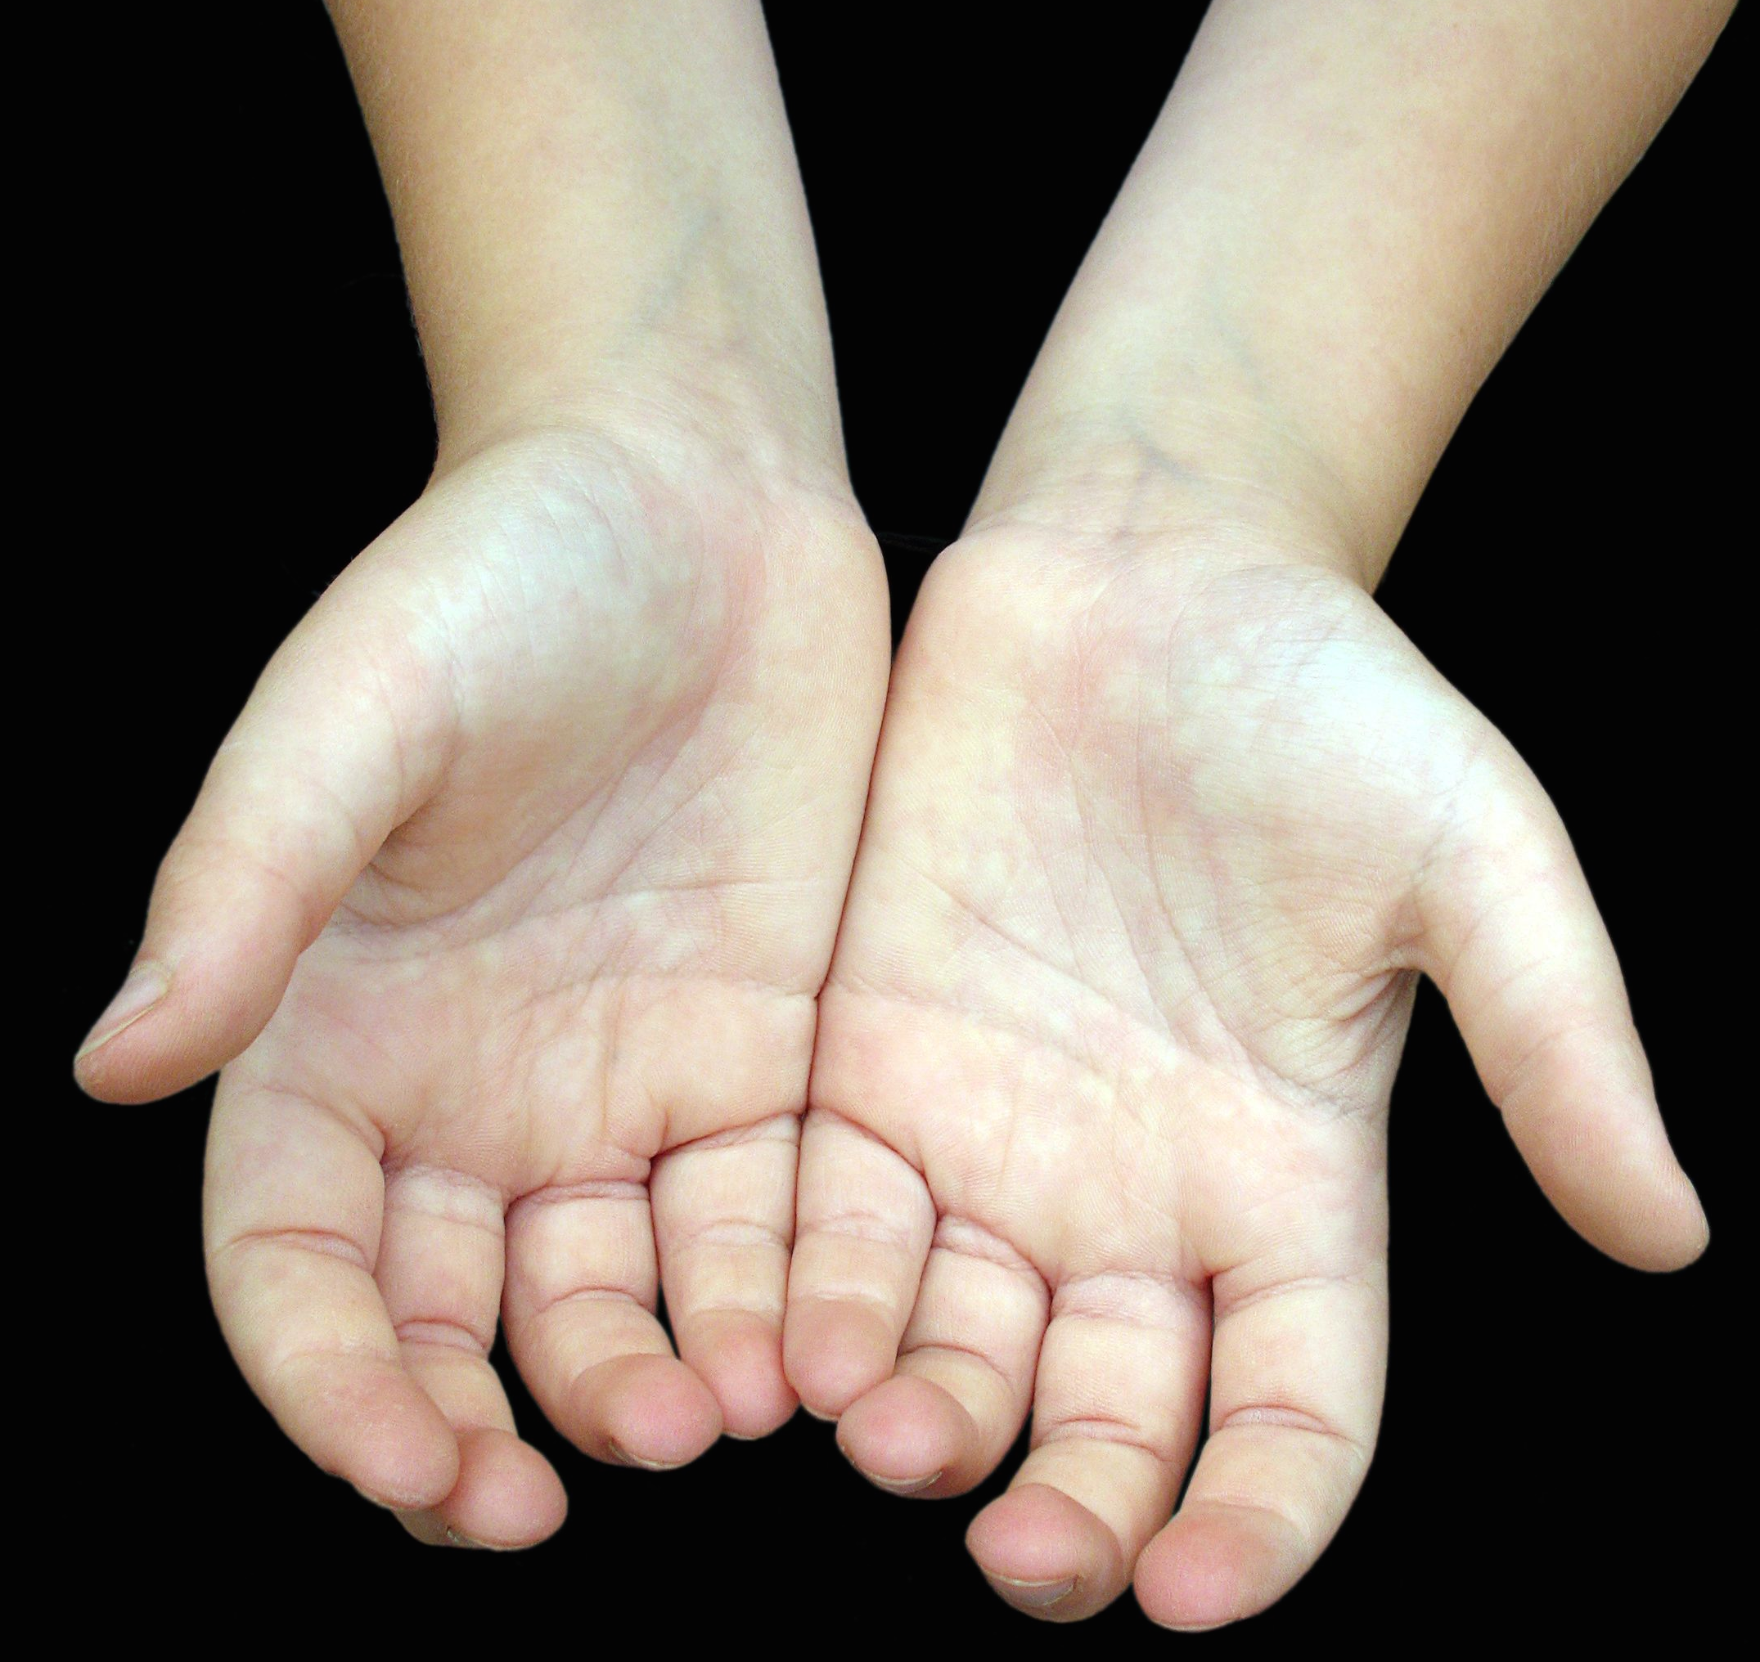
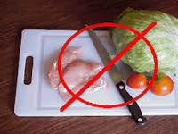
Risk Factor 2: Cross Contamination
Contamination is the presence of substances or conditions in food that can be harmful to humans.
Cross contamination is the transfer of a harmful substance from one food item to another, usually from raw to cooked or ready-to-eat food.
Can be transferred by anything food contacts: hands, prep tables, equipment, utensils, cutting boards, standing or dripping water
Notes:
Really focus on the importance preventing cross contamination.

Slide 17
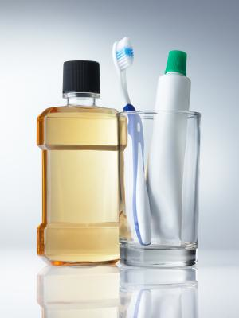
Cleaning and Sanitizing
Cleaning – the removal of soil (food) from surfaces of equipment and utensils.
Sanitizing – reduces the number of disease-causing microorganisms on equipment and utensils to acceptable public health levels.
Brush your teeth (clean)
Then use mouth wash (sanitize)
Notes:
See booklet page 47
Brushing – abrasion step; think of toothpaste as the detergent
Just a little mouthwash will not clean your teeth.
Image: www.more.com

Slide 18
Why Clean and Sanitize?
Reduces risk of biological contamination
Reduces bacterial multiplication by removing food particles
Protects food from physical or chemical contamination
Helps avoid attracting pests
Maintains safe environment (ex. slippery floors)

Slide 19
Cleaning and Sanitizing
Manual
Uses a 3- or 4- compartment sink
Mechanical
Uses a dishwashing machine
Cleaning Fixed Equipment
Uses a combination of manual and in-place cleaning procedures

Slide 20
5 Steps
Pre-flush and pre-scrape
Wash
Rinse
Sanitize (contact time is important)
Air dry

Slide 21
When to Clean and Sanitize
Clean and sanitize ALL food-contact surfaces.
Equipment and utensils must be cleaned throughout the day (clean-as-you-go)
The FDA Food Code requires equipment used with time/temperature control for safety foods (TCS) to be cleaned at least every 4 hours when used at room temperature

Slide 22
When to Clean and Sanitize
Before using equipment or utensils
Before switching to another type of food
As frequently as possible during shift (every 4 hours if in constant use)
Immediately after use
End of shift
Anytime there is risk of contamination (leaving task temporarily)

Slide 23
What to Sanitize
Food contact surfaces:
Preparation boards, cutting boards
Multi-use utensils
Tables and work surfaces
Food processing surfaces:
Machinery and equipment
Utensils (spatulas, mixers, mincers, knives, tongs, slicers)
Containers
Service items
Notes:
Utensils & equipment contacting food that is not TCS such as iced tea dispensers, carbonated beverage dispenser nozzles,
beverage dispensing circuits or lines, water vending equipment, coffee bean grinders, ice makers, and ice bins must be cleaned on a routine basis to prevent the development of slime, mold, or soil residues. Follow manufacturer’s directions.

Slide 24
Ideal Materials
Durable
Impervious
Smooth without cracks or seams
Light color
Easy to clean
Heat resistant
Notes:
What about that plastic container that is cracked? Melted in the microwave?

Slide 25
When to Clean? When to Clean and Sanitize?
Clean and rinse
all surfaces, hand and food contact
Clean and sanitize
all food-contact surfaces

Slide 26
Hand Contact Surfaces
Handles
Doors, refrigeration equipment, freezers, cupboards and drawers
Faucets, soap and paper towel dispensers
Switches
Wiping cloths, brushes, scrubbers and mops
Trash containers and lids

Slide 27
How to Sanitize
Chemicals
Quaternary Ammonium
Chlorine
Iodine
Heat
Hot water
Steam
Notes:
The effectiveness of chemical sanitizers can be directly affected by the temperature, pH, concentration of the sanitizer solution used, and hardness of the water.
Iodine is seldom used. 12.5-25 ppm

Slide 28
Chemical Sanitizers
Chlorine – effective against most microorganisms, in hard/soft water, relatively cheap, may corrode
Quats - odor free, non-corrosive, do not work well in hard water, not effective against all microorganisms. pH, temperature, concentration, contact time are important
Iodine – works rapidly, may stain some metals
Notes:
Chlorine is good for cleaning up throw-up.

Slide 29
Chemical Sanitizers
Chlorine
25-100 ppm depending on pH and water temperature
~7 seconds
Quaternary Ammonium (Quats)
100-200 ppm at 75ºF-120ºF water
30 seconds
Iodine can also be used, but are less common
12.5-25 ppm at 68ºF water
30 seconds
Notes:
These can be tough to remember. The best advice is to follow the manufacture/dealers instructions
You should test the concentration of sanitizers periodically. Test strips should be in stock and conveniently located.
Too much detergent in the dish compartment can get in the rinse water and sanitizer solution and affect sanitizer effectiveness.
Chlorine – above 100ppm degrades equipment – evaporates, so concentration goes down over time
Quats – follow manufacturer’s directions

Slide 30
Temperature to Sanitize
Surface temperature of equipment must reach at least 160ºF
In manual operations, hot water must be maintained at 171ºF or above (item in water for 30 seconds)
In dishwashing machines, hot water must be maintained at 180ºF to 194ºF

Slide 31
Safety Precautions
Dry hands before cleaning electrical equipment
Switch off power/ safety/ breaker switch
Do not use chemical unless trained
Never mix chemicals together
Use personal protective equipment (PPE)
gloves, aprons, goggles
Notes:
Chlorine bleach + window cleaner (with ammonia) = chlorine gas (Mustard gas)
Quats and chlorine mixed together releases toxic fumes

Slide 32
Safety Precautions (continued)
Use rack/basket to immerse items in hot water (sanitizing)
Follow manufacturer’s instructions, contact supplier with questions
Wash hands after cleaning

Slide 33
Safety Data Sheet
The Occupational Safety and Health Administration (OSHA) requires safety data sheets (SDS) in retail food establishments.
SDS provide workers information about:
The characteristics of hazardous substances present in the workplace
Personal protective equipment
Emergency first-aid procedures, and
Spill, leak, and disposal procedures.
Don’t let cleaner and sanitizers become a source of chemical contamination!

Slide 34
Remember Cross Contamination
Cross contamination is the transfer of a harmful substance from one food item to another, usually from raw to cooked or ready-to-eat food.
Can be transferred by anything food contacts: hands, prep tables, equipment, utensils, cutting boards, standing or dripping water

Slide 35
Communication
Inform - Master Cleaning Schedule
Keep workers informed about what to clean, how to clean it, and what tools and supplies are required to conduct cleaning activities.
Share
“I’ll be back… This area is dirty”
“I’m handling meat. Could you do salads?”
Correct
“Wait, you’re using the raw meat knife!”
“Why did you put the lettuce by the hand wash sink?”

Slide 36
Case Study
How It Happened
Health officials received reports of Campylobacter in Wilson NC
What They Found
Inspected 2 restaurants, but could not identify a clear cause
Notes:
We know that approved suppliers will have taken steps to reduce the risk.

Slide 37
Case Study
What Went Wrong
Cross contamination was a likely cause, maybe the result if improper meat handling and poor sanitation
Prevention
Proper cleaning and sanitizing
Prevent cross contamination

Slide 38
Quiz
Which of the following are the correct steps to follow when using your manual 3 compartment sink to wash dishes and utensils?
pre-scrape and pre-flush, wash, rinse, sanitize, and air dry
pre-scrape and pre-flush, rinse, wash, sanitize, and air dry
pre-scrape and pre-flush, wash, rinse, sanitize, and towel dry
pre-scrape and pre-flush, rinse, wash, sanitize, and towel dry
Notes:
Answer: a)
Air drying adds contact time for the sanitizer to work.
Rinse – important step – detergent can change the pH – Chlorine is pH-sensitive.

Slide 39
Quiz
Which of the following are the correct steps to follow when using your manual 3 compartment sink to wash dishes and utensils?
pre-scrape and pre-flush, wash, rinse, sanitize, and air dry
pre-scrape and pre-flush, rinse, wash, sanitize, and air dry
pre-scrape and pre-flush, wash, rinse, sanitize, and towel dry
pre-scrape and pre-flush, rinse, wash, sanitize, and towel dry
Notes:
Answer: a)
Air drying adds contact time for the sanitizer to work.
Rinse – important step – detergent can change the pH – Chlorine is pH-sensitive.

Slide 40
Quiz
In general, the following describe the best materials for food equipment and utensils except:
Impervious
Non-toxic
Resistant to rust
Dark colored
Notes:
Answer: d) You want to be able to see soiled items

Slide 41
Quiz
In general, the following describe the best materials for food equipment and utensils except:
Impervious
Non-toxic
Resistant to rust
Dark colored
Notes:
Answer: d) You want to be able to see soiled items

Slide 42
Quiz
If a sanitizer accidentally contaminates food, it is a:
Physical contaminant
Biological contaminant
Chemical contaminant
None of these
Notes:
Answer c)

Slide 43
Quiz
If a sanitizer accidentally contaminates food, it is a:
Physical contaminant
Biological contaminant
Chemical contaminant
None of these
Notes:
Answer c)

Slide 44
Quiz
The only correct way to make sure the proper strength of a chemical sanitizer in the third compartment of a manual washing sink is to:
Measure it using correct test strips
Change the solution every 3 hours
Change the solution at the end of each shift
Look for the color of the sanitizer in the final rinse water
Notes:
Answer: a)

Slide 45
Quiz
The only correct way to make sure the proper strength of a chemical sanitizer in the third compartment of a manual washing sink is to:
Measure it using correct test strips
Change the solution every 3 hours
Change the solution at the end of each shift
Look for the color of the sanitizer in the final rinse water
Notes:
Answer: a)

Slide 46
Review
Campylobacter and Shigella
Cross Contamination
Clean and sanitize
Communication and coordination

