Slide 1
The Art of Placemaking in Community Development
Part Three:
Building Public Spaces
Produced for CultivateNC™
Jackie Miller
NC State Cooperative Extension ANR/CRD

Slide 2

What did you learn from the surveys?
Notes:
Bring the flip chart pages from the last meeting.
Ask the group members to provide a summary of what they learned from the surveys.
Add notes to the appropriate flip chart pages.

Slide 3

Brainstorm
Ideas
Notes:
Reflect and discuss the community surveys
Select five or six themes or ideas that appear to be a good fit

Slide 4

CONSIDER CREATING 2 OR 3 GREAT PUBLIC SPACES!
Notes:
The Project for Public Spaces says, it’s not enough to have just one great public place in a community. You need a number of them to create a truly lively city or town.

Slide 5

List the functions of each space
Notes:
Its not enough to have just one function. Simply putting down a public bench will not create a great space. But if you put a bench near a playground or near a garden or shops and restaurants it will support a flourish of activity.

Slide 6
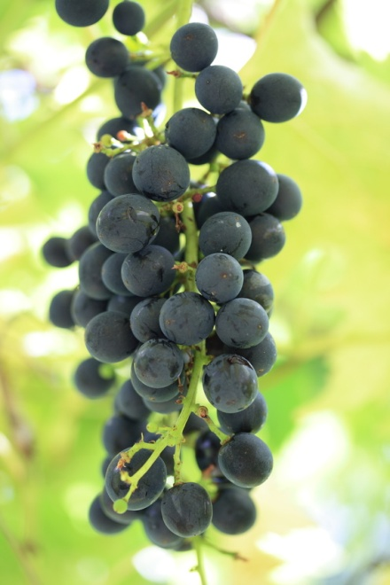
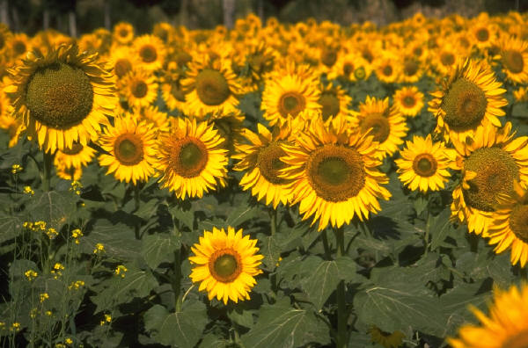
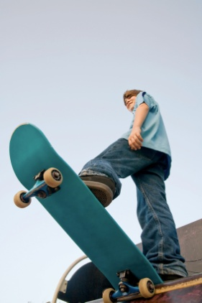


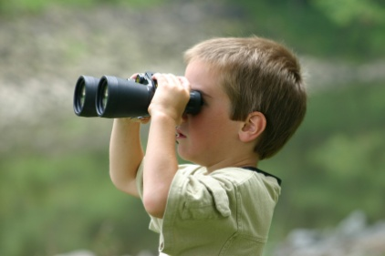

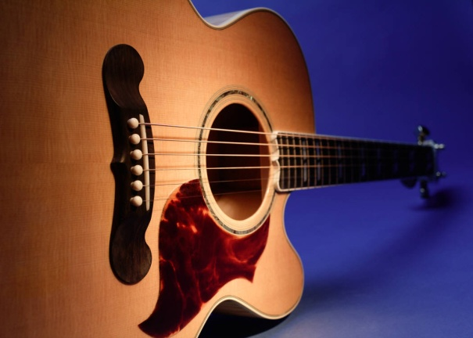
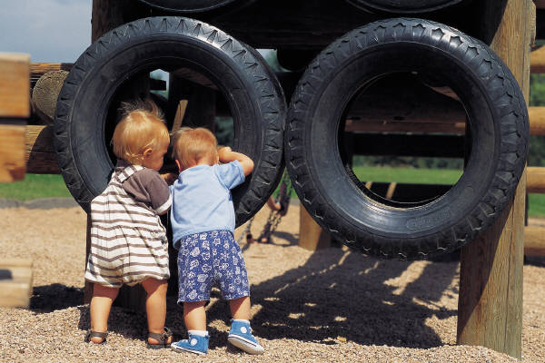
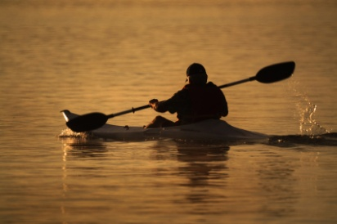
FUNCTIONS
Notes:
For example, a playground could be built next to the children’s library. You could add an outdoor stage for story time, puppet shows or music. Food carts could provide refreshments. You could also consider starting a garden nearby. Outdoor seating and game tables would provide comfort and entertainment.
The following is a list of functions. Can you think of more?
places to sit
playgrounds
art to touch
music to hear
food to eat
history to experience
people to meet
gardens
games
beautiful scenery
architecture
Others
Remember the more reasons to be there the more the space will be used.

Slide 7
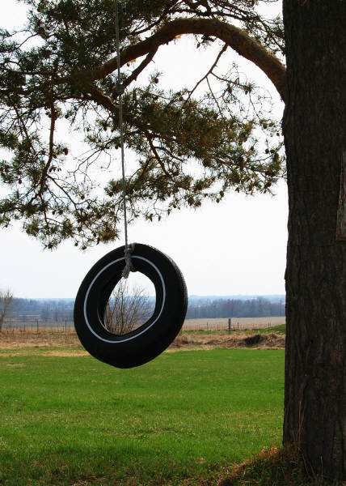
Form Supports Function
Notes:
Once the group has determined the functions. Choose forms to support that function.
For example, if you want to build a playground and the area is sunny through-out the day, you might want to choose structural materials that get will not get hot.

Slide 8
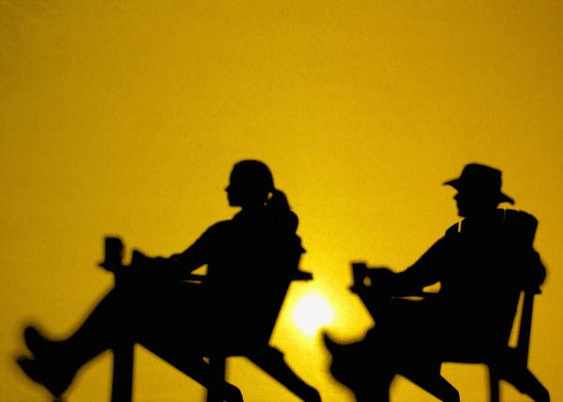
Create an inviting space that focuses on the needs and interests of the community
Notes:
It’s easy to get distracted with good ideas , but those are not necessarily the best idea for your community. For example, a playground would not be a good decision, if your community is mostly adults with few children.

Slide 9
Many great plans get bogged down because they are:

Slide 10
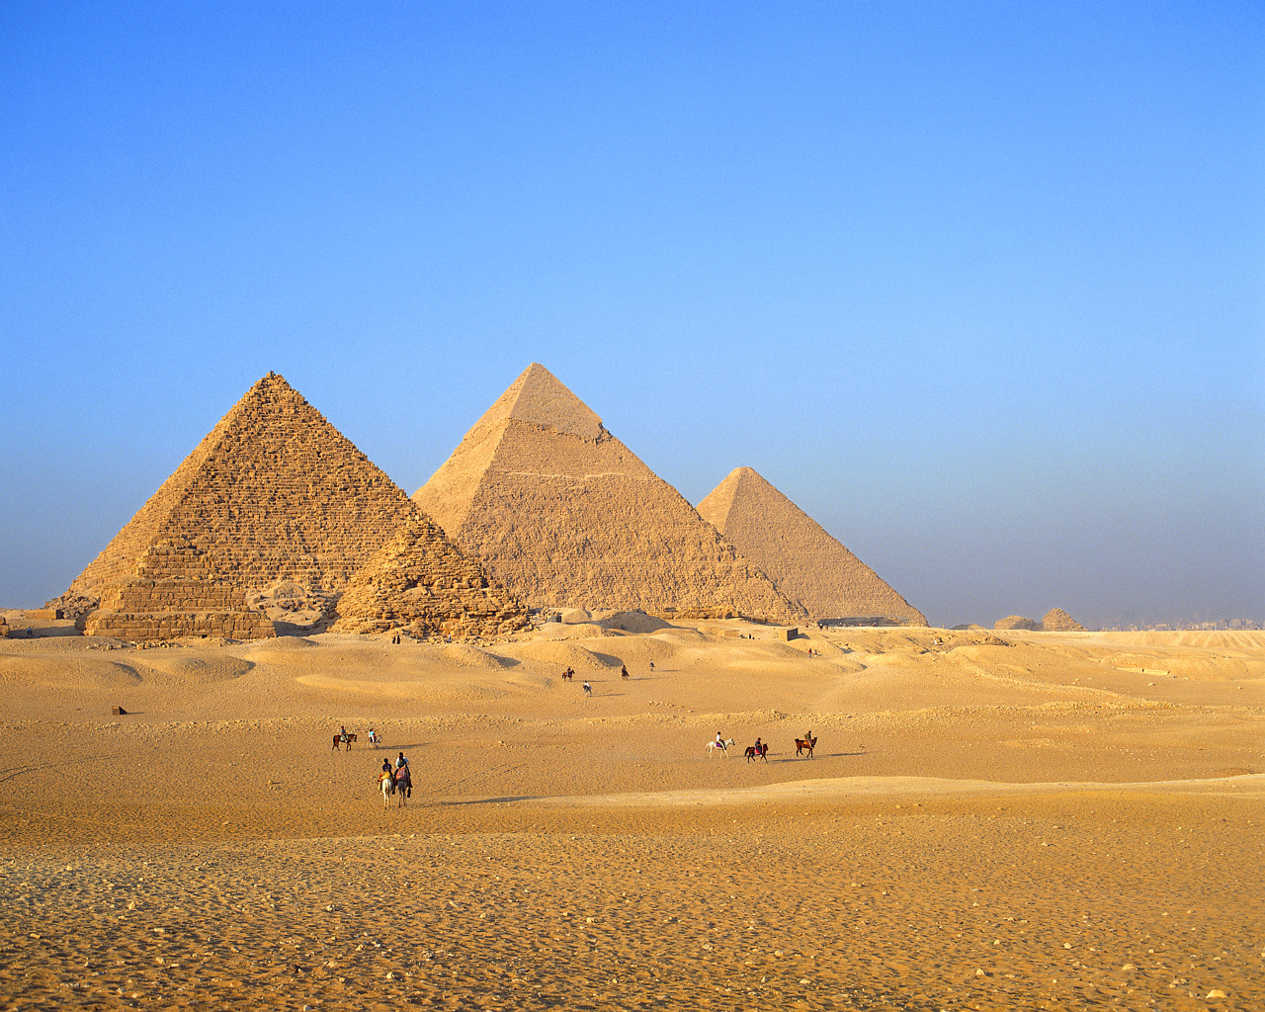
Too Big
Too Expensive
Take Too Long

Slide 11

Lighter, Quicker, Cheaper (LQC)
Notes:
LQC is an approach to Placemaking that focuses on small-scale and incremental changes
Start with a bench or a fresh coat of paint and a barrel of flowers
Put up a tent first and build later
Let an old abandoned building be the inspiration for a new public marketplace

Slide 12
LQC is an approach to placemaking that focuses on small-scale and incremental changes

Slide 13
Benefits of LQC
    Lower risk
    Lower cost, high impact
    Capitalizes on local resources
Notes:
Benefits of LQC. LQC projects quickly translate a community’s vision into reality and keep momentum moving.
Let’s revisit our ideas and see if we can determine the smallest thing we can do. And when we have completed that we can plan the next idea.. Let’s design a project that we can complete with local resources in a reasonable amount of time.

Slide 14

Does your list of LQC goals fit the 4 key qualities of a great public space?

Slide 15
1. Is the space accessible?
2. Are there functions & activities?
3. Is the space comfortable & safe?
4. Is it a sociable place: one where people meet each other?

Slide 16
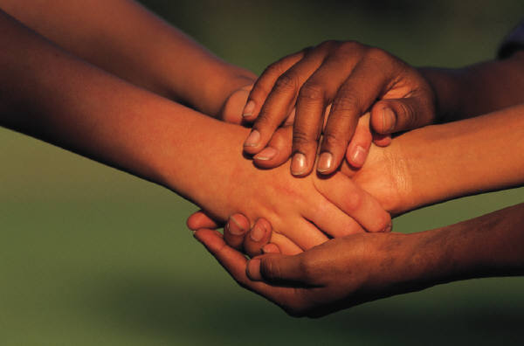
Look for Partners
Notes:
From the survey, you may find people, businesses or agencies that want to participate in the project.
Other sources for collaborations:
Community clubs
Church groups
Special interest groups
Local foundations

Slide 17
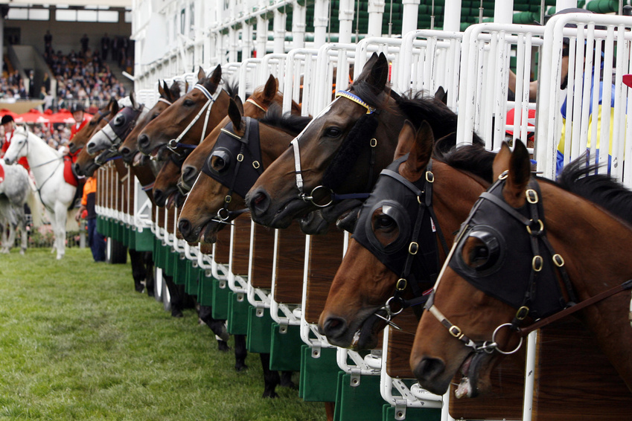
Action
Steps
Notes:
At this point, you will begin to identify specific jobs or responsibilities. You might choose to break into committees.
Don’t forget to include your partners or collaborators.
Set-up a form of regular communication between the planning team participants.

Slide 18

Communication
Notes:
Keep the community in the loop. This could be through, social media, local news articles, radio talk shows, monthly newsletters etc.

Slide 19

Finding Resources
Notes:
As the project begins to take shape, the progress will generate excitement in the community, this is why it’s important to keep them in the loop, and it will become easier to obtain funds or volunteer efforts to support the next steps or long-term goal.
Lastly, remember to visit your Extension agent. They have ties to resources that can provide technical assistance, overcome obstacles, and achieve your goals

Slide 20

Celebrate the Small Wins!
Notes:
Working to achieve a big goal often takes time. To help the group stay engaged and motivated, it’s important to celebrate the small accomplishments that lead up to the big win. (Harvard Business Review: http://hbr.org/2011/05/the-power-of-small-wins/)

