Slide 1
The Art Of Placemaking In Community Development Part One: An Introduction Produced for CultivateNC™ Jackie Miller NC State Cooperative Extension ANR/CRD

Slide 2
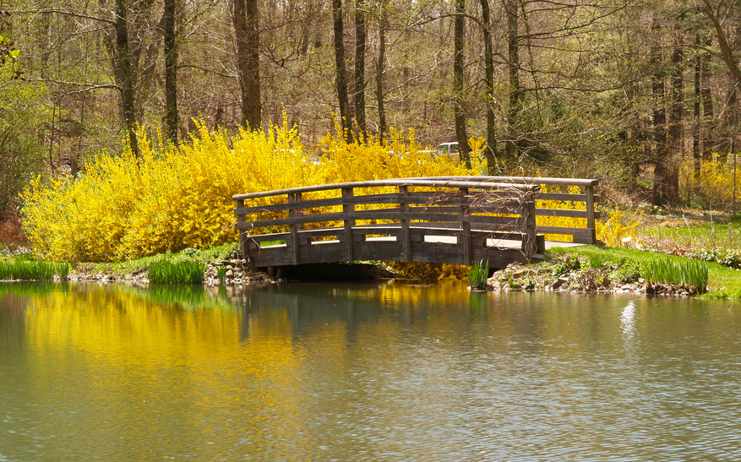
“Placemaking is the process of creating squares, plazas, parks, streets and waterfronts that will enrich the quality of life in your community.” (Wikipedia)
Notes:
Adapted from Wikipedia (http://en.wikipedia.org/wiki/Placemaking)

Slide 3
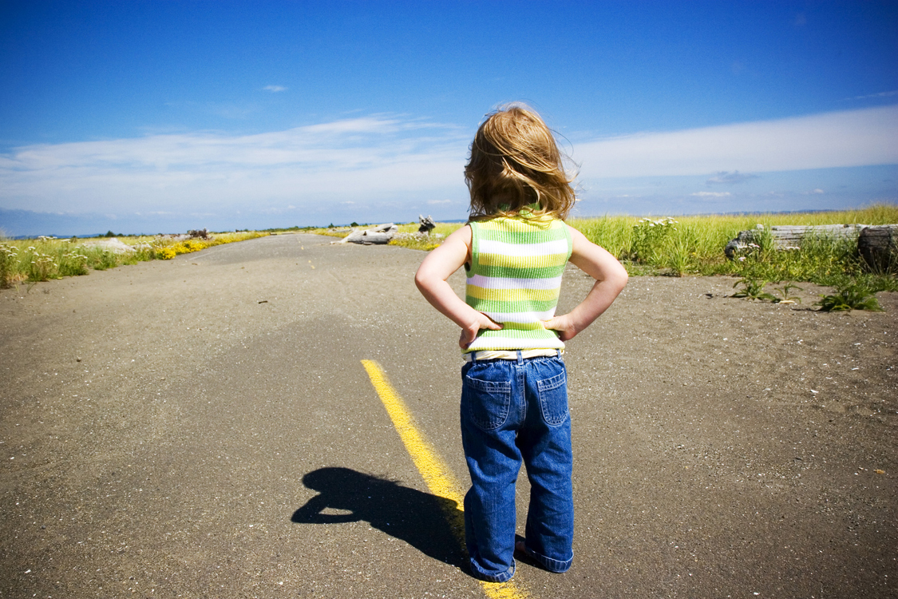
Placemaking is a whole new way of thinking about fostering vital communities
Notes:
The concepts behind Placemaking originated in the 1960s, when writers like Jane Jacobs and William H. Whyte offered groundbreaking ideas about designing cities that catered to people, not just to cars and shopping centers…
A decade later, “Placemaking” was picked up by architects and planners to describe the process of creating squares, plazas, parks, streets and waterfronts that will attract people because they are pleasurable or interesting.
Adapted from Wikipedia (http://en.wikipedia.org/wiki/Placemaking)

Slide 4
Seven Benefits of Placemaking

Slide 5
#1 Support The Local Economy
Notes:
Examples: farmers market, open air stage, riding trails for horses or bikes

Slide 6
#2 Attract New Business
Notes:
Small entrepreneur business people are usually looking for a quality of life when they consider moving their business or starting a business in a new community. When a community has great public spaces, it sends a message to all visitors that the people who reside here take pride in their community.

Slide 7
# 3 Reduce Crime
Notes:
Clean up depressed areas, recycle old buildings. One NC community, had a large number of vacant stores in their downtown area. The stores were for rent but a lack of small businesses made the town look and feel depressed. A marketing person came up with the clever idea of offering gallery space to artists for free. One artist offered wine tastings and movie nights as a way of getting visitors to his gallery in the evenings. The idea behind this plan was two-fold. First, the vacant buildings provided an opportunity for an artist to get working space and gallery space for marketing their work. In turn the artist would provide a new artistic sparkle to the vacant buildings, increase pedestrian traffic and reduced vandalism. If the space were to become rented, the artist could move to another vacant building.

Slide 8
#4 Improve Public Health
Notes:
Examples: Providing options for residents to access healthy foods. Give people a reason to walk instead of drive. Provide outdoor recreation that offers opportunities for exercise and socialization.

Slide 9
#5 Encourage Civic Engagement
Notes:
The Project for Public Spaces says, it’s not enough to have just one great public place in a community. You need a number of them to create a truly lively city or town. Be sure that you get people from every sector involved in the process at the very beginning. It may be difficult at first, to get people to participate. Particularly, if they are not accustomed to participating in civic meetings or projects. Remember, a public space is only successful if the residents use it. In general people are more supportive of ideas that they help create. A large mural depicting the heritage of the residents can be the starting point for a playground, plaza or market square.

Slide 10
#6 Encourage Youth Engagement
Notes:
Teenagers are not often invited to participate in the process of community development and yet they have the most to gain or lose in their community’s future.
For communities that are concerned about youth migration away from home, a youth-adult partnership can develop or deepen ties to the community.

Slide 11
#7 Improve the Environment

Slide 12
Who is responsible for public spaces?
Notes:
Creating good public spaces is a complex subject, because in most communities there is no person or committee responsible for creating public spaces.

Slide 13
It takes a collaborative effort
Notes:
Professionals such as traffic engineers, zoning commissions and architects have their jobs to perform. But creating a public space needs a collaborative approach that includes voices from the schools, healthcare, police, parks, retail businesses, and religious institutions.

Slide 14
Vollis Simpson Whirligig Park
Notes:
EXAMPLE: The Vollis Simpson Whirligig Park in Wilson County is a good example of what can happen when a community develops a public space using local talent and resources.
Whirligig sculptures created by local, internationally renowned artist Vollis Simpson will be the centerpiece for a new world-class downtown park anchoring an industrial artisan district in Wilson, NC.
This energetic cultural and educational venue will serve as a:
global tourist destination
a community living room
a model for economic development and downtown revitalization.
Where Art and Science Are Spun as One http://www.wilsonwhirligigpark.org/

Slide 15
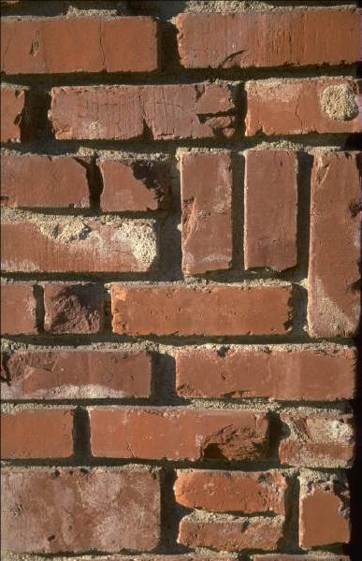
Why are some public spaces more successful? 4 Key Qualities
Notes:
In evaluating thousands of public spaces around the world, the Project for Public Spaces (PPS) has found that successful ones have four key qualities:

Slide 16
The place is accessible
Notes:
Can you see the space from a distance? Is its interior visible from the outside?
Is there a good connection between the space and the adjacent buildings, or is it surrounded by blank walls? Do occupants of adjacent buildings use the space?
Can people easily walk to the place? For example, do they have to dart between moving cars to get to the place?
Do sidewalks lead to and from the adjacent areas?
Does the space function for people with special needs?
Do the roads and paths through the space take people where they actually want to go?
Can people use a variety of transportation options – bus train, car, bicycle, etc. – to reach the place?
Are transit stops conveniently located next to destinations such as libraries, post offices, park entrances, etc.?

Slide 17
People are engaged in activities
Notes:
Are people using the space or is it empty?
Is it used by people of different ages?
Are people in groups?
How many different types of activities are occurring – people walking, eating, playing baseball, chess, relaxing, reading?
Which parts of the space are used and which are not?
Are there choices of things to do?
Is there a management presence, or can you identify anyone is in charge of the space?

Slide 18
The space is comfortable
Notes:
Are there more women than men?
Are there enough places to sit? Are seats conveniently located? Do people have a choice of places to sit, either in the sun or shade?
Are spaces clean and free of litter? Who is responsible for maintenance? What do they do? When?
Does the area feel safe? Is there a security presence? If so, what do these people do? When are they on duty?
Are people taking pictures? Are there many photo opportunities available?
Do vehicles dominate pedestrian use of the space, or prevent them from easily getting to the space?

Slide 19
It is a sociable place where people meet
Notes:
Are others meeting friends here or running into them?
Are people in groups? Are they talking with one another?
Do people seem to know each other by face or by name?
Do people bring their friends and relatives to see the place or do they point to one of its features with pride?
Are people smiling? Do people make eye contact with each other?
Do people use the place regularly and by choice?
Does a mix of ages and ethnic groups that generally reflect the community at large?
Do people tend to pick up litter when they see it?

Slide 20
Small changes can make a big difference
Notes:
The theory of broken windows. “If a window is broken and left unrepaired, people walking by will conclude that no one cares and no one is in charge. Soon, more windows will be broken, and the sense of anarchy will spread from the building to the street on which it faces, sending a signal that anything goes.”
(Malcolm Gladwell, The Tipping Point, How Little Things Can Make a Big Difference)

Slide 21
Observe your public space
HOMEWORK
Notes:
Each of the group members should visit and observe the public space in question. (If the group has not selected a particular public space to work on, ask the participants to visit any public space in the community that they believe could be improved or enhanced.)
They should take notes of their observations and cell phone pictures to share at the next meeting.

Slide 22
This presentation was adapted from the project for public spaces (PPS). Their website offers many useful articles, resources, inspirational stories and a blog. Visit their website at http://www.pps.Org/

Slide 23
This completes the first of a three-part series on Placemaking
Notes:
This completes the first of a three-part series on Placemaking

