Slide 1
Introduction to
Wholesale and Direct Marketing
Channel Options for Produce Growers
Produced for CultivateNC™ Jackie Miller NC State Cooperative Extension ANR/CRD
Notes:
Each participant should receive a copy of the Guide to Marketing Channel Selection
“This publication is an aid for new farmers and for those considering other marketing options. The presentation you are about to hear focuses on fresh produce but many of the principles will apply to other agricultural products such as flowers, dairy, meat and honey.
Link to publication: http://communitydevelopment.ces.ncsu.edu/?p=352922

Slide 2
Two marketing options
Wholesale marketing
Selling to a buyer that is not the consumer.
Grocery stores
Distributors
Produce auctions
*Restaurants*
Direct marketing
Selling directly to the consumer
Farmers Markets
Farm stores
Farms stands
CSA’s
U-pick operations
Internet sales
Notes:
* Restaurants are a unique category. In many circumstance the restaurant pays a higher price for fresh, specialty products. The price is often close to Direct marketing sales.

Slide 3
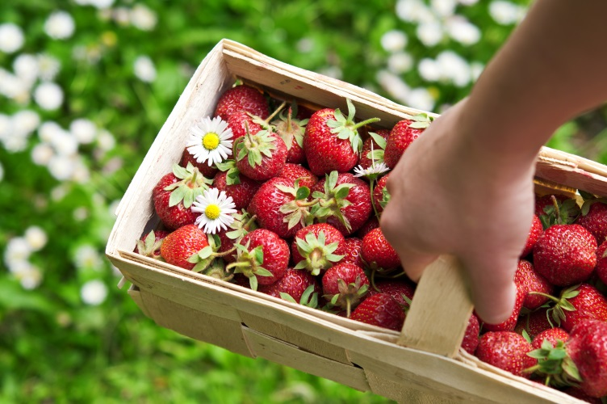
Comparison of wholesale and direct marketing sales
Strawberries | Sale Price/Pint | Pints Sold | Total Gross Sales
Direct Market | $4.00 | 36 | $144.00
Wholesale | $1.50 | 300 | $450.00
Notes:
Farmers are challenged to balance the lean and the plenty when selling through different channels. As one farmer described, the constant challenge is finding an outlet for the varying and sometimes unexpected harvest volumes, “Even if a whole field ripens at once, I am not going to pick it unless it is sold.” While that may mean letting a crop spoil in the field, spoilage is less expensive than paying people to harvest produce that may not sell.
Excerpt from the Guide to Marketing publication: http://files.campus.edublogs.org/blogs.cornell.edu/dist/0/2113/files/2012/04/Market-Channel-Assessment-132dr2l.pdf (Page 7)

Slide 4
Which marketing plan makes the most sense for your lifestyle and farm operation?

Slide 5
Wholesale buyers expect a high quality product on schedule
Notes:
Wholesale buyers are under pressure to provide a high quality product on schedule.

Slide 6
Grocery store shoppers expect to find a good selection and variety of high quality produce, dairy and meat everyday of the week.

Slide 7
Restaurant chefs do not have time to run to the grocery if their shipment of lettuce arrives late or is of poor quality.

Slide 8
Keeping the consumers happy falls on the shoulders of the grower!

Slide 9
Will your crop ripen on schedule? Will your harvest fulfill your commitments?
Notes:
Wholesale distributors and grocery store managers will want to know

Slide 10
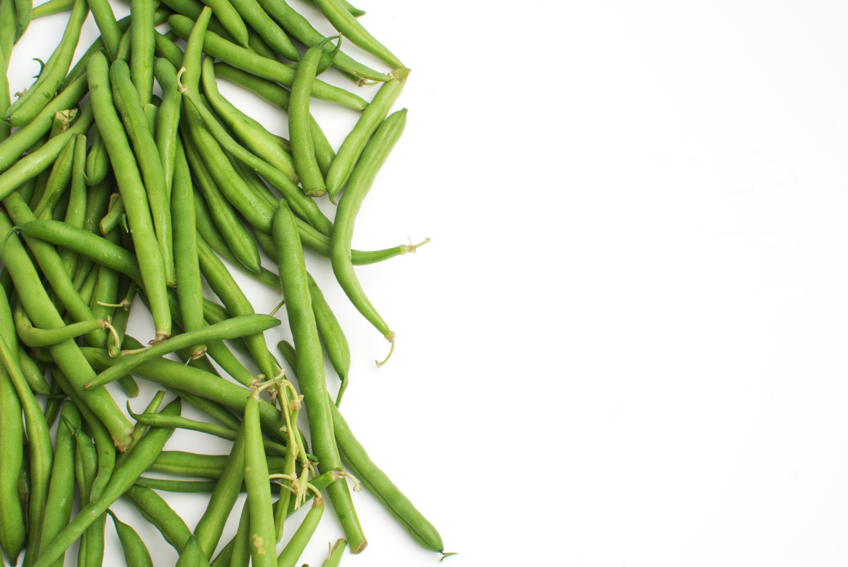
Do you have enough labor to harvest, wash, grade, pack and deliver on schedule?

Slide 11
If you do not meet your commitment, the buyer may be hesitant to make another purchasing agreement with you.

Slide 12
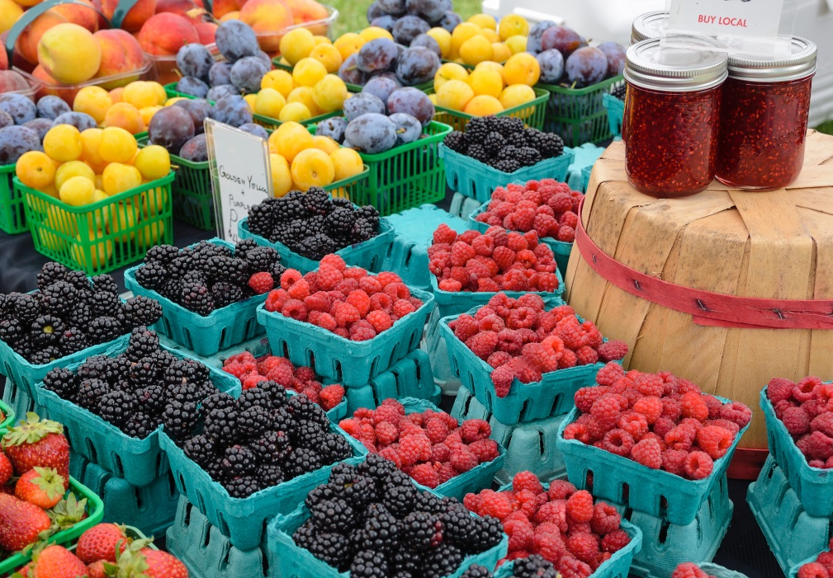
Direct Marketing offers more flexibility but depends on an ample number of customers.

Slide 13
Customer turnout is affected by
Weather
Location
Advertising
Population

Slide 14
Activity:
Use the Guide to Marketing Channel Selection to determine the Pros and Cons for each type of Marketing Channel
Advantages
Disadvantages
Costs
Risks
Notes:
Activity:
Preparation: On small pieces of paper, write one of the following channel options. Fold the papers and place them into a container (box, can, or hat).
(Channel options: Grocery store and food retailers, restaurant, distributor, produce auctions, institutional and food service buyers, CSA, farmer’s market, road side stand, U-pick)
Ask the participants to separate into 9 groups. Give each group some flip chart paper and markers. Ask a volunteer from each group to reach into the container and pick one slip of paper. The group should work on the channel option listed on the paper, for example: farmer’s market would be one option.
Direct the groups to use the Guide to Marketing Channel Selection to gather information about the channel. They will be looking for the Pro’s and Con’s, the costs associated with that channel and anything else a farmer would want to know. Give them about 10-15 minutes.
Then instruct the groups to draw cartoons or stick figure illustrations to show what they learned about the channel. Give them another 10 minutes to complete the drawings.
Ask the groups to choose a volunteer to report out and describe the drawings.
As the participants to regroup into one large group and give their reports.

Slide 15
All market channels have six basic challenges
High labor and marketing costs
Inability to provide a product of consistent quantity and quality
Buyer failure to fulfill commitment
Unpredictable customer turnout
Competition
Low price risk
Notes:
In a survey conducted with Central New York vegetable farmers, they were asked what they felt were the primary risks with associated each channel. The responses were categorized into 6 basic challenges.
Ask the group if they have additional challenges to add? There may be some challenges that are specific to your location or community?
Link: http://files.campus.edublogs.org/blogs.cornell.edu/dist/0/2113/files/2012/04/Market-Channel-Assessment-132dr2l.pdf (Page 8)

Slide 16
Things to think about
How much sales volume do you need?
How much risk would you be comfortable with?
What is your lifestyle preference?
Can you meet the labor requirements?
Have you evaluated channel costs?
Crop storage life?
Local opportunities for wholesale or direct sales?
Notes:
When you are considering your channel preference each grower will want to consider the following variables.

Slide 17
Example:
Wholesale marketing requires more labor to harvest, wash, sort, and pack the produce for delivery
Direct marketing requires more labor for sales time and customer interaction
Notes:
Which of these variables makes more sense for your farm operation and your lifestyle preference?
Link: http://files.campus.edublogs.org/blogs.cornell.edu/dist/0/2113/files/2012/04/Market-Channel-Assessment-132dr2l.pdf (Page 25)

Slide 18
Why not do both!

Slide 19
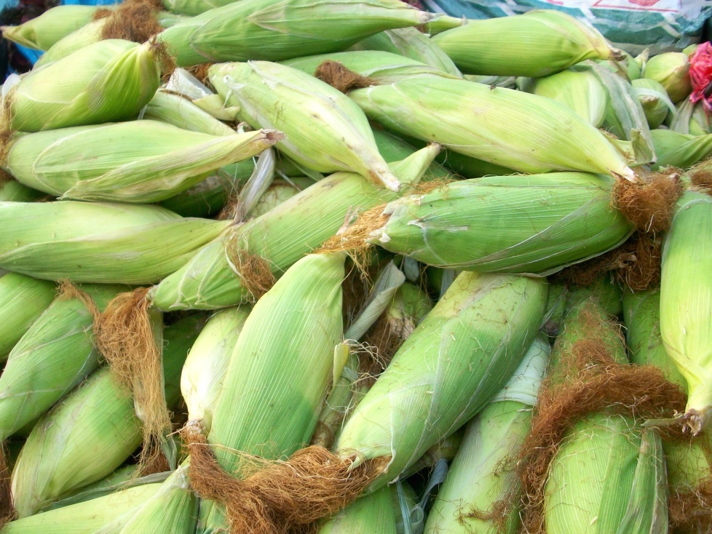
Example
A local grocery store manager might be interested in knowing when you have a larger harvest volume and can offer the grocer a good deal!
Notes:
Even though your main channel of sales is the farmer’s market you could develop a relationship with the local grocery store manager, so that it only takes a phone call to sell an unexpected harvest volume.
Ask the group to name other examples:
Restaurants that are interested in working with local farms to grow specialty produce…such as mushrooms.

Slide 20
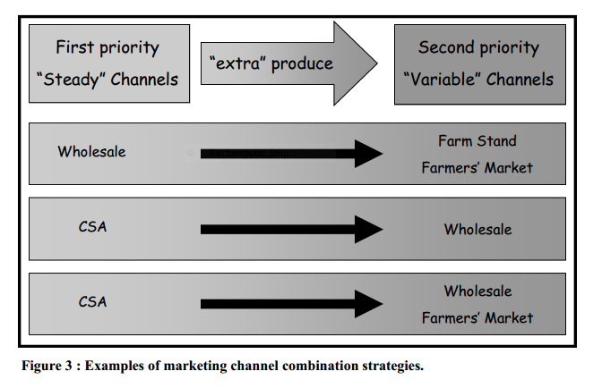
Notes:
This chart illustrates some strategies used by real farms. (Page 13)
Ask for a volunteer to explain the chart.
Each farm has a steady marketing channel with a relatively consistent demand. Once that channel has been satisfied the farm’s other channels can be supplied with additional harvest.
http://files.campus.edublogs.org/blogs.cornell.edu/dist/0/2113/files/2012/04/Market-Channel-Assessment-132dr2l.pdf (page 13)

Slide 21
Check it out!
Notes:
In order to select the marketing channels that best suit your farm and your personal
preferences take some time to research. Consider which channels are practical in your area,
say within a 10-20 mile radius of your farm’s location. For example, if the farm is in a very
rural location, a u-pick operation may not draw a large enough crowd .
Once you identify some marketing channels that interest you, visit other farms or
marketplaces of that type. How are their prices? How many customers are there and what is
the volume of produce being sold? What overhead costs and amount of labor are necessary for
those farms to sell there? When you visit, take notes and try to rank each marketing channel for
your perceptions of how well they fit your goals in terms of: risk, lifestyle preferences, volume
sold, prices and profit, labor required, and associated costs.

Slide 22
Collaborative marketing options
Notes:
Collaborative marketing is a realistic solution for small to mid-size farms that are seeking access to larger markets, but do not have the volume to serve such accounts.
Excerpted from Collaborative Marketing for Small Farms, Cornell University : http://communitydevelopment.ces.ncsu.edu/?p=352935

Slide 23
“In collaborative marketing, several like-minded producers join together formally to market and distribute farm products.”
Notes:
By choosing to market jointly with other farms, you will adjust your planting intentions, harvesting and storage techniques, crop schedule, certifications, buyer relationships and many other farm office decisions.
It is not a decision to be taken lightly. In fact, establishing some type of business collaboration may be one of the more complicated decisions you will make for your farm.
http://www.ces.ncsu.edu/?p=352935 (page 1)

Slide 24
Reasons to collaborate
Reduce individual farm marketing expenses by dividing a single larger-scale marketing opportunity across multiple farms
Meet expectations of a wholesale buyer to reduce their risk, while reducing risk to participating farms

Slide 25
Collaborative marketing can increase local job opportunities
Example:
A regional food hub is a business or organization that actively manages:
Aggregation
Distribution
Marketing
Notes:
Aggregation, distribution and marketing represent good opportunities for local business development and employment.
USDA Regional Food Hub and Resource Guide: http://www.ams.usda.gov/AMSv1.0/getfile?dDocName=STELPRDC5097957

Slide 26
Collaborative marketing options can be simple or complex:
Food hub
Farm cooperative
Joint venture agreement
Consignment sales
LLC
Not for profit corporation
Notes:
Each of these options represent different legal agreements. It would take another class to get more specific and that is not our intention today. I just wanted you to let you know there is another option that enables small and mid-sized farms to compete in a larger marketplace. Your Extension agent can provide more information if you are interested in learning more about collaborative marketing.

Slide 27
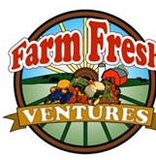
North Carolina Examples
Sandhills Farm to Table (Moore and neighboring counties)
Triad Farm to Table (Stokes, Surry, Davidson, Yadkin, Davie, Rockingham, Guilford and Forsyth), both of which are cooperative forms of CSA
TRACTOR ( non-profit food hub)
Farm Fresh Ventures (producer cooperative serving Anson, Montgomery, Richmond, Stanly and Union Counties in NC and Chesterfield County in SC)

Slide 28
References
Guide to Marketing Channel Selection: How to sell through Wholesale and Direct Marketing Channels
http://files.campus.edublogs.org/blogs.cornell.edu/dist/0/2113/files/2012/04/Market-Channel-Assessment-132dr2l.pdf
Collaborative Marketing for Small Farms, Cornell University : http://communitydevelopment.ces.ncsu.edu/?p=352935
USDA Regional Food Hub and Resource http://communitydevelopment.ces.ncsu.edu/?p=352925

