Slide 1
What type of farm insurance do you need?
Produced for CultivateNC™ Jackie Miller NC State Cooperative Extension ANR/CRD
Notes:
Reference Materials:
Insurance Coverage Options for Fresh Produce Growers: Produced by Roderick M. Rejesus, Assistant Professor and Extension Specialist, NC State University; Annette Dunlap, NC Dept. of Ag. and Consumer Services
http://ncfreshproducesafety.ces.ncsu.edu/ncfreshproducesafety-good-agricultural-practices/ncfreshproducesafety-risk-crisis-management/ncfreshproducesafety-liability-management/

Slide 2
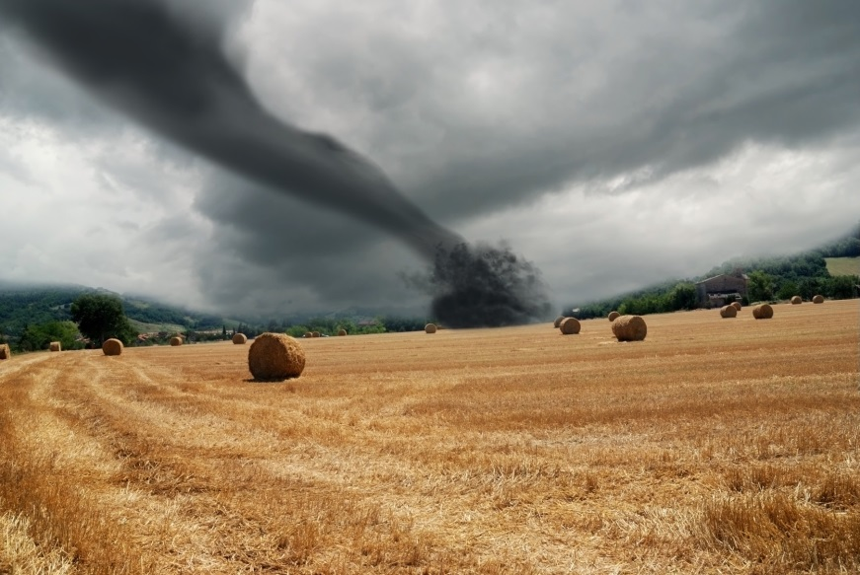
WEATHER
FIRE
ACCIDENTS
Notes:
This slide illustrates some of the traditional reasons homeowners and business owners get insurance. Most of you are familiar with these insurance concerns.

Slide 3
Increased consumption of fresh produce
Notes:
The current trend to eating healthy has also led to an increase in foodborne illness. Restaurants, grocery stores, farms and any business dealing with fresh produce should consider the risks and costs of insurance options that protects your farm operation from the loss of revenue.

Slide 4
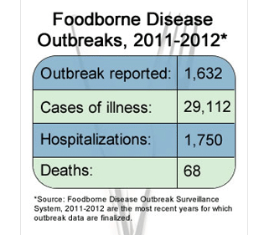
Notes:
These statistics came from the CDC (Center for Disease Control and Prevention).
http://www.cdc.gov/features/foodborne-diseases-data/
Germs and Foods
Pathogens and foods responsible for the most outbreak-related illnesses, hospitalizations, and deaths in 2012:
Illnesses
Salmonella in fruits (446 illnesses)
Salmonella in fish (425 illnesses)
Salmonella in chicken (345 illnesses)
Hospitalizations
Salmonella in chicken (109 hospitalizations)
Salmonella in fruits (55 hospitalizations)
Salmonella in fish (55 hospitalizations)
Deaths
Listeria in dairy (5 deaths)
Campylobacter in chicken (4 deaths)

Slide 5
A growing number of retail stores are requiring that food products carry a minimum level of Product Liability Insurance, normally $1 million.
Notes:
Due to the increase in consumption of fresh produce and foodborne disease outbreaks, a growing number of retail stores are requiring that food products carry product liability.
If you belong to a food coop or hub, you may be required to purchase the group insurance. Be aware, that most group insurance coverage will not cover all of your crops, just the crops that are being sold through the coop or hub.

Slide 6
Increased consumer awareness
Notes:
The rise in Foodborne disease has led to more consumer awareness AND more consumer protection regulations.

Slide 7
Food Safety Modernization Act (FSMA)
“The new act creates incentives for food companies to order prophylactic recalls before determining whether their products are actually contaminated …which would increase the frequency of recalls”
Notes:
The Food Safety Modernization Act (FSMA) creates incentives for food companies to order prophylactic recalls before determining whether their products are actually contaminated—in essence, voluntary recalls—which could increase the frequency of product recall
losses.”
North Carolina Dept of Agriculture and consumer Services:
http://www.kslaw.com/imageserver/KSPublic/library/publication/ca090412a.pdf

Slide 8
Salmonella alert jeopardizes $40 mil. in Florida tomatoes
Some examples
Oregon E.Coli strawberries linked to 14 sick and 1 Dead
Notes:
Do you remember these headlines?
Consumer claims and product recalls often affect the sales of all growers in a region where foodborne illness has been detected.
Your business can be affected even if you are not the responsible party.
Headline Notes:
Produce shippers are sitting on $40 million of Florida tomatoes that could be lost unless federal officials clear them soon of any link to a salmonella outbreak in the western U.S…
By Kevin Bouffard Published: Tuesday, June 10, 2008 at 2:40 a.m.
Last Modified: Tuesday, June 10, 2008 at 6:27 p.m.
http://www.theledger.com/article/20080610/NEWS/806100423
Oregon Public Health Division officials confirmed today that deer feces found in strawberry fields in Washington and Yamhill counties was the source of E. coli O157:H7 infections that sickened at least 15 people in July, including one person who died….
Posted By Bill Marler on August 20, 2011
Food Poison Journal
http://www.foodpoisonjournal.com/foodborne-illness-outbreaks/oregon-e-coli-strawberries-linked-to-14-ill-and-1-dead/#.U8k2FbGTH8s

Slide 9
A Product Recall or Warning can cause a catastrophic drop in sales and damage your farms reputation.
Notes:
The Food Safety Modernization Act (FSMA) creates incentives for food companies to order prophylactic recalls before determining whether their products are actually contaminated—in essence, voluntary recalls—which could increase the frequency of product recall
losses.”
North Carolina Dept of Agriculture and consumer Services:
http://www.kslaw.com/imageserver/KSPublic/library/publication/ca090412a.pdf

Slide 10
Crop insurance can be an important risk management tool

Slide 11
No single policy will meet all of your insurance needs
Notes:
Insurance is complex, no single policy will cover everything. In many cases, the farmer/business owner will select a basic policy and add riders to cover specific risks.

Slide 12
Insurance Products
General Liability
Commercial Business Liability
Product Liability
Product Recall
Business Losses
Accident or Product Recall
Malicious Tampering
Excess/Umbrella
Whole Farm Revenue Protection
Notes:
Today we will be reviewing 9 typical insurance products that are available through private insurance companies and 1 Federal Program. Each of these policies offer specific types of coverage. In most cases, you will select one policy and then add riders to provide additional coverage in the appropriate areas.

Slide 13
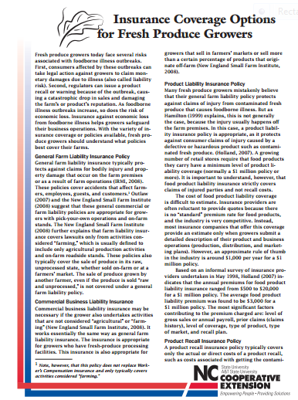
Packet of reference materials
Notes:
Each of the participants should be given a packet of reference materials:
Insurance Coverage Options for Fresh Produce Growers
Link: http://ncfreshproducesafety.ces.ncsu.edu/wp-content/uploads/2014/03/ag-710-final-printed.pdf (Much of the information presented in the PPTX came from this source.)
Beginning Farmer and Ranchers Fact Sheet
Link: www.rma.usda.gov/pubs/rme/beginningfarmer_2014.pdf
Whole Farm Revenue Protection Fact Sheet
http://www.ctfarmrisk.uconn.edu/index_5_697396082.pdf
http://www.rma.usda.gov/pubs/rme/fctsht.html
Provide a copy of a Traceability Log: http://ncfreshproducesafety.ces.ncsu.edu/ncfreshproducesafety-good-agricultural-practices/ncfreshproducesafety-audits-and-plans/ncfreshproducesafety-food-safety-plans/traceability/
Include a copy of slides 31, 32, 33, 34 and 35. These slides offer website addresses for additional reference materials. We want to make is as easy as possible for your growers to find the needed reference materials.

Slide 14
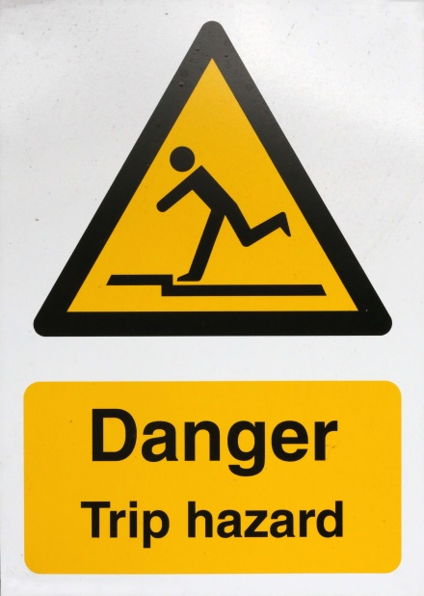
General Farm Liability Insurance
These policies cover accidents that come from farm-based agricultural production activities.
It covers farmers, employees, guests and customers.
It is appropriate for U-pick operations and farm stands
Notes:
Typically, the general farm liability policies cover accidents that come from farm-based agricultural production activities.
It cover farmers, employees, guests and customers.
It is appropriate for U-pick operations and on site farm stands

Slide 15
Commercial Business Liability Insurance
This insurance is similar to General Farm Liability but it covers farms that have fresh produce processing facilities.
It is also appropriate for growers that sell in the farmers’ market.

Slide 16
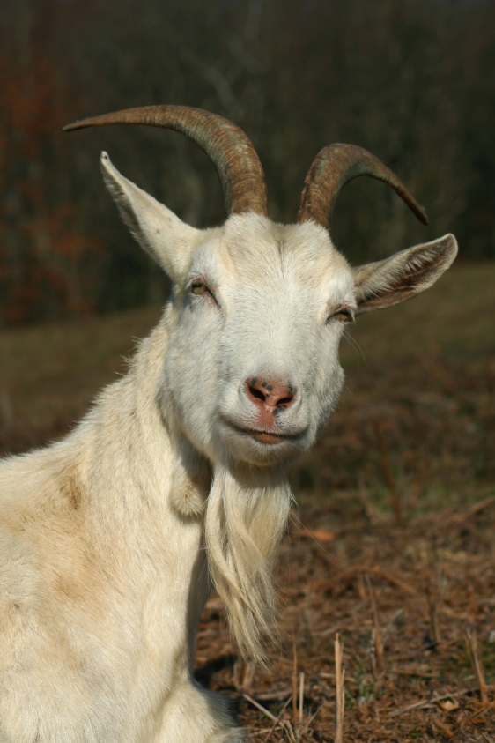
Example (Agritourism)
When you bring the public onto your farm, you increase the risks and consequences of accidents and health risks.
Notes:
Check with your insurance provider, about the type of agritourism ideas you are considering. Some programs, such as a petting zoo will need additional insurance. In many cases you will need to add a rider to your General or Commercial farm liability policy.

Slide 17
Note
General liability policies do not replace Worker’s Compensation Insurance and typically cover only activities considered farming.
x
Notes:
These policies do not replace Workmans compensation AND they do not provide coverage for consumer claims of injury.

Slide 18
Insurance policies that deal directly with foodborne illness fall into three separate insurance categories: 1. Product liability 2. Product recall costs 3. Business losses

Slide 19
1. Product Liability Insurance
Protects your business against consumer claims of injury caused by a defective or hazardous product.

Slide 20
2. Product Recall Insurance (Covers direct costs)
Removing the product from the shelf
Destroying the contaminated product
Product replacement
Transportation costs
Notes:
Theses costs are not covered by liability insurance and they can greatly impact your income.

Slide 21
Indirect Costs
3. Business losses
(Covers indirect costs)
Loss of profit
Business interruption losses
Third party losses, (downstream retailer losses business)
Notes:
Businesses losses however, are not covered by product liability or recall insurance.
Loss of profit refers to instances when the product recall or warning damages consumer confidence in the grower, negatively affecting revenues in the current or next business cycle.
Business interruptions are those losses resulting from a period where the grower’s operations shut down.
Third party losses refer to those costs that occur when a downstream retailer loses business as a result of the contamination

Slide 22
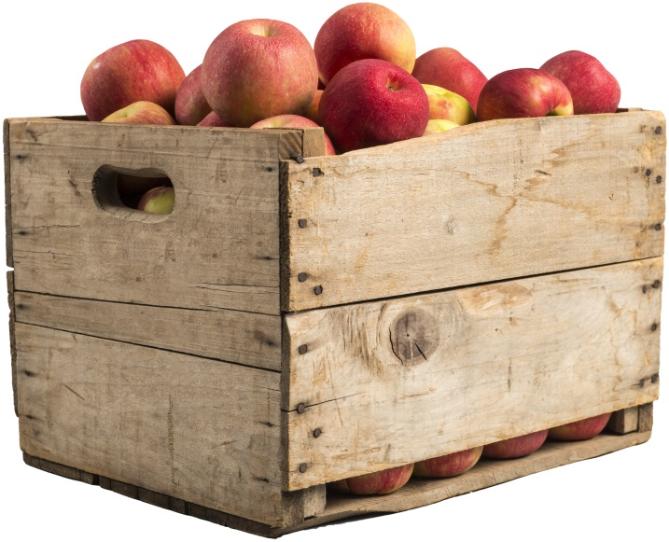
Accident or Product Contamination Policies cover:
Product recall costs (Direct costs)
Business losses
(Indirect costs)
But, it only covers the responsible grower
Notes:
Covers both the direct and indirect costs of product recall is the Accidental or Product Contamination policy.
Keep in mind that these policies usually cover only the farm responsible for the contamination. If there is a general product recall (recalling produce from a certain region), the insurance will not cover the cost of the loss unless you are the responsible grower.

Slide 23
Malicious Tampering Insurance provides coverage for:
Criminal actions of sabotage against the grower
Product recall costs
Business losses
Covers only the responsible grower
Notes:
Malicious tampering insurance is a more comprehensive policy that covers losses from criminal actions of sabotage against the grower, as well as the losses covered in the accidental or product contamination polity including the direct and indirect recall costs. Again, this policy only covers the grower responsible for the contamination or outbreak.

Slide 24
Excess/Umbrella/Surplus Lines of Insurance
This policy can be tailored to protect against losses from foodborne illness
outbreaks even when the grower is NOT the responsible party.
Notes:
The excess or surplus-lines market is an insurance marketplace for unique or hard-to-place risks.
For produce growers these excess or surplus lines provide additional protection above and beyond the losses covered under other policies.
This policy can be tailored to protect against losses from foodborne illness outbreaks even when the grower’s product is not contaminated.

Slide 25
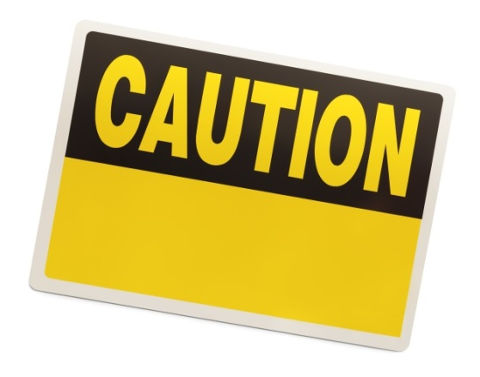
Note: The insurance rates for Excess/Surplus Insurance policies are not regulated under state laws, and the insurance Guaranty Association offers no protection for companies that sell Excess/Umbrella/Surplus lines of insurance.
Notes:
A grower has to be careful and do their homework when considering this type of policy.
What is an insurance guaranty association?
Insurance guaranty associations provide protection to insurance policyholders and beneficiaries of policies issued by an insurance company that has become insolvent and is no longer able to meet its obligations.
(American Council of Life Insurers)
https://www.acli.com/Tools/Industry%20Facts/Guaranty%20Associations/Pages/FS08-007.aspx
Link to the North Carolina Guaranty Association
http://www.ncrb.org/nciga/NorthCarolinaInsuranceGuarantyAssociation/tabid/140/Default.aspx

Slide 26
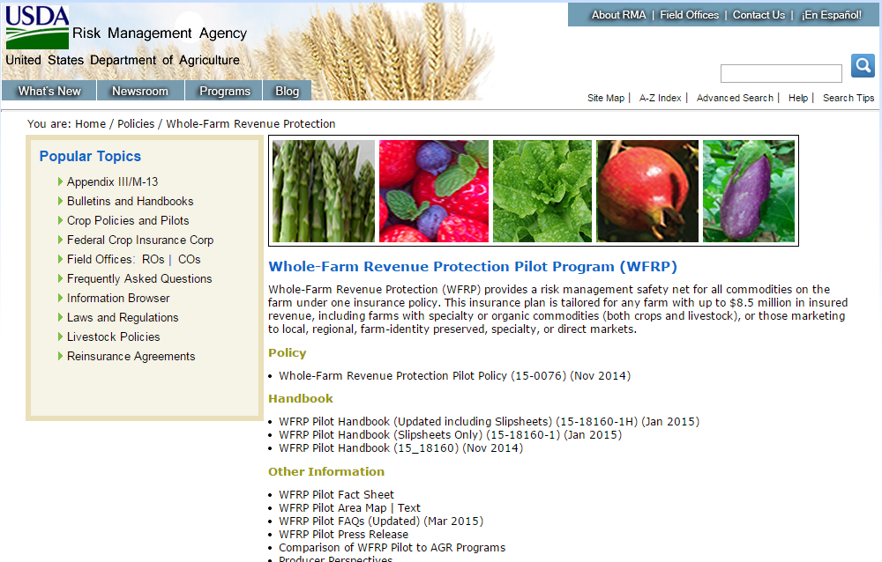
Notes:
The new Whole-Farm Revenue Protection (WFRP) policy is a Federal Program that combines Adjusted Gross Revenue (AGR) and AGR-Lite along with several improvements to target diversified farms and farms selling two to five commodities, including specialty crops to wholesale markets.
Fact Sheet: http://www.rma.usda.gov/policies/wfrp.html
AGR and AGR-Lite terminated at then end of 2014.

Slide 27
WFRP Key changes for 2015
WFRP allows farmers to insure all crops (& livestock) at once, rather than insuring commodity-by-commodity
Lift the coverage level from 80 to 85%
Include coverage of packing, washing. grading and packaging
A subsidy is available for farms growing two or more types of crops
A premium discount is also available to farms that have diversified their crops
The new product will, over time be made available nationwide
Notes:
As part of the pilot project, Whole-Farm Revenue Protection will be available where AGR and AGR-Lite are currently offered, and will expand to other counties as data are available for underwriting and actuarial ratemaking.
Note: You could point out information that directly relates to the farmers in your audience. These could be positive and or negative things that will impact their farm operation with this type of insurance coverage.

Slide 28
Crop insurance is NOT a safety net for poor agricultural practices
Notes:
If you are NOT incorporating good agricultural practices in your farm operation, the WFRP insurance will likely not cover risks from food contamination. You do not have to be certified but incorporating good agricultural practices reduces your risk from food contamination and makes you a better insurance risk.

Slide 29
Good record keeping is essential

Slide 30
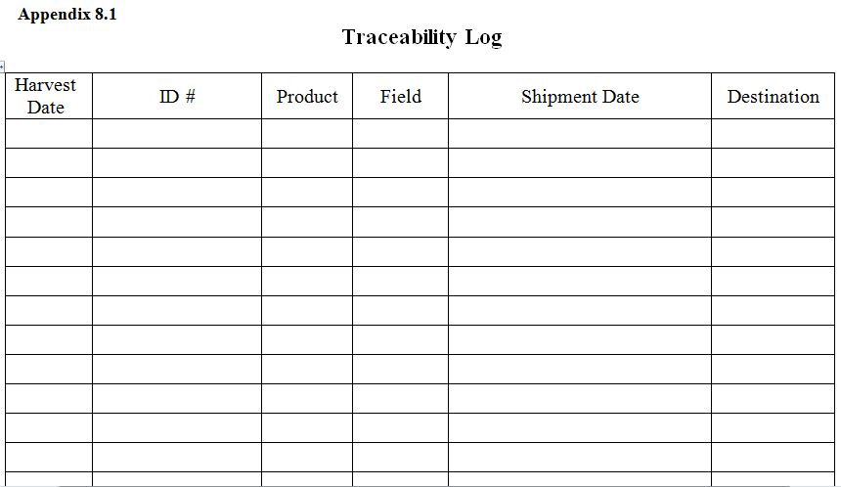
Notes:
This log can be found on NC Fresh Produce Safety portal
http://ncfreshproducesafety.ces.ncsu.edu/ncfreshproducesafety-good-agricultural-practices/ncfreshproducesafety-audits-and-plans/ncfreshproducesafety-food-safety-plans/traceability/

Slide 31
Good Agricultural Practices can influence loan applications
Notes:
Even banks are beginning to use good agricultural practices as part of their evaluation when assessing loan applications.

Slide 32
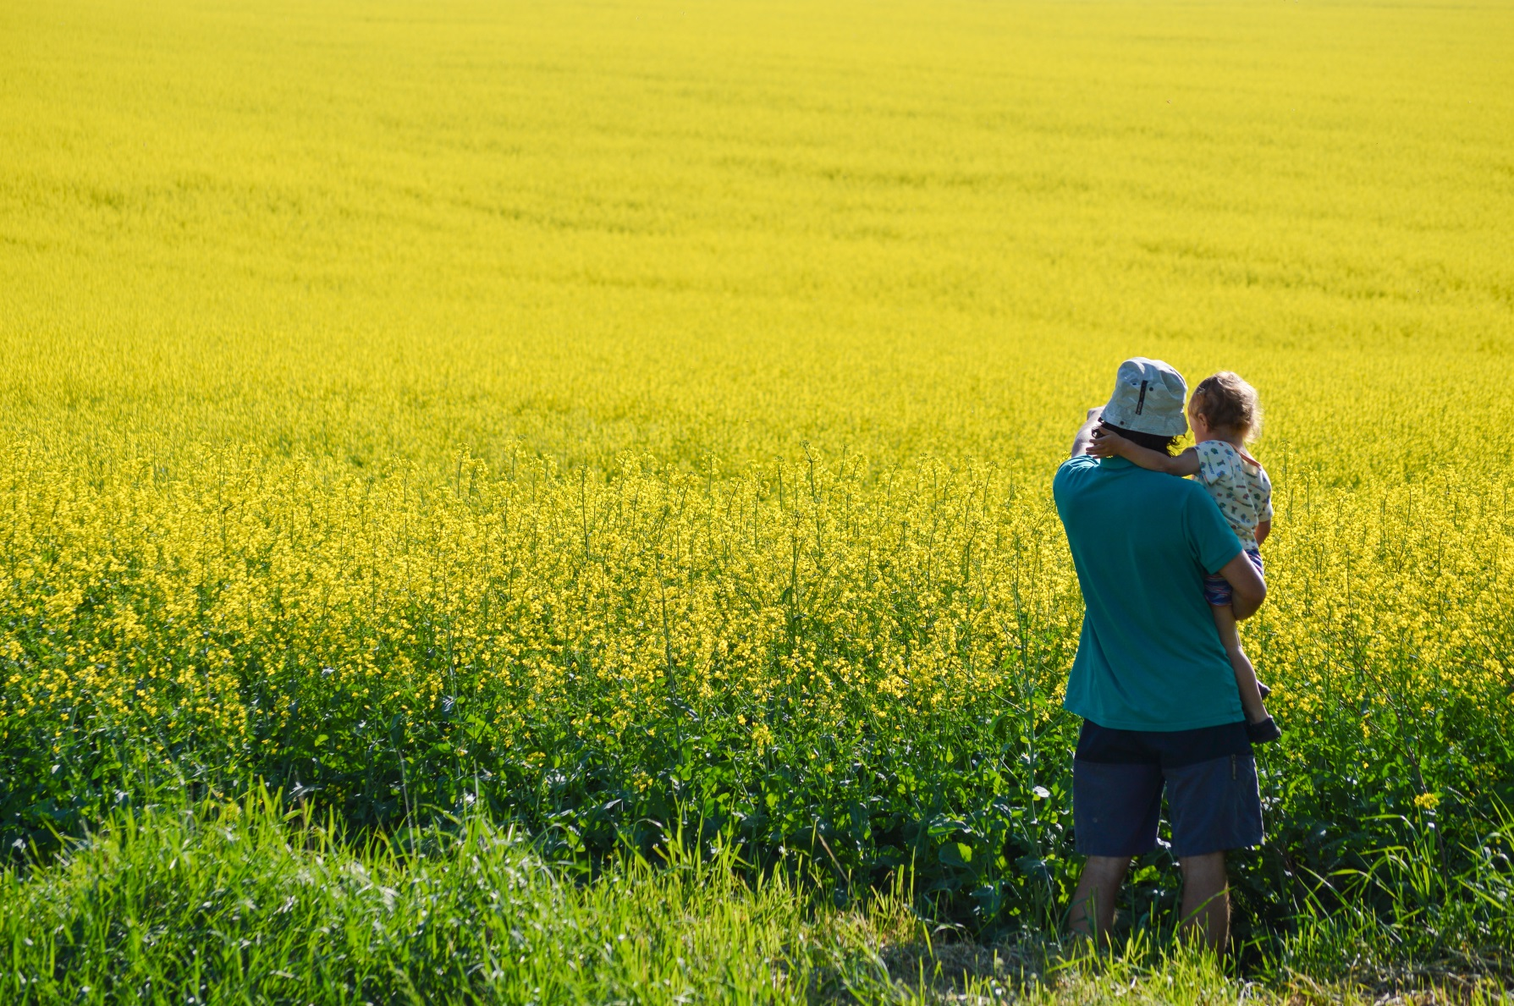
Package or
Combination Policies
Saves $$$
Notes:
The general farm liability policy and commercial business coverage can be combined with a homeowner’s policy. A combination policy makes sense for growers whose farms have both residential and commercial characteristics. Such policies are especially appropriate for family- and individually operated farms (rather than large corporate farming operations). Combination policies generally offer the additional advantage of a lower premium than for two policies purchased separately.

Slide 33
Marketing
Notes:
The way you market and distribute your produce will affect your insurance options.

Slide 34
EXAMPLE (Not a recommendation)
STRAWBERRIES
U-PICK MARKET
GENERAL LIABILITY
RETAIL GROCERY
PRODUCT LIABILITY
GENERAL LIABILITY
WFRP
WFRP
FARMERS MARKET
BUSINESSLIABILITY
WFRP
Notes:
Example: Flowchart example to help participants see the relationship between the Crop, the Market Channel and the Insurance options.
The top square identifies the crop (strawberries)
The second row describes 3 different ways to market strawberries, (u-pick, farmers market, grocery)
The third row identifies SOME of the insurance products they might consider (5 insurance policies)
Please remind your group that each insurance agency will offer different options, the scenarios provided in this presentation are a sample, not recommendations.

Slide 35
Talk with several agencies
Since there is currently no industry standard, and there is a lot of competition for your business, you may find a big variance in rate quotes and service.
Notes:
Insurance agents will ask for specific information before making a quote. Most companies will give an estimate only when growers provide a detailed description of their product, distribution and marketing plans.
Once you have collected the needed information, talk with several insurance providers and research your options.

Slide 36
Beginning Farmer and Rancher Benefits for Crop Insurance
www.rma.usda.gov/pubs/rme/beginningfarmer_2014.pdf
Notes:
There are some special options for beginning farmers and ranchers. In your reference materials, you will find an fact sheet on this topic.
Note, if you have beginning farmers and or ranchers in your audience, make some time to present some of the material.
Factsheet: http://communitydevelopment.ces.ncsu.edu/?p=353238

Slide 37
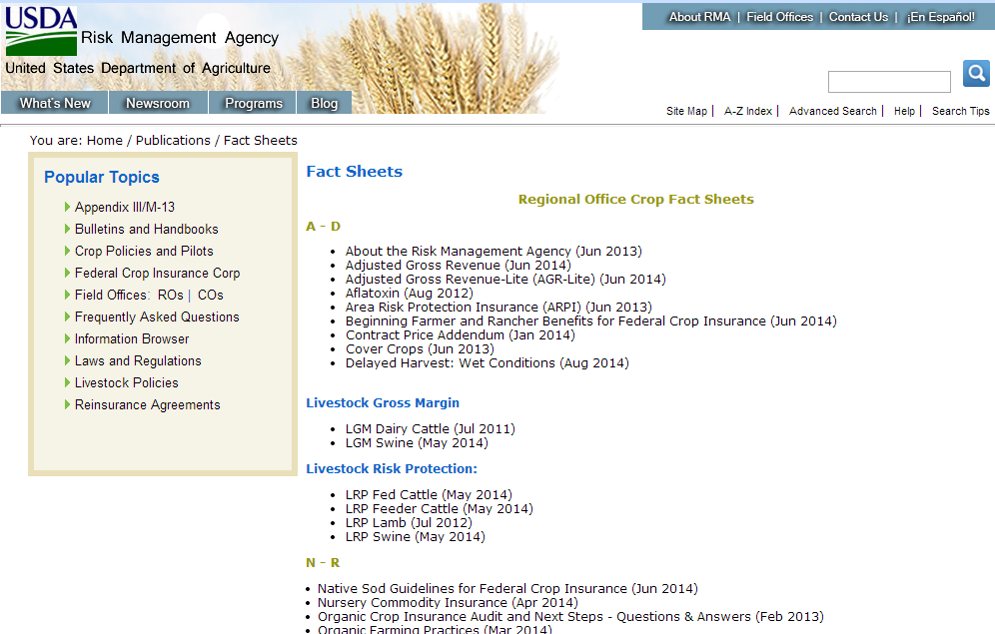
http://www.rma.usda.gov/pubs/rme/fctsht.html
Notes:
The last 4 slides are screen shots taken from websites that would provide good reference information.
If you have access to the internet you could show the participants these webpages and familiarize the group with what information they could find.
This is a good link for farmers to locate Risk management fact sheets on the USDA website.
http://www.rma.usda.gov/pubs/rme/fctsht.html

Slide 38
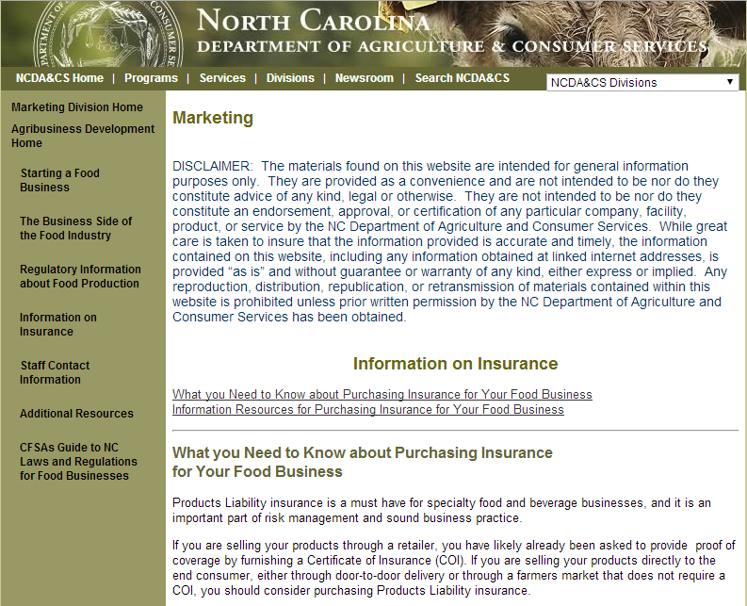
http://www.ncagr.gov/markets/agribiz/insurance.html
Notes:
Link NC department of Agriculture and Consumer Services:
http://www.ncagr.gov/markets/agribiz/insurance.html
This NC website provides insurance information that is similar to what we have reviewed but in more detail.
If you have access to the internet you could visit this webpage and familiarize the participants with what information they could find

Slide 39
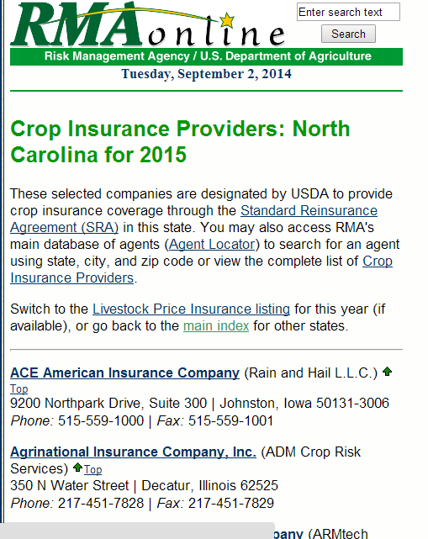
http://www3.rma.usda.gov/tools/agents/companies/2015/north_carolinaCI.cfm
Notes:
Link to NC insurance providers: http://www3.rma.usda.gov/tools/agents/companies/2015/north_carolinaCI.cfm
These selected companies are designated by USDA to provide crop insurance coverage through the Standard Reinsurance Agreement (SRA) in this state.

Slide 40
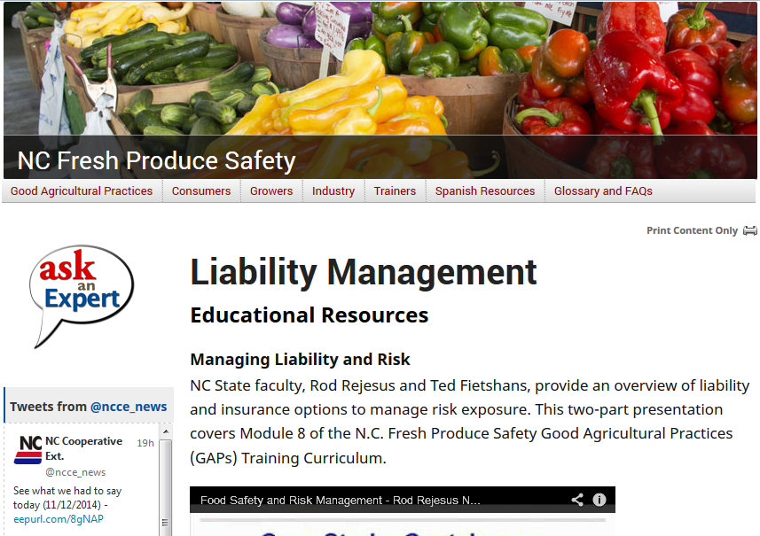
http://ncfreshproducesafety.ces.ncsu.edu/
Notes:
This website represents the “N.C. Fresh Produce Safety program,” part of N.C State University’s Plants for Human Health Institute. The program is led by Diane Ducharme and is based at the N.C. Research Campus in Kannapolis.
Link: http://ncfreshproducesafety.ces.ncsu.edu

Slide 41
References
Insurance Coverage Options for Fresh Produce Growers: Produced by Roderick M. Rejesus, Assistant Professor and Extension Specialist, NC State University; Annette Dunlap, NC Dept. of Ag. and Consumer Services
http://ncfreshproducesafety.ces.ncsu.edu/ncfreshproducesafety-good-agricultural-practices/ncfreshproducesafety-risk-crisis-management/ncfreshproducesafety-liability-management/

