Slide 1
Ten Tips For Running A Successful Meeting
Produced for CultivateNC™
Jackie Miller
NC State Cooperative Extension ANR/CRD

Slide 2
A successful meeting leaves people with a feeling that: - Progress was made - Time was wisely used
- People had fun
Notes:
Definition of a Good Meeting

Slide 3
Tip #1 Share the Responsibility
Notes:
In small informal groups, the meeting coordinator and the meeting facilitator are often the same person, but sharing the responsibilities with another person can keep the project from becoming a burden that destroys enthusiasm and creative energy.
As the project begins to form into action steps, committees can be formed on a project basis and participants can get involved based on the time they have available and specific areas of interest or access to resources that are most critical to that project.
Volunteers from outside the group can also be recruited to help with project steps. This has additional advantage of expanding resources and support for the project.

Slide 4
Tip #2 Find a Good Meeting Location
Easily accessible?
People feel safe?
Adequate for the group size?
Space for projectors and flip charts?
Notes:
Easily accessible?
People feel safe?
Adequate for the group size?
Space for projectors and flip charts?

Slide 5
Tip #3 Plan An Agenda
Notes:
Each meeting should have a clear set of goals. What do you hope to accomplish?
The process does not have to feel formal or stiff but the agenda should provide structure and keep the meeting focused.
Each item on the agenda should begin with an action verb: decide, discuss, review, select etc.
Two weeks before the meeting ask the group if they have agenda items to include.

Slide 6
Sample Meeting Agenda
Welcome and Introductions: Display a large copy of the project goals at each meeting. Define what NEEDS to be accomplished today.
Project Updates: Ask each team member to provide an update. Make a list on a flip chart of problems that were encountered.
Brainstorm Resolutions: Review project goals and objectives; brainstorm resolutions
Notes:
Provide a copy of the Agenda sample, (slides 6, 7 & 8) for each group
Project Updates might be divided into two categories:
Items that need consent to move forward
Items that need to be discussed

Slide 7
Agenda continued
List the Next Steps
Who will be responsible for each step?
Are there any obstacles that may keep you from moving forward?
How can the team help?(this list will be the basis for the next meeting agenda)
Introduce New Items
Allow time for education and dialogue
Notes:
Introducing new items will often require time for participants to be educated about the new item and the reasons why the item is being introduced. Participants will also need time to ask questions, discuss and reflect. In some cases, a new item will be introduced at one meeting but decisions will be made at a later meeting.

Slide 8
Agenda continued
Wrap-up Questions
Does everyone have a good understanding about today’s plans?
Does anything need to be clarified?
Is there anything missing?
Are there any suggestions or changes about the meeting location or format?
Set a date/time for the next meeting

Slide 9
Tip #4 Create A Visual Record
Notes:
Ask one person in the group to take notes in a notebook or on a computer. The notes should be available for reference at every meeting.

Slide 10
Tip #5 Encourage Participation
Notes:
Be interested in the views of every participant
Inspire the group; encourage participation and teamwork
Intervene if the discussion starts to fragment
Prevent dominance and include everyone
Summarize discussions and conversations

Slide 11
Tip #6 Establish Ground Rules
Notes:
Its not necessary for every group to have a set of ground rules, but in some circumstances ground rules can improve communication, minimize disruptions and increase productivity. Each group should discuss and agree to its own ground rules. More detailed information about establishing ground rules can found in the PowerPoint presentation titled, “Decision Making.”

Slide 12
Majority Rules or
Consensus
Notes:
Decision-making is the one ground rule you may want to establish at your first meeting. For example, there may be two options for achieving your goal and the group is divided on how to move forward. In these situations there are two basic methods for decision making: majority rules or consensus. If the majority rules, the group can opt for a 2/3 majority or the project leader can have the final say. For consensus, the group must all agree before a decision is final.
Consensus Process
The rule is that no decision is made until everyone agrees
The facilitator should state the question
Clarify the question
Members are encouraged to share their interests and concerns
During discussion, the facilitator takes a consensus check by asking everyone to rate their current view of the issue on a scale of 1 – 4. A rating of:
4 means you are strongly in favor
3 means you favor but with reservations
2 means you oppose but will not impede consensus
1 means you strongly oppose and will impede consensus
This rating tells the group where they stand and makes sure all interests and concerns are raised and discussed.

Slide 13
Tip #7 Setting Deadlines will Stimulate Action
Notes:
The effectiveness of a meeting can be measured in terms of its outcomes. It is the leaders job to be clear at the end of every meeting who is responsible for what and by when. (We refer to these as action steps or next steps). Setting a deadline will help stimulate action.

Slide 14
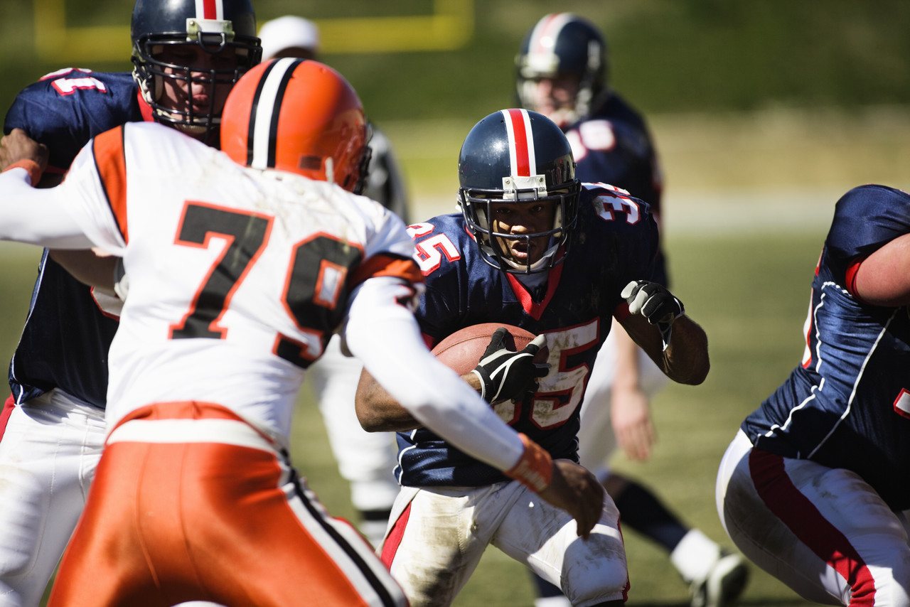
Tip #8 Conflict Management
Notes:
Conflict can be healthy in a group. It shows that members are taking ownership and sharing their ideas honestly. However, there are times when healthy conflict escalates and ceases to be constructive. Since emotions resulting from conflict tend to intensify over time. It is important to address the conflict as soon as it begins to become unhealthy.
When conflict does occur, some people will want to debate (argue about who is right or wrong) while others will shy away from conflict. They may even decide to go along with the group just to avoid conflict.

Slide 15
Strategies for Handling Conflict
Lead the discussion away from intense language
Promote information sharing
Notes:
The facilitator or leader should guide the group away from intense language or overly passionate discourse and encourage dialogue that promotes information sharing and understanding. For example, one person may have additional information that is affecting their decision. Sharing this information will allow the group members to be better informed and understand why a person has strong feelings. With the additional information, the group may have an easier time of finding common ground and moving away from conflict into discussion and strategizing.

Slide 16
Tip #9 Keep The Meetings Short
Notes:
Meetings tend to fill-up whatever time was allotted, but your participants will appreciate a meeting that stays focused and adjourns on time or even a little early.

Slide 17
Tip #10 Celebrate the Small Wins!
SMALL WIN
SMALL WIN
SMALL WIN
SMALL WIN
Notes:
Celebrating the small but significant milestones and achievements along the way lifts the spirit of the group and provides a catalyst that motivates the team to move forward. (Harvard Business Review: http://hbr.org/2011/05/the-power-of-small-wins/)

Slide 18
Bonus Tips: Strategies for minimizing common meeting obstacles
Notes:
The tips for minimizing common meeting obstacles came from: Growing Communities Curriculum: Community Building and Organizational Development through Community Gardening (2nd Edition) Columbus, Ohio: American Community Gardening Association pg 142.

Slide 19
Working Towards Group Agreement
When participants seem totally blocked and unable to break through an impasse, go back to the initial question or purpose of the activity and restate it.
Ask which alternatives are supported by data.
Notes:
For large groups, see the Decision-Making PowerPoint presentation for additional ideas and activities.

Slide 20
When a Point is being Discussed to Long
Notes:
Summarize and suggest tabling the question for a later time…perhaps later in the meeting agenda or at the next meeting

Slide 21
Coping with a One-Person Show
Notes:
Interrupt with “You have brought up many good points that will keep us busy for a long time. Would anyone like to take up one of these points?”

Slide 22
When a Speaker Drifts from the Subject
Notes:
Bring the discussion back to the topic by using the related ideas
Ask the group if they would like to continue the discussion or return to the agenda
Explain that there isn’t time to go down that road today, due to limited time and goals we need to focus on the organization more globally; we should get together another time to talk about that.”

Slide 23
When a Participant has Difficulty Expressing Their Thoughts
Notes:
State appreciation for what has been said and re-phrase the material with a preface such as, “Is this what you mean, Ms Jones?”

Slide 24
Ten Tips for Running Successful Meetings
Adapted from Growing Communities Curriculum: Community Building and Organizational Development through Community Gardening (2nd Edition) Columbus, Ohio: American Community Gardening Association

