Slide 1
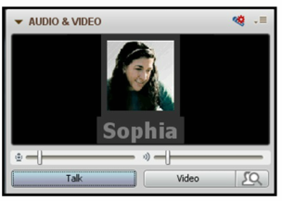
Welcome to the CultivateNC Lunch n’ Learn. Our program will begin at 11:30 EDT.
Chatbox (lower left corner): For guests who are not part of Cooperative Extension please type your email address into the Chat Box so we can email any materials that may be available.
Please use the Chat box for questions during the presentation.
To configure your audio and microphone click the set-up
button located in the Audio & Video panel and follow the
steps.
Q&A: You can ask questions through Talk or Chat.
To talk, click on the hand icon to alert the moderator.
Click on the talk button in the Audio/Video panel when the moderator calls on you. Remember to unclick the talk button when finished to eliminate background noise.
Notes:
(Becky): Good morning and welcome to the CultivateNC Lunch n’ Learn Series. My name is Becky Bowen, and I am the Program Manager of CultivateNC, a new community development program of the North Carolina Cooperative Extension Service. Before we get started with today’s presentation: Redevelop, Re-energize, and Reinvent, I want to quickly review some features of the Collaborate system. For our guests who are not part of Cooperative Extension please type your email address into the Chat Box, found in the lower left corner of your screen. That way we can capture your contact information for future emails about this series.
For everyone attending today, please use the Chat box for questions during the presentation. We hope to have 15 minutes at the end of this presentation for our presenter to answer your questions.
To configure your audio and microphone click the set-up button located in the Audio & Video panel located in the top left-hand corner of your screen. Follow the steps for set-up there.
For Q&A, you can either talk by clicking on the hand icon to alert me as your moderator, who will call on you when your time comes. You can then click on the talk button in the Audio/Video panel to ask your question. Please remember to unclick the talk button when you are finished

Slide 2
Notes:
(Susan): Good morning. This is Dr. Susan Jakes, and before we begin, I would like to give a little background on the CultivateNC program.
CultivateNC evolved from a pilot project in Anson and Stanly Counties, called Creativity Inc. (Some of you may recall that Creativity Inc. had been a program that came through the Institute for Emerging Issues.) The information that was garnered from that project was put into a curriculum that would be useful for Cooperative Extension.
As we did this we became increasingly interested in spurring public innovation, so instead of focusing on just creativity, we wanted to help communities inclusively convene to innovate around important issues and opportunities. We also incorporated youth as the action researchers to do the asset mapping background work for this community innovation.
When all of this was put together it was a gigantic endeavor that few have time to embark upon. We then began to think about how this could be broken into meaningful pieces to make it most useful in community projects. In the course of this work CultivateNC was born. CultivateNC seeks to guide Communities Uncovering Local Talent: Inspiring Vibrant and Transformative Economies. This work can be around ag, youth, local food…
One of the outcomes of the curriculum was a series of PowePoint presentation tools.

Slide 3
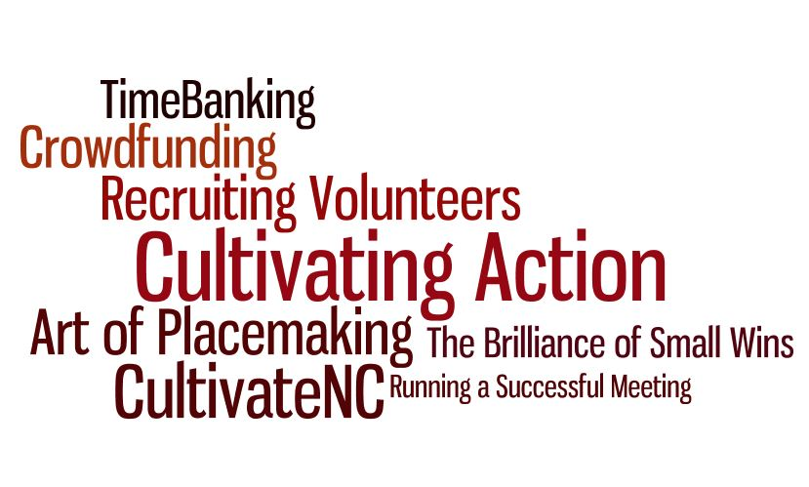
Notes:
(Becky): Today’s webinar is an introduction to this series of PowerPoint presentation tools, which can be found in the North Carolina Cooperative Extension Community Development portal. For those of who are familiar with this portal, we invite you to go there now to check it out. For those of you who are not familiar with the portal, we will give its web address later on in this presentation.
Today’s presenter, Jackie Murphy Miller, is the author, artist, poet, composer, and designer who has created all of the PowerPoint presentations that comprise the Cultivating Action series. She is a staff member of CultivateNC, who along with Dr. Jakes and myself, is seeking to create local resources in community development within the North Carolina Cooperative Extension Service.
Listed on this slide are the presentations that have been created so far by Jackie. They include a presentation on TimeBanking, Crowdfunding, Recruiting Volunteers, the Art of Placemaking, the Brilliance of Small Wins, and running a Successful Meeting. These presentations are brief, relevant, and most importantly, easy on the eyes and ears. We believe that they will help you make a difference in your community.
Jackie, I’m sure everyone is anxious to hear your thoughts on each of these presentations, so please take it away . . . .

Slide 4
Capacity Building Tools
Notes:
Thank you Becky, I started to develop these PowerPoint presentation tools for the CultivateNC curriculum. In the curriculum we suggest convening monthly breakfast meetings. At these meetings we have three goals:
strengthen community connections
increase our knowledge of local problems and resources
Provide short skill-building presentations and to make that easier we thought we could build some skill-building presentations
But, they kind of took on a life of their own and we soon realized that these tools could be used in a variety of community development programs. Some of the presentations focus on skill-building while others introduce new and emerging development topics. But the overarching goal of both is to give you the tools that will help grow your community.

Slide 5
Ten Tips For Running A Successful Meeting
Created by Jacqueline Murphy Miller for CultivateNC
Notes:
For example: Ten tips for running a successful meeting is a skill-building tool in the Cultivating Action series. For most of you, running a meeting is second nature, but there are many people in the community who have not had the opportunity to learn those skills. This type of presentation might give that person more confidence and willingness to participate; or it might enable a PTA president to make their meetings more productive and engaging.
To give you a taste of how these presentations work lets review a slides

Slide 6
Notes:
This is a screen shot from the presentation. This is Tip #1 Share the Responsibility. Below the slide you can see the trainer notes are included. These notes can be downloaded and read during your presentation or you can simply put the ideas into your own words.

Slide 8
Notes:
Tip # 3: If we were looking at the actual presentation this slide would followed by another slide with suggestions and ideas for crafting an agenda.

Slide 9
Notes:
You have probably noticed by now that I try to keep the message simple. Most people cannot absorb a message from a slide full of text. When I am creating slide I ask myself what is the one message I want people to remember?

Slide 10
Notes:
You will also notice, that the photos are vivid and humorous or playful. The idea is to keep the audience engaged and hopefully a little bit entertained.

Slide 11
Recruiting Volunteers
Created for CultivateNC™
Jacqueline Murphy Miller
Notes:
Recruiting Volunteers is another skill-building tool in the Cultivating Action series. It would be useful for leadership training, or advising a community group such as the County Fair committee on how to build their volunteer base.

Slide 12
Notes:
This is a screen shot from the Recruiting Volunteers presentation. This training tool includes a broad overview from How to write a volunteer job description to

Slide 13
Notes:
To looking for potential volunteers.
If you look at the facilitator notes you will see I Have added an activity. As you know, an activity is a good way to keep the audience engaged. You can choose to use them or not depending your group and the time available.

Slide 14
Created by
Jacqueline Murphy Miller
for CultivateNC
Notes:
Not all of the Cultivating Action tools are trainings, some of the tools are created to introduce a new idea or concept such as crowdfunding.
If you have a group that is looking for ideas to raise funds, Crowdfunding can be a good option.
I have selected two examples of local crowdfunding projects to inspire you.

Slide 15
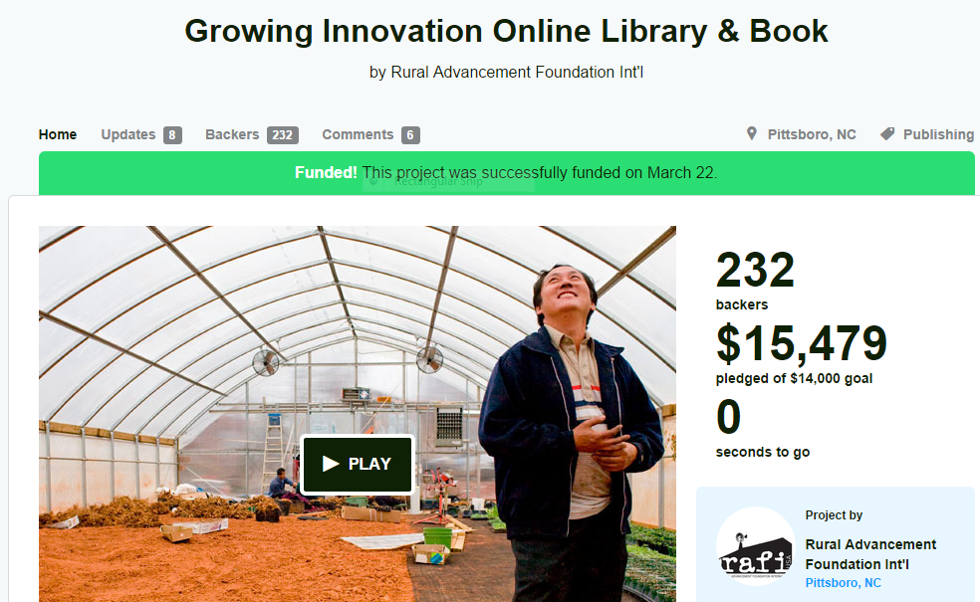
Notes:
This slide is a screen shot taken from Kickstarter.com, a crowdfunding website.
If you look closely you will see that our local nonprofit RAFI wanted to raise funds to build an online library of agricultural innovations developed by farmers and create a book celebrating their ingenuity.
They needed $15,000 and as you can see they went over their goal.
https://www.kickstarter.com/projects/rafiusa/growing-innovation-online-library-and-book?ref=card

Slide 16
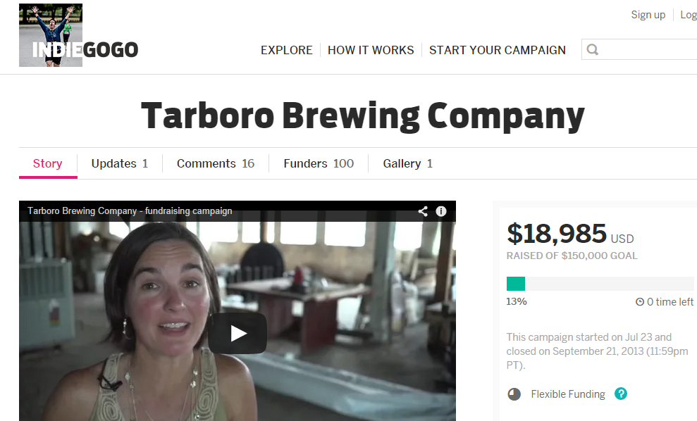
Notes:
The second example is a couple that own a restaurant called On the Square in downtown Tarboro. They had an opportunity to purchase a old nearby building and wanted to open a brewery. They decided to use the INDIEGOGO crowdfunding service. They didn’t raise all the money, but they raised close to $19,000 to get things started.
If you are interested in learning more about the Tarboro Brewing Company, be sure to check out the Crowdfunding tool. There is a short video at the end of the presentation that gives information about the brewery and the crowdfunding.
Link to Crowdfunding: http://www.ces.ncsu.edu/wp-content/uploads/2014/06/Crowdfunding.pdf

Slide 17
The Art Of Placemaking In Community Development Part One: An Introduction Created by Jacqueline Murphy Miller for CultivateNC
Notes:
This is the title slide for The Art of Placemaking in Community Development. it is a three part series that provides a framework for developing a public space such as a park, outdoor market or skateboard ramp.
This training tool provides a basic outline to guide the group through the process of planning, organizing and building a foundation.
It is divided into three presentations because the subject is too large but, it created an opportunity to get the participants involved with homework activities. Next slide

Slide 18
Notes:
For example: Learning what the community thinks of the idea is an important first step in the planning process.
By conducting a survey you can learn about
Issues or concerns,
If nearby businesses or residents have concerns, its better to learn about problems early to see if they can resolved.
good suggestions,
potential support or partners
The survey questions could be written at the meetings and then depending on the size of the group, some or all of could volunteer to survey a certain area or group to learn what others think.

Slide 19
Placemaking in your community
Notes:
Let’s say for example that a group in your community has an idea for a project and have asked you to facilitate the process. The framework provided in this presentation series might make it easier for you to yes.

Slide 20
The Brilliance
of Small Wins
Notes:
Another tool, that would be appropriate for project planning is the Brilliance of Small Wins. In fact, this would be a good introduction tool to use before moving into the Art of Placemaking. The focus of this presentation is about thinking smaller. Here is how the presentation begins: next slide

Slide 21
Many great plans get bogged down because they are: -Too big -Too expensive -Take to long

Slide 22
One way to overcome these pitfalls is to think smaller
Notes:
County Director Susan Kelly recently used “The Brilliance of Small Wins” for a group discussion on revitalizing downtown Rockingham.
I asked Susan if she could provide some feedback that I could share in this presentation.
It definitely saved me time, she said and more importantly gave me the idea for giving the presentation in the first place. It just happened to fit in to what we have been discussing at our downtown partnership meetings. It presentation was very easy to use and the notes were very helpful. A good length too.

Slide 23
Great ideas start with you
Notes:
Every time you provide a brown bag lunch training, convene a workshop or give a presentation to a town council meeting you are building capacity in your community. Our hope is that these Cultivating Action tools will make that job a little easier.

Slide 24
Co-facilitator
Notes:
These PowerPoint presentations are like having a co-facilitator that you carry around in your pocket and pull out when needed. The presentations have facilitator notes and some include activities to guide the group; but if you have the time you can add your own stories or new slides to create your own spin on the presentation.

Slide 25
Cultivating Action Tools
The Art of Placemaking I, II, III
The Brilliance of Small Wins
Crowdfunding
TimeBanking
How to Run A Successful Meeting
Recruiting Volunteers
More to come…
Notes:
In 2012, Extension filled out a CRD survey. One area that was identified for improvement was training tools. There were comments that indicated that many of you had to visit other university sites to find the tools you need.
This list of Cultivating Action tools is just the beginning but we could use your help to identify the training topics you would like to see on this list.

Slide 26
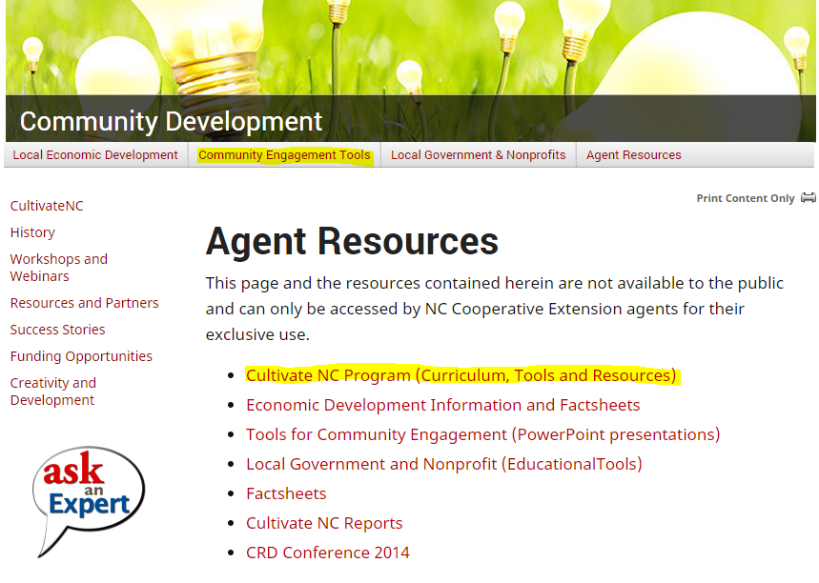
http://communitydevelopment.ces.ncsu.edu/
Notes:
The action tools can be found in two locations on the community development portal.
For public viewing, all of the Cultivating Action presentations are available in PDF format. The PDF’s are found in Sub-menu titled Community Engagement Tools (highlighted in yellow) right below the black bar.
The PowerPoint versions, are located in Agent Resources (highlighted in yellow in the center of the page). The PowerPoint format includes the facilitator notes and gives you the flexibility to include additional slides and create a presentation that is more personal to your community or to fit your goals.

Slide 27
Troubleshooting: If you can’t see the facilitator notes
Download and save the presentation to your computer first, and then open the presentation using your PowerPoint software.
Notes:
If you have questions about resources please contact Jackie or Becky.

