Slide 1
Forest Certification Applications for Small Private Landowners
Susan E. Moore, Ph.D.
Extension Associate Professor
Department of Forestry & Environmental Resources
North Carolina State University

Slide 2
Outline
What is forest certification?
The debate
The demand
Existing forest certification systems applicable to small landowners
Landowner interests and concerns
Role of Extension in informing and educating

Slide 3
Forest Certification
The process of evaluating forests or woodlands to determine if they are being managed according to an agreed set of standards
A method of identifying woodlands managed with a goal of sustainability
An attempt at a market-driven reward system for well managed forests
Started in 1993 by Forest Stewardship Council
(American Tree Farm System, 1940s)

Slide 4
Certification Systems Available in NC
Forest Stewardship Council
Program for the Endorsement of Forest Certification – Umbrella organization
Sustainable Forestry Initiative
American Tree Farm System

Slide 5
General Certification Debates
Effectiveness – better practices and more benefits
Focus – environmental, social, economic
What’s included in Standards
Plantations
Rigor vs. enrollment
Green authority or greenwash
Inspection and audits
Revisions, strictness, regulatory “creep”
Costs vs. Benefits
Maintenance / continuous improvement
And more
Notes:
Extension should avoid entering these debates – we can provide information from research studies.

Slide 6
Growing Demand
Green Building Programs
US Green Building Council membership has more than tripled since 2000
Number of LEED projects increased 400% from 2005 to 2008
Green building market is projected to more than quadruple over the next few years (from $12B to $60B)

Slide 7
Growing Demand
Additional opportunities for small private landowners?
Paper
Furniture
Carbon offsets
Biomass

Slide 8
Programs
American Tree Farm System
Individual – State Committee
Group Certification
Third party
Forest Stewardship Council
Family Forest Certification
Group Certification
Forest Management Certification

Slide 9
American Tree Farm System
www.treefarmsystem.org
www.affoundation.org
Notes:
9
Introduction – Agenda

Slide 10
Tree Farm Mission
To promote the growing of renewable forest resources on private lands while protecting environmental benefits and increasing public understanding of all benefits of productive forestry

Slide 11
National Tree Farm Statistics
90,000 Family Tree Farms
24 Million Certified Acres -- 1 in 10 Forested Acres in US
4,000 Volunteer Foresters / Inspectors

Slide 12
AFF Standards
New Standard for 2010-2015 released on January 1, 2010
Developed specifically for small woodland owners
Management plan requirements streamline the process for landowners to participate in USDA conservation incentive programs
Standards now require maintenance of special cultural and environmental sites [historical, archeological, geological, biological and ecological sites]
Periodic monitoring has been added to encourage landowners to monitor their woodlands for changes that could interfere with their management objectives
Landowners are encouraged to make practical efforts to prevent, eradicate or otherwise control invasive species using a range of integrated pest management methods

Slide 13
Process for ATFS Certification
Initial inspections can be prompted by several means; 1.) inquiry from property owner to state committee, 2.) referral from certified forest owner, 3.) invitation from state committee member, 4.) recommendation from other parties
Following initial contact, an inspecting forester is assigned by the state committee to visit the forest owner and conduct an on-the-ground inspection of the property
The inspecting forester undertakes a document review of the management plan and assesses its adequacy
The forester inspects the property to measure conformance to the AFF Standards of Sustainability

Slide 14
ATFS Eligibility – Acreage Requirements
State Tree Farm Committees may enroll properties from 10-10,000 acres
Group programs may be 10-20,000 acres
Individual third-party certificate holders may include under their certificate contiguous properties from 10 – 20,000 acres
ATFS acreage limits apply only to contiguous parcels:
defined as discrete parcels that share a boundary line or corner point and are held under the same legal ownership.

Slide 15
ATFS Eligibility – Landowner Requirements
Ownership must be privately held and not publicly traded
Ownership may be a public entity such as municipalities, schools, public and private universities and watersheds
Properties owned by state government organizations must undergo third party certification assessments

Slide 16
ATFS Eligibility – Landowner Requirements
Properties must be non-industrial but may be associated with small local business (annual receipts less than $7M and less than 500 employees)
Owner must clearly exhibit commitment to sustainable management though management objectives or management plan
Owner(s) demonstrates proactive forest management involvement
Owner(s) is engaged in active outreach efforts or can contribute to the effort

Slide 17
Forest Stewardship Council
www.fscus.org
www.fsc.org

Slide 18
FSC Mission
To promote environmentally appropriate, socially beneficial, and economically viable management of the world's forests.

Slide 19
FSC Principles
Compliance with laws & FSC principles
Tenure and use rights & responsibilities
Indigenous people’s rights
Community relations & worker’s rights
Benefits from the forest
Environmental impact
Management plan
Monitoring and assessment
Maintain high conservation value forests
Plantations

Slide 20
Forest Stewardship Council
Family Forest Certification Standard:
Any forest management unit with a total forest area of 2,470 acres or less is eligible to be considered a Family Forest and to use the FSC-US Family Forest Standard

Slide 21
FSC Family Forests Program
For small-scale forest owners, non-timber forest product producers and forest operations producing low-level harvesting (average annual harvest is no more than 20% of mean annual increment)
Streamlines the technical requirements for management plans, assessments, and monitoring
Notes:
Allows small, low intensity managed properties to be evaluated for FSC certification using modified certification procedures and a set of forest management standards that take into account scale and intensity of small forest management operations.

Slide 22
Family Forest Standard
Indicator 4.4.b The forest owner or manager seeks and considers input in management planning from people who would likely be affected by management activities.
FF Indicator 4.4.b Low risk of negative social or environmental impact.
Indicator 6.3.b To the extent feasible within the size of the ownership, particularly on larger ownerships, management maintains, enhances, or restores habitat conditions suitable for well-distributed populations of animal species that are characteristic of forest ecosystems within the landscape.
FF Supplementary Applicability: The ability to address the intent of this Indicator is based on size of ownership. The landowner or manager shall assess whether or not these habitat conditions can be maintained, enhanced and/or restored.

Slide 23
FSC – Group Certification
A process by which multiple landowners or forest managers are certified under one FSC certificate
A Group Manager holds the certificate
Economies of scale for
preparing multiple management plans,
implementing management activities,
conducting sales and marketing
sharing the costs of preparing for, obtaining, and managing certification

Slide 24
Southern Forests Network
www.southernsustainableforests.org/GCP/Certification.htm
The Southern Forests Network’s Group Certification Program provides private forestlands and small facilities with FSC certification and technical assistance.

Slide 25
Landowner Issues
Awareness
Confusion
Cost
Lack of markets (?)
Private property rights

Slide 26
Extension’s Role
Educate
Publications
Webinars
Teleconferences
Field Days
Demonstrations
Remain neutral between systems

Slide 27
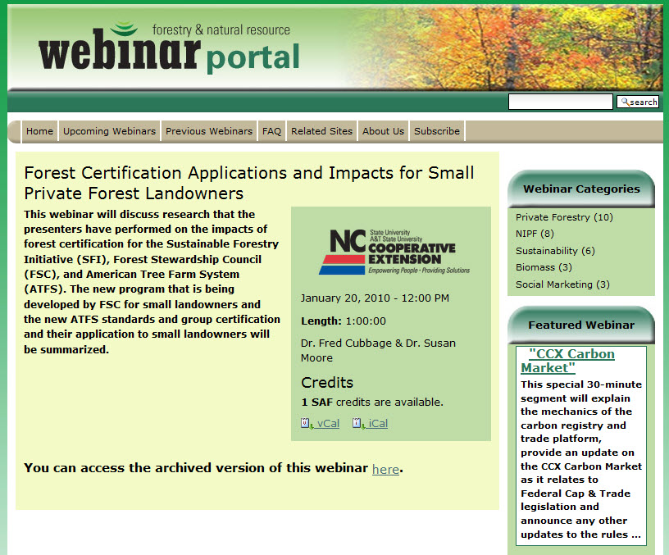
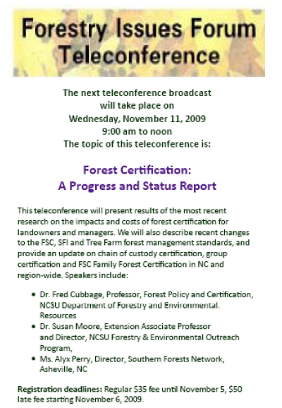

Slide 28
Sources of Information
www.treefarmsystem.org
www.affoundation.org
www.fscus.org
www.southernsustainableforest.org
www.familyforestsalliance.org
http://www.fscus.org/standards_criteria/family_forests_program.php

