Slide 1
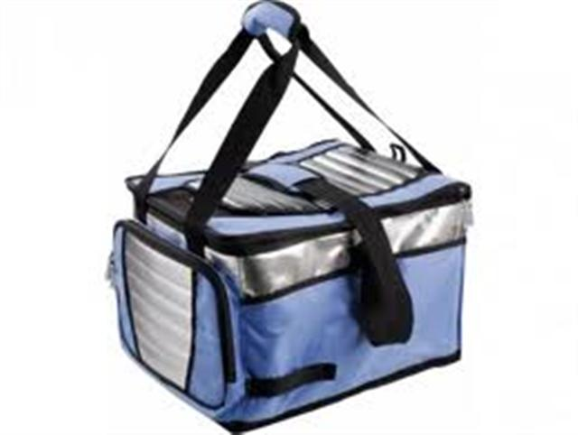
Field Trip and Food Transport: Do It Safely
Ben Chapman and Katrina Levine
North Carolina State University
April 30, 2015

Slide 2
NC Department of Public Instruction (NC DPI)
Resources for food safety for field trips:
http://childnutrition.ncpublicschools.gov/information-resources/haccp-food-safety/haccp-continuing-education/field-trip-safety/field-trip-safety

Slide 3
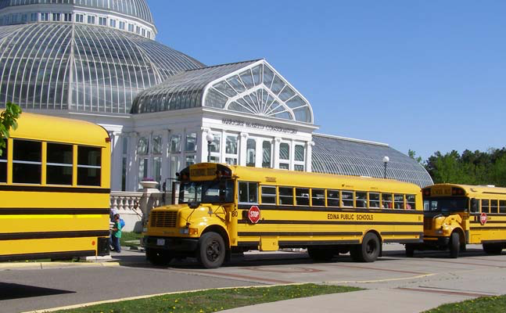
While temperature control of food can be a challenge in any school nutrition operation
More challenging for meals served off premises on field trips.

Slide 4
90% of food items in sack lunches were at unsafe temperatures (Almansour et al., 2011)
The temp of refrigerated foods reached Danger Zone within 10 minutes of being in a car trunk exposed to sunlight

Slide 5
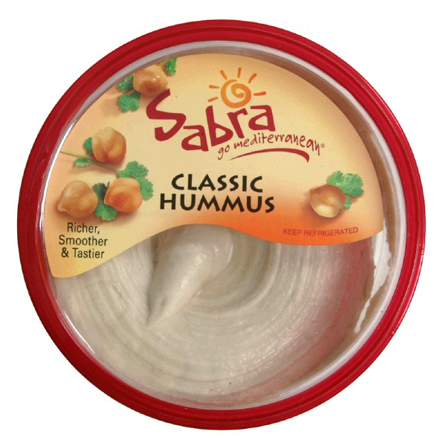

Slide 6
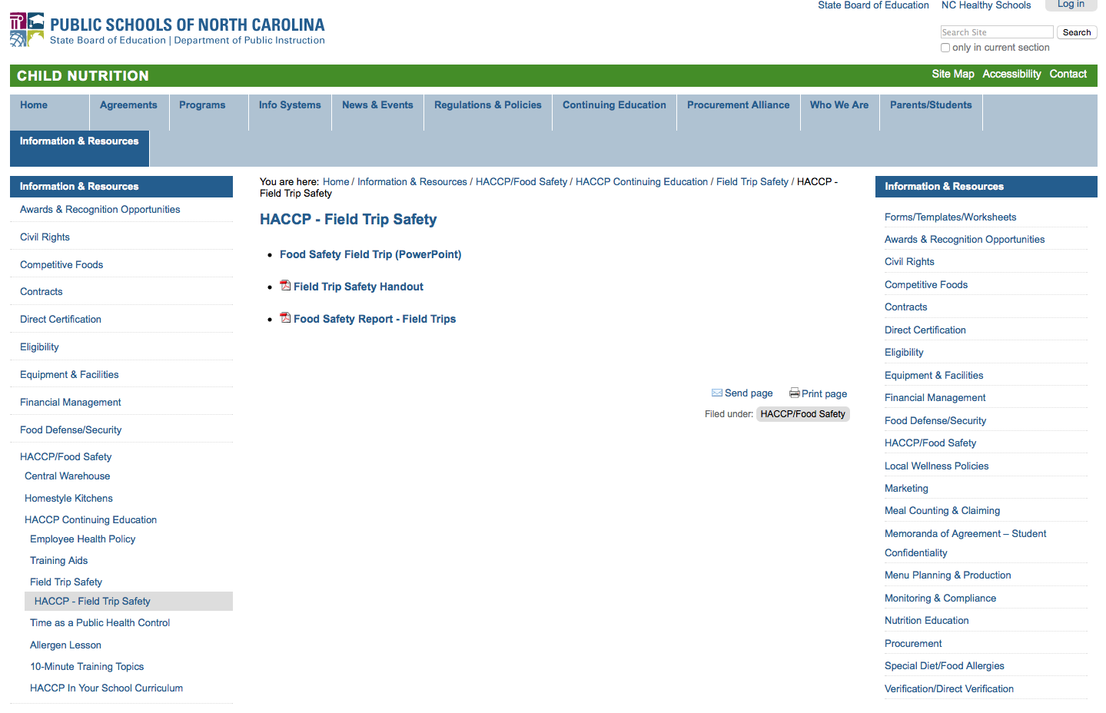

Slide 7
http://childnutrition.ncpublicschools.gov/information-resources/haccp-food-safety/haccp-continuing-education/field-trip-safety/field-trip-safety

Slide 8
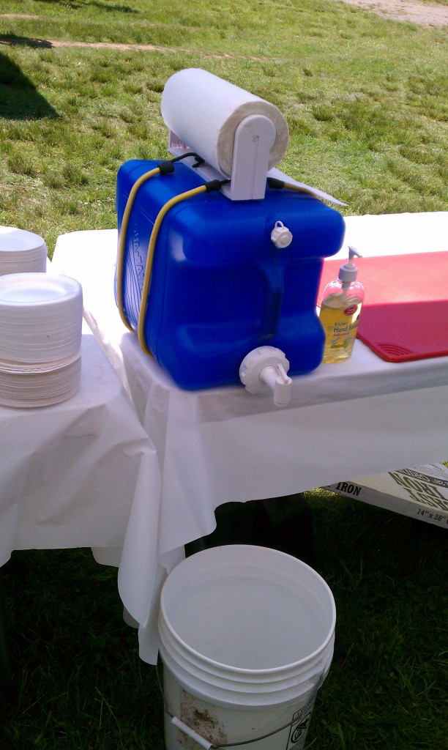
Summer nutrition program data:
Handwashing
Temperatures

Slide 9
Why is food safety a concern?
It’s difficult to control food temperatures when we travel
Harmful bacteria grow quickly between 41°F and 135°F (Temperature Danger Zone)
Notes:
School nutrition staff, teachers, other school staff, parents and volunteers must work together to ensure that field trip meals are safe to eat.
It’s difficult to control food temperatures when we travel. We don’t take our refrigerators/freezers with us, and the equipment and tools we use to keep cold foods cold and hot foods hot are not ideal.
Harmful bacteria grow quickly between 41°F and 135°F (Temperature Danger Zone), so perishable foods and beverages won't stay safe long when being transported.
Fortunately, there are things you can do as a food service employee to reduce the risk of getting foodborne illness from foods that must be transported. We are going to talk about these risk-reduction practices today.

Slide 10
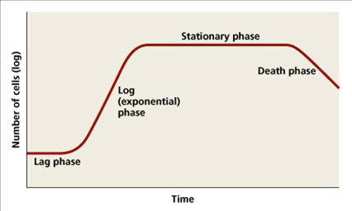

Slide 12
The “Bad Guys”
Pathogen | Foods Commonly Affected
Staphylococcus aureus | Dairy, uncooked and ready-to-eat TCS foods
Escherichia coli O157:H7 | Meats, fruits and vegetables, dairy
Salmonella | Meat and poultry, fruits and vegetables, eggs, dairy
Listeria monocytogenes | Refrigerated ready-to-eat foods, fruits and vegetables, dairy, meat and poultry, seafood
Campylobacter | Meat and poultry, dairy
Clostridium perfringens | Meat and poultry, stews, casseroles, gravies
Clostridium botulinum | Fruits and vegetables, dairy
Shigella | Seafood
Bacillus cereus | Cooked foods (especially rice)
Vibrio | Seafood
Yersinia | Pork
Notes:
Should we go over the types of bacteria commonly related to temp abuse? It seems like a pretty long list. If so, this table needs work.
http://www.homefoodsafety.org/food-poisoning/foodborne-pathogens

Slide 13
What should be kept cold?
Deli sandwiches
Turkey, ham, roast beef, chicken and tuna salads, etc.
Cut fresh fruit and vegetables
Melons
Tomatoes and leafy greens
Except whole fruit and pre-packaged, shelf-stable cut fruit like fruit cups and applesauce
Dairy products
Milk, yogurt, cheese
Except UHT shelf-stable milk
Notes:
These foods – known as TCS, or Time as a Control for Safety, foods - are the types of foods that should be kept in portable cold storage units. This means that they must either be held at or below 41°F or consumed within 4 hours (or 1 hour if the temperature is above 90°F).
Deli sandwiches – turkey, ham, roast beef, chicken and tuna salads, etc.
Cut fresh fruit and vegetables, especially melons, tomatoes and leafy greens (excludes whole fruit and pre-packaged, shelf-stable cut fruit like fruit cups and applesauce). This includes foods prepared with these, such as a peanut butter and banana sandwich, salads, or a fresh fruit cup.
Dairy products – milk, yogurt, cheeses
What about bruised/damaged whole fruit?
Baby carrots?
Shelf-stable milk/dairy?
Pre-packaged juice?

Slide 14
Planning Ahead
Think about:
Weather conditions
Length of the trip
Amount of food
Resources you have for packing and transport
Food allergies/special needs
This can affect:
Type of food served
How it is packaged/transported
Notes:
Planning ahead can help you choose ways to prepare and package food for trips that reduces the risk of foodborne illness. If you are able, find out the details of the trip, especially where they will be going and how long the trip will be. Check to see how much food will be needed and what resources (coolers, containers, etc) you have for packaging and transporting the food.
Think about the weather or environmental conditions during the trip. Will it be very hot? Will food be held near sunny windows?
Consider when the food will be packed and when it will be eaten. How long will the food be kept in transportation storage containers?
Think about the amount of food that may need to be kept cold and the equipment available for cold storage transport. Will the coolers be big enough, and do they seal completely? Can TCS foods be packaged separately from non-TCS foods to minimize cooler space needed?
Also, consider any food allergies or special dietary needs. How can you prevent cross-contamination of allergy-free foods?
These factors can affect what type of food is packed and how it is packaged for transport. For example, if adequate coolers are not available, select foods that do not need to be kept cold for safety, such as whole fruit or plain nut butter sandwiches. It is important not to overpack coolers, or use ones that do not seal tightly, because this will make it harder to keep foods cold enough. Using the same transport container for regular and allergy-free foods could lead to cross-contamination.

Slide 15
Food Allergies/Special Needs
Find out if there are any food allergies or special needs
Prevent cross-contamination of allergy-free foods:
Prepare and assemble them separately using cleaned and sanitized equipment/surfaces
Keep any allergen-free foods separate when packing
Clearly label any special foods and make sure the person distributing the food knows where they are

Slide 16
Preparing the Food
Wash hands before starting
Use cleaned and sanitized equipment and surfaces
Keep assembled and cut foods in tightly wrapped or sealed containers
Refrigerate TCS foods (see list) at 41°F or below until ready to pack
Notes:
Monitor how long food is out during prep/assembly? Time/temp logs?
Preparing day of vs in advance

Slide 17
Packing the Food
Receive cold perishables at or below 41°F
Date and time mark when it was removed from refrigeration
“must be eaten or discarded by: xx (time)” – should be 4 or 1 hour(s)
Notes:
Receive all cold perishable foods at 41°F or below from the school nutrition staff and note the time that the food was removed from refrigeration temperatures in the cafeteria and mark the storage cooler with a “Must be eaten or discarded by: xx (time)” message (i.e. the message should be either 4 hours or 1 hour depending on the storage temperature). Cold foods should be kept below 41°F OR eaten within 4 hours if stored below 70°F OR eaten within 1 hour if kept at temperatures above 90°F.

Slide 18
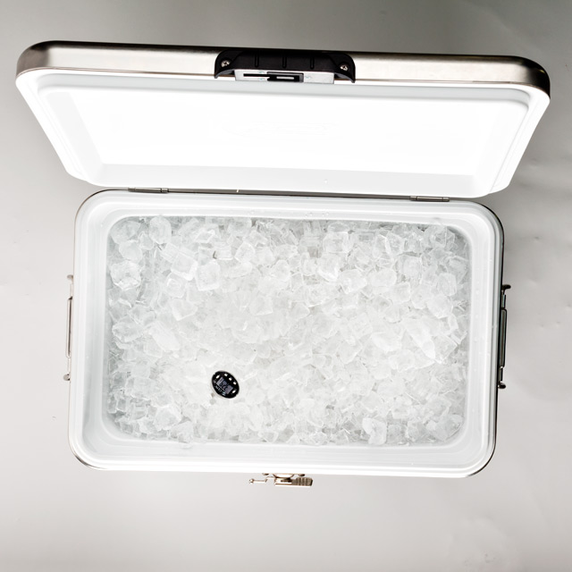
Monitoring Temperatures
Make sure portable food transportation units are cleaned and sanitized
Keep these units tightly closed until all meals distributed
Notes:
If items are placed in portable food transport units (such as coolers), keep the units tightly closed until meals are distributed. These units should have an ambient air thermometer or a probe thermometer inside of the unit and the temperature of the perishable foods should not be above 70 degrees for more than 4 hours.
More on Time as a Public Health Control
Time/temp logs?

Slide 19
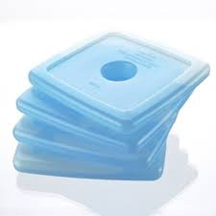

Slide 20
What to tell teachers:
Think ahead
Access to handwashing facilities near where students will be eating.
Plan a time when food will be eaten – and let us know
Are there any special dietary needs?
During the trip
Keep portable cold storage containers tightly closed until meals are distributed – temp must not be above 70°F for >4 hrs.
Serve foods/beverages within 4 hrs of picking up meals
Record the time the meals are served.
Keep any allergen-free foods separate
Store transport containers and foods out of direct sunlight and away from engines.
Notes:
Encourage the teachers or leaders of the field trip to also think ahead about food needs before the trip.
- Find out if there will be access to handwashing facilities near where students will be eating.
- Have them plan a time when food will be eaten
- Know if there are any special dietary needs, such as food allergies, that will need to be accomodated
If items are placed in portable food transport units (such as coolers), keep the units tightly closed until meals are distributed. These units should have an ambient air thermometer or a probe thermometer inside of the unit and the temperature of the perishable foods should not be above 70 degrees for more than 4 hours.
Plan to serve foods and beverages within 4 hours of picking up meals from the school nutrition program (unless foods (food or outside temp?) are above 90 degrees; if so, use the 1 hour rule). Record the time that the meals are served. This could be done directly on the student roster for checking meal service.
Keep any allergen-free foods separate to avoid cross-contaminating them.
Store transport containers and foods out of direct sunlight and away from engines

Slide 21
What to tell teachers
At mealtime
Everyone should wash hands thoroughly before meals are distributed
Alcohol-based hand sanitizer is NOT a substitute
Gloves or utensils when distributing unwrapped/unpackaged ready-to-serve food
After mealtime
Discard all leftover food immediately after the meal
Everyone should wash their hands thoroughly after eating or handling food
Notes:
Everyone (students and meal distributors) should wash their hands first! Use soap and water and wash for 20 seconds. If soap and water are not available, wipe off any visible dirt and use hand sanitizer, rubbing it in completely. This is not ideal because hand sanitizer does not kill viruses like the highly contagious norovirus. Whoever is distributing meals must wash their hands prior to handing out the meals.
Use clean disposable gloves or utensils when distributing any unwrapped or unpackaged ready-to-serve food (such as whole pieces of fresh fruit, and sandwiches packaged in bulk containers.)
Ask that students not share foods to reduce incidences of allergic reactions.
Discard all leftover food items immediately following the meal service.

Slide 22
Other Concerns
Foods brought from home
Be aware of students with food allergies and request that students not share foods without adult supervision and consent.
Check the student roster to indicate which students received a meal and return the roster to the school nutrition manager after the field trip
Notes:
School is not responsible for foods brought from home?
Be aware of students with food allergies and request that students not share foods without adult supervision and consent.
Check the student roster to indicate which students received a meal and return the roster to the school nutrition manager after the field trip.

Slide 23
We are trying to limit growth
Prepare – correct equipment
Eat on time
Wash hands
Discard leftovers

Slide 24
Contact
Dr. Ben Chapman
benjamin_chapman@ncsu.edu
Follow me on twitter @benjaminchapman
919-809-3205
foodsafetyinfosheets.org
foodsafetytalk.com
barfblog.com

