Slide 1
4-H: Youth & Community Development
4-H: Yo
Michael J. Yoder Ph.D., P.A.S.

Slide 2
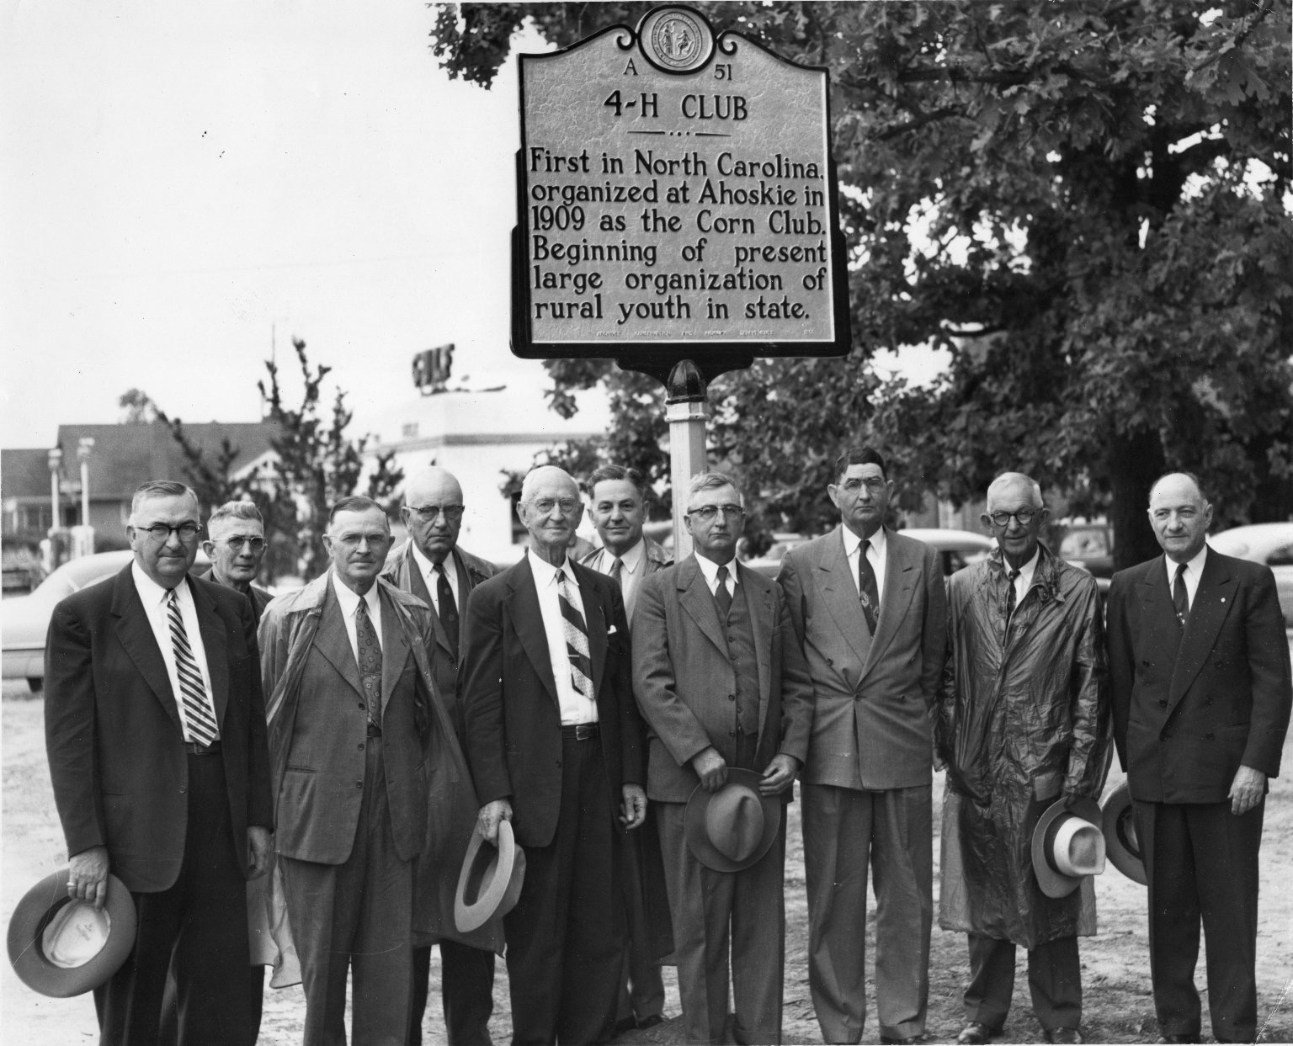
Historical Perspective
Late 1890’s - Rural America
1901 - out of school clubs
1902 - predecessors of first 4-H clubs, 3-leaf clover designed; corn contests
1904-1915 - Corn Clubs: Indiana, Iowa, southern states

Slide 3
Why Corn Clubs
Many farmers were most easily interested in better methods of corn production through their sons.
USDA’s desire to educate future farmers in better agricultural practices.

Slide 4
The Corn Clubs Legacy
Increased demand for agricultural education
4-H and FFA: youth education and leadership development
Promoted application of biotechnology and best management practices
Extension model for dissemination of information.

Slide 5
Tomato Canning Clubs
“Also known as ‘tomato clubs' throughout the South, these organizations were established for young women as the counterpart to boys' ‘corn clubs;' all were part of a Southern initiative overseen by the United States Department of Agriculture (USDA) to encourage crop diversity and mitigate the impact of the boll weevil.”
-Moore, 2001-

Slide 6
Tomato Canning Clubs
Moore says that the Progressive reformers' real aim in recruiting girls into tomato clubs was to convince their mothers that the girls needed education.
-Moore, 2001-

Slide 7
Pedagogy and the
Corn and Tomato Clubs
To teach the value of intellectual guidance, careful observation, cultural comparison and investigation, and the need of a broader education, for the farming population.

Slide 8
4-H: Youth & Community
Development
4-H is the nation’s largest positive youth development and youth mentoring organization, empowering seven million young people in the U.S.
In partnership with 110 universities
Available through 4-H clubs, camps, after-school & school enrichment programs
In every county & parish in the U.S.

Slide 9
4-H and the
Land Grant Mission
Liberal Arts, Agricultural and the Mechanic Arts. Embraced by the rural community - “the people’s college”
Meeting the needs of society. <2% of Americans make their living on a farm.
STEM, Robotics, Environmental Education, Animal and Plant Programs, Leadership, etc…
Emphasis is still on lifeskill development.

Slide 10
4-H: Youth & Community
Development
◦ Four times more likely to make contributions to their communities (Grades 7-12);
◦ Two times more likely to be civically active (Grades 8-12);
◦ Two times more likely to make healthier choices (Grade 7);
◦ Two times more likely to participate in Science, Engineering and Computer Technology programs during out-of-school time (Grades 10 – 12); and
◦ 4-H girls are two times more likely (Grade 10) and nearly three times more likely (Grade 12) to take part in science programs compared to girls in other out-of-school time activities.

Slide 11
“The potential for change is a core strength of all youth – a strength that can be built upon. This strength is cause for optimism for it means we can positively influence the life paths of all children.“
Lerner, 2013
–

Slide 12
Questions?
Questions?

