Slide 1
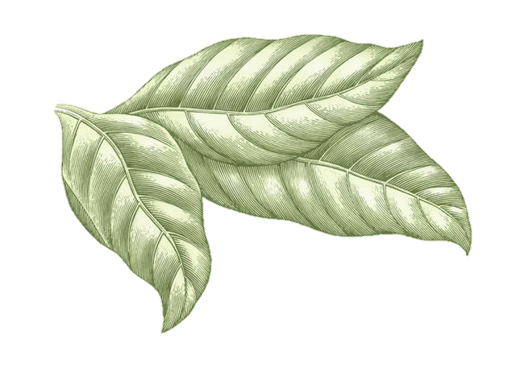
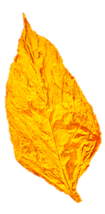
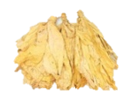
Organic Tobacco Production Overview
Matthew Vann
Extension Associate
Department of Crop Science

Slide 2
Organic Production Process
Grow, sell, repeat...
Not that simple
Defined order to the process
Obtain a Contract
Certify Land
Inspection
Maintain Certification
Inspection
Sell Leaf
Inspection

Slide 3
Contact Information for Contracting
Before taking a SINGLE step, call someone!
Getting a contract obligation is step #1!!
RJR: Robbie Parker 919-810-0581
RJR: Ron Wright 336-829-9200
SFNTC: Randal Ball 919-692-3120

Slide 4
Organic Certification
Organic certification is through the USDA-National Organic Program (NOP).
Third parties perform inspections & certifications.
Example: Quality Certification Services
Certification service group must offer NOP AND EU certification
Crop Consultants are available to help with certification.
Most certification services have contact information

Slide 5
Organic Certification
In general, the certification process can take 6-12 months.
Depending on the time of year and farming situation
Plan ahead!
Extensive paperwork must be filed before certified leaf can be sold

Slide 6
Organic Certification: Transition from Conventional to Organic Production
Certification requires three consecutive years of no synthetic material application.
SFNTC can purchase leaf as Pesticide Residue Clean during the transition
Leaf must be produced with organic practices
Certification service will assist

Slide 7
Stepwise Plan
Contact a certification group/request application forms.
Develop organic system plan
Certifier initial review/desk audit
Onsite inspection
Final review

Slide 8
Maintaining Organic Certification
Use of non-approved products is the easiest way to lose certification.
Use of synthetic materials will result in a three year re-certification process
Annual inspection by a certification service is required.
More paperwork.....

Slide 9
Overview of Production Requirements
Must have organic certification
Maintain accurate/up-to-date records
Do not use synthetic materials
Do not use prohibited “natural” products
Just because something is labeled as “natural/organic” does not mean it is approved
Check with your buying company and certification service before trying something new
Must have crop nutrient management plan
Use organically certified seed/transplants
Must have defined boundaries between organic and conventional fields.
Buffer zones= ≥50 feet

Slide 10
Overview of Production Requirements
Irrigation ponds must be protected from non-organic run-off
Organic leaf must be cured in organic only barns.
Cannot mix organic and non-organic leaf during curing
Separate baling and storage
Separate spraying equipment

Slide 11
List of Approved Products
Fertilizer:
Nature Safe 13-0-0
Allganic K 0-0-51
Natural Lime
High Calcium Limestone
Dolomitic Limestone
Worm Castings
Sulfate of Potash
Pest Control:
Dipel DF
Entrust??
Sucker Control:
O-Tac (fatty alcohol)
Greenhouse:
Sunshine Natural Mix
Seed:
Cross Creek Seed

Slide 12
List of Products NOT Approved
Materials from GMO’s
Bio-solids/Sewage Sludge
Non-organic seeds & transplants
Synthetic Chemicals
Ash from burning
Sodium Nitrate
Bulldog Soda

Slide 13
Material Consideration
Use only approved products.
If there are questions contact your leaf purchaser & your certification service!
The list of “natural” and “organic” products is very long, but most materials have not been evaluated for tobacco production
Many issues will be avoided if you maintain open communication with the above groups.

Slide 14
Agronomic Considerations: Greenhouse
Seabird guano is approved for use.
Similar management approach.
Temperature, seeding rate, clipping, etc.
 | Stem Length (cm/plant) |  | Usable Transplants (%)
Fertilizer | 2002 | 2003 | 2002 | 2003
16-5-16 | 8.7 | 5 | 73 | 88
Bat Manure (8-4-1) | 2.6 | 1 | 0 | 0
Seabird Guano (13-8-2) | 6.8 | 3 | 77 | 72
Bat Manure (3x rate) | -- | 3 | -- | 84

Slide 15
Agronomic Considerations: Fertility
Nature Safe 13-0-0
Nutri-max 12-1-0

Slide 16
Agronomic Considerations: N Fertility
Apply nitrogen materials at conventional material rates.
i.e., if you have traditionally targeted 60 lbs. N/acre, shoot for that with these materials
Any application method is acceptable.
Broadcast prior to transplanting, side-dress, or a combination.
Realize that N is in organic form and has to convert to ammonium or nitrate for plant use.
No immediate “green up”

Slide 17
Agronomic Considerations: Weed Control
No organically approved herbicides.
Increased reliance on cultivation and hand weeding.
Best option is to choose fields with low weed pressure and rotate crops.
Use cover crops to suppress weed growth

Slide 18
Summary
Organic production is a long term concept.
Approach it with that in mind
Contact RJR or SFNTC before doing anything else.
Contact a certification group in a timely fashion.
Crop management is different.

