Slide 1
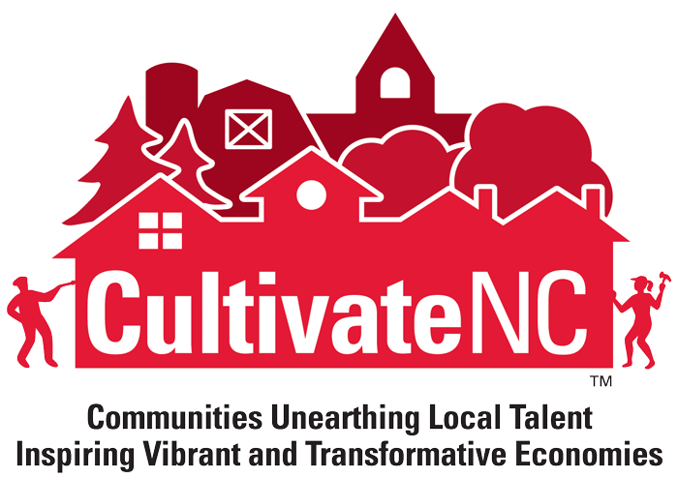
Lunch n’ Learn Webinar Activating Empty Spaces (8/21/14)
Notes:
BECKY: Good morning and thank you for joining today’s Cultivate NC Lunch n’ Learn. My name is Becky Bowen, and I am the Program Manager of CultivateNC, a new community development program of the North Carolina Cooperative Extension Service at North Carolina State University. Susan Jakes, Jackie Murphy Miller and I will be the moderators of today’s Lunch n’ Learn session.
SUSAN: (Gives directions on how to use the Collaborate program)
We at Cultivate NC are excited to bring you a series of 30 minute learning webinars focused on best practices and innovative thinking in community development. This monthly series targets county Extension directors, agents and specialists who engage in community or economic development in North Carolina.
BECKY: Our first program, Activating Empty Downtown Spaces – Pop-up!, is an interesting idea first introduced to Cultivate NC at the 2014 NC Main Street Conference. Beth Yerxa, Executive Director of Triangle Artworks, is the architect of the Pop Up Toolkit and is here to explain how pop-ups can be used to energize your downtown spaces. Take it away, Beth!

Slide 2
Beth Yerxa, Executive Director
beth@triangleartworks.org
@TriArtWorks
Notes:
Beth Yerxa –ED of ArtWorks: Thank you. Triangle Art Works works with the arts community, working to meet their needs as a business community in the Triangle. Like other industry groups, artists are always looking for space to do and sell their work and to get more attention for the work they do, including reaching new audiences and finding new ways to engage audiences. A new way they are meeting these needs is through the use of “Pop-Up” shows, events and installations.

Slide 3
WHAT IS A POP-UP?
___________________________________________
➔Temporary use of active/inactive spaces, such as
Storefront Installation
Building exterior/outdoor
Pop-up Business/event
Can be anywhere!
Notes:
BETH: So what is a pop-up? A Pop-up is a temporary use of active or inactive spaces. There are a couple of main types which are low risk, including a building exterior, wrapping a building in plastic to advertise a program, projecting something onto the building, painting an exterior, using an art installation, and generally getting your program info out there. You can put something behind the glass, or on the glass of a storefront. It can be low risk, low cost but still have high impact.
Another type of pop-up is to fill an actual space with something temporary, hold an event, a sale, a market, in an empty downtown building, a barn, a parking lot, anywhere, and in any sort of space. The general idea is to use a space in a different, but temporary way.

Slide 4
Why should you use a Pop-Up?
_________________________________
Creates “buzz”
Reach new customers/audience
Generate new business
Low cost/risk
Notes:
BETH: So, why should you use a pop-up? First of all, it creates buzz. Marketing is really difficult these days - print media is not as effective as it once was, marketing can be expensive, and social media is a moving target, so marketing your events and programs is hard. Popups are a new idea in a new space and can create a lot of buzz – which can do your marketing for you.
Also, by moving to unique locations, you can reach new audiences and generate new business. Because Pop-ups are temporary, they are also low cost and low risk.
Here’s a good example to explain these benefits- When the Opera performs in a opera hall is great, but they have to spend a lot of money to let people know about the performance and build new audiences. But when they do a show in a downtown bar on a Wednesday night, it adds a level of excitement … people are tweeting about it, the media is reporting on it, and people are talking about it. So, they are reaching people that they may never have reached through a traditional marketing campaign, all for very little cost and effort. Again, it’s doing something usual in a new way, so people will look at you and your product in a new way.

Slide 5
How do they apply beyond the arts community?
_______________________________
Testing business concept
Testing customer base for product
Reaching new audiences
Making people look at the issue or product in a new place and a new way
Notes:
BETH: So how do we apply this concept beyond the arts community? It can be used to test a business concept, test a new customer base, ideas, programs, and reach new audiences. It makes people look at your program in a new way.

Slide 6
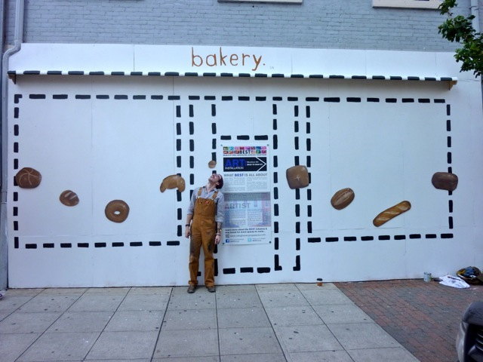
Notes:
BETH: So I want to show you the different ways pop-ups have been used in the arts community, and the way these uses are reaching these goals…so you can think of ways to adapt these ideas to your work. This first slide is of Wilmington Street in downtown Raleigh – a few years ago it was a rather rundown area with abandoned buildings.
An organization called Beautifying Emerging Spaces Together (BEST) talked to the owner and asked if they could put up new board over the store front. They engaged an artist and asked him to envision something for this building. He envisioned a bakery and even with this simple representation, not only does the storefront and the street look a lot better, but suddenly people are looking at this space differently. This space is now rented, and the street looks totally different.

Slide 7
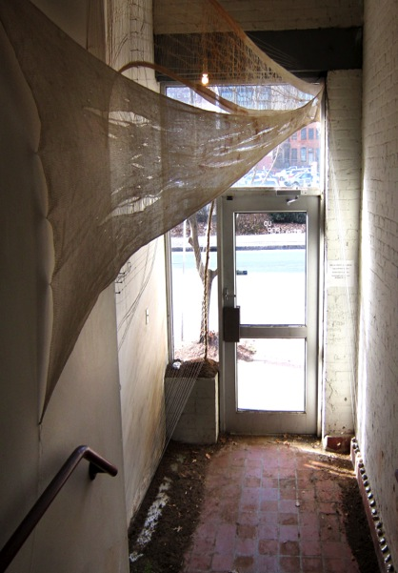
Artspace
Raleigh, NC
Notes:
BETH: This installation was done a few months ago in Raleigh. Artspace is a big art studio in downtown Raleigh. Along one side of the building, Artspace had no real presence. It was mostly taken up with a Mexican restaurant and a paddleboard store. On that side, Artspace only had an unused doorway. People rarely noticed this doorway. Recently, Artspace had one of their artists create an art installation in this doorway. People are now asking stopping and are looking into the space. This provided an artist a new place to showcase her work, but also made people notice the space again and that Artspace is in the building. There are lots of examples where Pop-ups have been used to bring attention back to forgotten spaces.

Slide 8
Aesthetic Installations aestheticinstallations.blogspot.com
Notes:
BETH: This is an empty storefront in Elkin, NC, where the downtown Main street program is using the storefront to make people think differently about the space. It’s saying, “Hey, think about this idea!”. Storefront pop-ups allow you to reach a new audience with your work or message, or maybe to educate. Think about who where the people that you want to reach are. Are there restaurants downtown? Can a storefront downtown be used to promote agricultural products or an educational message? Want to reach kids? Is there a space that you can use near a soccer field? It is all about thinking about these spaces differently.

Slide 9
Notes:
BETH: A good example of getting an educational message across through a storefront is this empty storefront in Washington, NC . It is a simple installation, where the town is using the storefront to educate visitors and residents about the history of the town. It’s very effective, but very simple.

Slide 10
Notes:
BETH: Beyond the storefront, a Pop-up can also use the whole building. This is is an empty building in Garner, NC, downtown that has been empty a long time. The town owned it and had also been working to better support their local arts businesses, so decided to combine the two.

Slide 11
Notes:
BETH: They also contacted the Arts Council to set up a 2 day Xmas market.
The town invited local artists and small businesses and created a Christmas market.

Slide 12
Notes:
BETH: As you can see, it is very bright and cheerful and was very popular. The community loved it and the vendors were successful. These temporary sales events also bring out the “QVC effect” – because they are short-lived, people feel like they have to get there “before its gone!”. .

Slide 13
Notes:
BETH: These types of pop-ups can go beyond art and craft. The Garner market also offered a local coffee roaster a first chance to promote his product and start to build a customer base.

Slide 14
Aesthetic Installations aestheticinstallations.blogspot.com
Notes:
BETH: Again, this temporary store concept is very popular. Here Then Gone pop up shop in Elkin, NC.

Slide 15
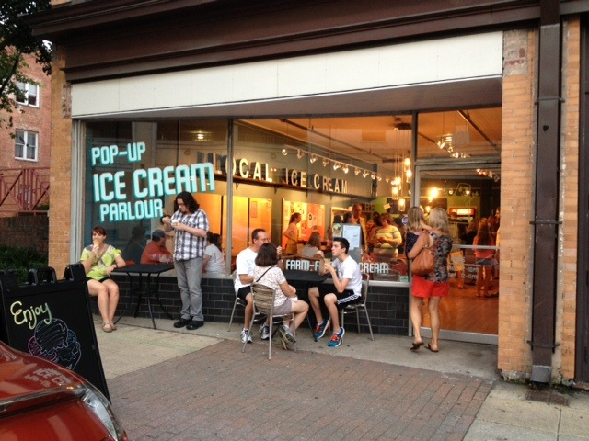
Notes:
BETH: As this slide from Raleigh shows, Pop-ups can also be used by small businesses. A local ice cream cart did not have the capital to open a new store. Instead they rented equipment and opened this 3-month popup ice cream shop in an empty space. This allowed them to build capital as well as a customer base.

Slide 16
Notes:
BETH: If you do not have a downtown with empty buildings, you can still use the pop-up concept. A pop-up can be anywhere. Think about where people already are congregating. This slide is from Garner again, where they already had a successful concert series at an old school with covered walkways. On the nights of their concerts, they started inviting local artists, craftsmen and vendors to set up booths.

Slide 17
Notes:
But it was held in an old school that had covered walkways.

Slide 18
Notes:
This not only added another element to the concerts, which was great for the community, but it also allowed the vendors to make sales. So think outside the box. In rural areas, very active and popular crossroads with unused buildings or spaces could be used to promote food, craft, and performances. You can use a barn, a parking lot…anywhere.

Slide 19
How do you get started?
Notes:
So pop-ups are a good idea, but how do you get started?

Slide 20
Partnered with UNC Law Pro Bono Project
Step-by-Step Guide for both Property Owners and Arts/creative groups and businesses
Agreement Checklist – Issue spotting and tips for agreement between property owner and business/organization.
How to purchase: popups@triangleartworks.org. .
Notes:
BETH: We heard this same question from our arts community, so wanted to give them a resource to use. So, we partnered with the UNC Law School Pro Bono program to create the Pop-Up Tool Kit. It gives step-by-step instructions of how to think through what it will take.- Setting your goals, thinking through your needs and tips for making a match between a property owner and a pop-up business. You can order the pop-up toolkit on the Triangle Art Works web site (www.triangleartworks.org).

Slide 21
Tips for Pop-Ups
_____________________________________________________________________
Develop a clear statement of concept
Think it through
Identify goals
Identify needs (space, equipment, etc)
Write it down!
Identify possible partners
Think outside the box, but be pragmatic.
Notes:
BETH: Some quick tips for Pop-ups.
You definitely have to start with a clear concept. You need to get into a restaurant space on Sunday? It probably won’t happen quickly. Think it through, identify your goals, think what you will need, and write it down! Going through this process will also help you identify possible partners. If you have a clearly defined plan, then it is easier to approach partners and work through the details.

Slide 22
Checklist for Agreement
_____________________________________________________________________
Permits/Taxes
Liability
Use of facilities/equipment
Parking
Clean-up
AV/Power usage
Publicity – what is/isn’t said
Alcohol
.
Notes:
BETH: There is a checklist in the toolkit that the property owner and pop-up business can put between them to make sure they discuss all the possible issues before they start. This will avoid unexpected issues and help make the pop-up successful. Issues include: permits/taxes, liability issues, parking, clean-up. marketing, among others.

Slide 23
Who could be your partners?
_____________________________________________________________________
City/county staff
Downtown development office/Main Streets
Economic Development staff
Local chamber and other orgs
Arts Council
PTAs
Notes:
BETH: Who could your partners? Collaboration is king in these days of limited staffs and budgets. Think about who in your area may work with an audience you are trying to reach, or may share your goals. Approach them to work together– boys and girls clubs, arts council, whatever.
.

Slide 24
Beth Yerxa, Executive Director
beth@triangleartworks.org
@TriArtWorks
Notes:
Endo of presentation.

Slide 25
Becky: Could you provide some examples of local food and pop-ups?
Notes:
BETH: There have been lots of examples of Pop-ups using local foods. In the Triangle, there have been Pop-up dinners with local chefs and promoting local food and farms in a wide variety of places, from a room next to a commercial kitchen, to a farm field, to the middle of downtown streets. Some examples are Farm to Fork, Pop-up dinners at the Cookery in Durham, Acorn Kitchen which does pop-up dinners in places announced at the last minute, and Wild Yonder, a pop-up “sleepaway camp” for adults which works with local chefs, musicians, etc.

Slide 26
Question 1:
How do you get building owners to cooperate with a pop-up concept?
Notes:
BETH: It all goes back to building the concept carefully. This is one thing we talk about in the toolkit. Not only does the concept have to meet your goals, but also should be mutually beneficial to the property owner, unless you have a property owner that shares your goals. There are many instances of properties that have been idle that are sold after the pop-up. As we talked about earlier, people stop noticing long idle spaces, so a pop-up can make people notice it again. Will your concept promote the space or bring in a new audience? Make sure to tell them that it will be in as good or better condition after you leave it. If there is a larger community benefit, engage your downtown or economic development organization to help you.

Slide 27
Question 2
What are some issues regarding liability and leases for a pop-up?
Notes:
BETH: It is diffcult to give a simple answer because pop-ups can take place in anything from a barn to a downtown building, or just be a window display. But generally, you need to make sure you have your risks covered. Make sure that all liability issues are discussed and spelled out in writing with the property owner. It is possible that you could come under their insurance, or see if others can provide insurance coverage, like a music vendor or a catering company. If not, you need to talk to an insurance company for a short term policy or rider to your policy. Again, this is where a clear, written concept will come in handy, as your insurer can better assess the risks. It will cost money but maybe not that much, as its temporary.

Slide 28
BECKY: Can an Extension agent talk to these insurance companies ahead of time to grease the wheel ahead of time?
Notes:
BETH: If you’re doing a pop-up that will benefit your community, you should get as many people as possible to the table ahead of time to make it easier for the pop-up enterprise. So certainly get them on board if you can. But you will still need to make sure you are covered.

Slide 29
BECKY: Are there examples of where this topic is discussed at a brown bag lunch or breakfast meeting at the chamber of commerce?
Notes:
BETH: There are lots of examples around the country of municipal pop-up programs of all types. Some big programs where the municipality uses pop-ups to lead redevelopment of an entire area and some where they simply have a meeting to inform property owners of the possibility of pop-ups to temporarily engage their inactive properties. Triangle downtown and economic development groups are using our Tool-Kit for this.

Slide 30
BECKY: Thank you for joining us today for the first Cultivate NC Lunch n’ Learn webinar and thank you, Beth, for your very informative presentation.
We would appreciate your feedback. Please click on the link and complete a short evaluation.
http://harvest.cals.ncsu.edu/surveybuilder/form.cfm?testid=25351
Notes:
We invite those of you listening to complete the evaluation of this webinar located in the LMS system, and please join us next month on September 24 for a presentation on the new tools available to you through the Cultivate NC program. This month you have learned about pop-ups and their potential impact on invigorating your downtown area. Next month you will learn about a technique to “cultivate action” within your community.
Good-bye, everyone!
We would appreciate your feedback. Please click on the link and complete a short evaluation.
http://harvest.cals.ncsu.edu/surveybuilder/form.cfm?testid=25351

