Slide 1
Pesticides & Farmworker Health Toolkit http://go.ncsu.edu/pesticide-toolkit
Catherine LePrevost, Julia Storm, Greg Cope
NC State University
Notes:
This presentation provides an introduction to the Pesticides and Farmworker Health Toolkit--a crop-specific pesticide education resource for training Spanish-speaking farmworkers about pesticide hazards. The toolkit presents pesticide safety information in a highly visual, interactive, and discussion-based format. The development of this resource was funded by a Pesticide Environmental Trust Fund grant. The toolkit has been approved by the Environmental Protection Agency for worker training as required by the Worker Protection Standard.

Slide 2
Introductory YouTube Video
(Click on bag to begin.)
Notes:
A 3-minute video provides an overview of the toolkit training, including toolkit components and the development process. [Click on the bag to play the YouTube video.]

Slide 3
Target Audience for Pesticide Safety Education: Spanish-Speaking Farmworkers
Migrant and Seasonal Farmworkers:
Young- to middle-aged Latino males
Low literacy levels
Limited formal education
Estimated 86,855 migrant/seasonal workers in NC in 2009
At risk for pesticide exposure, short-term and long-term pesticide-related illness
(NAWS, 2005; Freeman Lambar, 2009; Donham & Thelin, 2006)
Notes:
The toolkit materials were developed for and tested with Spanish-speaking farmworkers. The farmworker audience can be characterized generally as being young or middle-aged and Latino, having low literacy levels in English and in Spanish, and having limited formal education (typically between 3 and 6 years for NC farmworkers). We have a relatively large population of farmworkers in NC. Because farmworkers live and work in close proximity to agricultural chemicals, this population is at risk for pesticide exposure and illness.

Slide 4
Development Process
2007: Brainstorming Meeting with Stakeholders, Literature Review
Stakeholder input on materials
Type – entire educational package, not a stand-alone brochure
Content – crop-specific
Format – color images, limited text
EPA hazard communication study
Vivid, colorful, realistic images
2008: Field Testing with Farmworkers
4 focus groups with follow-up interviews
Feedback on images, concepts
2009: Field Testing with Bilingual Trainers and Farmworkers
Flip-chart training, activities, handout
Pre- and post-tests, performance-based assessment
2010: EPA Approval for Worker Training under WPS
Notes:
Toolkit development began in 2007 with a brainstorming meeting with stakeholders and a review of the literature. At the brainstorming meeting in July 2007, stakeholders indicated that an updated Pesticides and Farmworker Health Toolkit should consist a complete educational package, including a single-page, crop-specific pesticide safety handout that incorporated the use of colorful illustrations and minimal text. During the summer of 2008, field testing of the prototype tobacco toolkit and accompanying handout occurred. Through four focused small group discussions and follow-up interviews, toolkit developers learned more about farmworkers' layout preferences for the handout and about their understanding of central learning messages associated with the toolkit. In 2009, the toolkit flip charts, interactive activities, and handouts were assessed by both farmworkers and trainers. Analysis of farmworker assessments indicated increased knowledge and skill levels following toolkit training. Trainers enthusiastically received the toolkit and provided constructive feedback on the educational materials. Based on the input of farmworker pesticide educators, in early 2010 toolkit developers expanded the toolkit training to include all of the criteria for worker training mandated under the Worker Protection Standard.

Slide 5
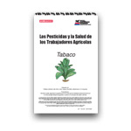
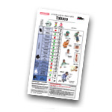
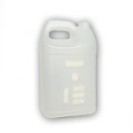
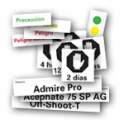
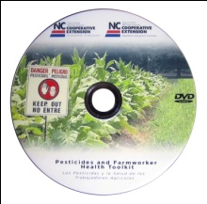
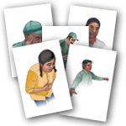
Crops & Crop-Specific Toolkit Components
Apples
Bell Peppers
Blueberries
Christmas Trees
Cucumbers
Grapes
Landscape/Turf
Strawberries
Sweetpotatoes
Tobacco
Tomatoes
Flip Chart
One-Page Handout
Interactive Activities
Introductory DVD for Trainers
Toolkit Contains All Spanish Materials
English Flip Chart/Handout and
Bilingual Poster Available
Training Length: 45 minutes – 1 hour
Notes:
On the left are the 11 crops for which the Pesticides and Farmworker Health Toolkit is available. On the right are the items packaged in a toolkit: a crop-specific flip chart and 50-pack of handouts, interactive activities, and an introductory DVD for trainers. The toolkit contains all Spanish materials. An English flip chart and handout for each crop are available for individual purchase. A bilingual poster with the information contained on the handout is also available. The complete toolkit training is between 45 and 60 minutes in duration.

Slide 6
FLIP CHART
Contains trainer’s discussion guide on one side, visuals for workers on other side
Engages farmworkers in discussion and hands-on learning activities
Addresses all WPS training points for workers
Notes:
The most important toolkit component is the crop-specific flip chart. One side of the flip chart is visual to engage the farmworker audience. The other side contains all of the information that a trainer needs to lead a discussion of pesticide hazards and safety information and to facilitate hands-on activities. The Environmental Protection Agency has certified that the flip chart addresses all of the criteria for worker training under the Worker Protection Standard.

Slide 7
HANDOUT
Highlights most important flip chart concepts
Displays pesticide information by crop production stage
Contains most commonly used pesticides identified by NCSU crop production specialists
Notes:
The handout, which contains the key concepts from the flip chart, is designed to be taken home by the worker at the end of the training. As you can see on the tomato handout, the pesticides included on the handout are organized by crop production stage. Crop production specialists at NC State University identified the 10-15 most commonly used pesticides for each crop to be displayed on the handout.

Slide 8
FLIP CHART: CROP PRODUCTION STAGES
Contains several pages on relevant crop production stages for that crop (e.g., Cosecha = Harvest)
Engages farmworkers in discussion of tasks during stages
Contains pages on why pesticides are used and highlights common pests (insect, disease, weed)
Notes:
The flip chart training begins with several pages on the crop production stages for the specific crop. The trainer leads the workers in a discussion of the tasks that the workers are performing during each stage and introduces the chemicals that are typically used. Following the crop production stages is a page that discusses why pests are used and highlights a common insect, weed, and plant disease for that crop.

Slide 9
FLIP CHART: TOXICITY SIGNAL WORD
Traffic light analogy helps farmworkers understand toxicity levels (Nivel Toxico) and signal words
Peligro-Veneno = Danger-Poison
Peligro = Danger
Aviso = Warning
Precaucion = Caution
Notes:
The traffic light is introduced to communicate the concept of relative toxicity. The red light indicates a Danger or Danger-Poison (when used with the skull-and-crossbones sign) signal word. The yellow light indicates a Warning signal word. The green light indicates a Caution signal world. The traffic light analogy was found to be effective in communicating variable toxicity to farmworkers during pilot testing in the toolkit development process.

Slide 10
FLIP CHART: REI
REI is designed to prevent worker exposure
Notes:
The flip chart introduces the restricted entry interval (REI) sign and initiates a discussion of the REI concept to limit worker exposure to pesticides. Employer responsibilities for providing notification to workers about treated areas and maintaining a central posting location are reviewed.

Slide 11
FLIP CHART: ROUTES OF ENTRY
Work clothing represents protective clothing required by almost all labels
Notes:
A discussion of the points of entry covers how a pesticide can enter the body. The workers represented on this page and throughout the flip chart are wearing appropriate work clothing of long-sleeved shirts, pants, and boots.

Slide 12
FLIP CHART: ILLNESS EQUATION
Toxicity x Exposure = Illness
Toxicity x Exposure Prevention = Health
Notes:
The flip chart introduces the classic toxicology equation in a visual manner. This page shows that toxicity and exposure are both needed for pesticide illness. The training emphasizes that following the REI prevents pesticide illness. The equation underscores the distinction between toxicity and exposure.

Slide 13
FLIP CHART: OTHER WAYS TO PROTECT YOURSELF
Highlights other ways to prevent exposure throughout the day in addition to REI
Notes:
In addition to presenting the REI as a means to reduce pesticide exposure, the flip chart highlights other ways to protect oneself throughout the work day. When workers leave for work at the beginning of the day, they should wear appropriate work clothing. At work, they should wash their hands before eating, drinking, smoking, and using the restroom; leave a field if they observe drift; and not take home pesticides or pesticide containers. Once they have arrived home, workers should shower, change out of their work clothing, and launder their work clothing separately from their non-work and family clothing.

Slide 14
FLIP CHART: COMMON SYMPTOMS
Highlights common symptoms caused by overexposure to many pesticides
Reviews irritation symptoms of pesticide exposure
Notes:
The flip chart reviews symptoms of pesticide poisoning in case pesticide exposure/illness does occur. The training includes a discussion of common symptoms (caused by many pesticides) and irritation symptoms.

Slide 15
FLIP CHART: ORGANOPHOSPHATE POISONING
Presents specific combination of symptoms typical of organophosphate illness
Notes:
Toolkit developers also chose to highlight organophosphate poisoning in the flip chart as many of the most severe pesticide poisoning cases are related to organophosphate pesticides. The specific combination of symptoms typical of organophosphate poisoning are presented.

Slide 16
FLIP CHART: EMERGENCY INFORMATION
Concludes with discussion of what to do in case of emergency
Identifies important phone numbers, including local health clinic
Notes:
The toolkit training concludes with emergency information, including a scenario for group discussion, a review of appropriate emergency responses, and identification of important phone numbers (911, Poison Help, and the local health clinic).

Slide 17
HANDS-ON ACTIVITIES
Jug labeling group activity to practice using handout
Symptom charade game to review common, irritation, and organophosphate poisoning symptoms
Notes:
Within the flip chart training, several pages are devoted to hands-on activities. These activities serve to reinforce key concepts from the toolkit training. The first activity is a jug labeling group activity in which workers use the crop-specific handout to identify the toxicity signal word and REI for a specific pesticide. The second activity is a symptom charade game that reviews the illness and irritation symptoms introduced in the training.

Slide 18
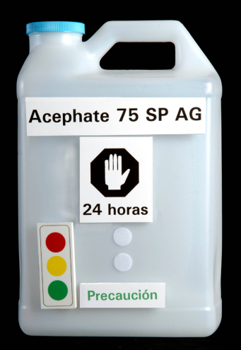
Now it’s your turn!
Using the tobacco handout, identify the toxicity signal word and REI for Prep.
Add the correct labels for the toxicity signal word and REI to the labeling jug. See the example for Acephate.
Notes:
[Demonstration 1: Demonstrate the jug labeling activity with an individual or small group. Instruct the individual/group to use the tobacco handout on the right to identify the toxicity signal word and REI for Prep and then to add the appropriate labels to the labeling container. Ask the individual/group to identify when Prep is used. Follow up by asking the audience if the correct toxicity signal word, REI, and crop production stage were selected by the individual/group.]

Slide 19
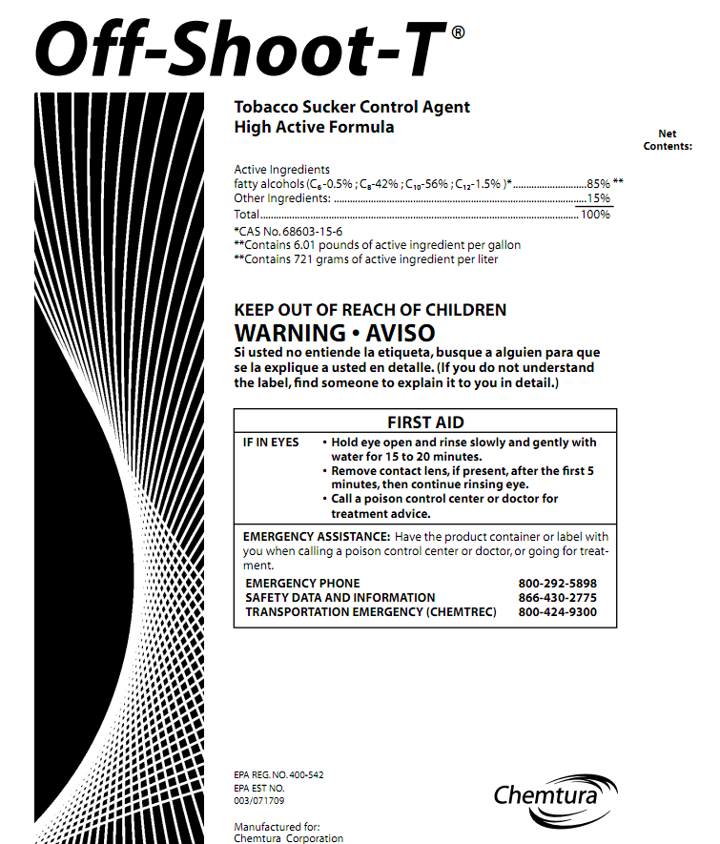
Now it’s your turn! Using the Off-Shoot-T label, add the correct toxicity signal word and REI to the labeling jug.
Notes:
[Demonstration 2: Demonstrate how to use an actual pesticide label to complete the jug labeling activity with a different individual or small group. Instruct the individual/group to use the Off-Shoot-T label to identify the toxicity signal word and REI and then to add the appropriate labels to the labeling container. Ask the individual/group to identify when Off-Shoot-T is used. Follow up by asking the audience if the correct toxicity signal word, REI, and crop production stage were selected by the individual/group.]

Slide 20
Time application is completed is when REI clock starts ticking!
Notes:
[Refer to the record-keeping page for recording the completion date and time of pesticide application, and review that this is when the REI clock starts ticking.]

Slide 21
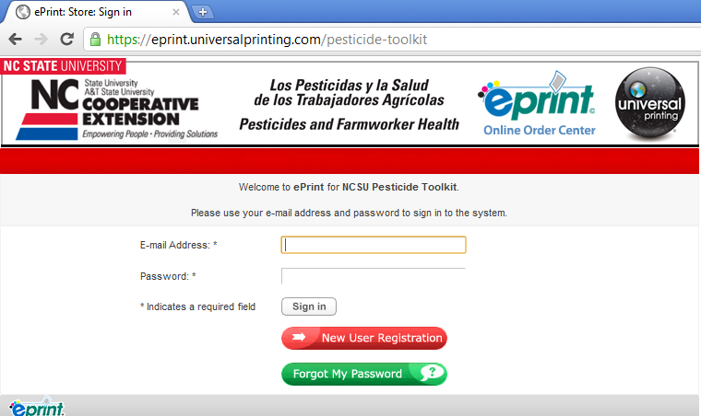
Order Toolkits Online: https://eprint.universalprinting.com/pesticide-toolkit
Apples
Bell Peppers
Blueberries
Christmas Trees
Cucumbers
Grapes
Landscape/Turf
Strawberries
Sweetpotatoes
Tobacco
Tomatoes
1. Register as a new user
2. Use your e-mail address and password to enter the online store.
Contact Julia Storm with questions: julia_storm@ncsu.edu
Notes:
Toolkits for each of the 11 crops on the left are available for purchase from Universal Printing. Use the link above to access the Pesticides and Farmworker Health Toolkit ordering site. If you have not been provided a user name and password, you will need to register as a new user. To register, click on the red icon (New User Registration) at the bottom of the page. You will be asked to provide your name, e-mail address, and a password of your choice. You will then be able to use your email address and password to enter the online store.

Slide 22
Training in the Field and on the Farm
Collaborate with Bilingual Local Resources:
Health clinic outreach workers
Spanish-speaking Extension agents
English-speaking Extension agents and Spanish interpreters
Agribusinesses with Spanish interpreters
State agency bilingual trainers (e.g. NC
DOL)
Bilingual growers and supervisors
For more Info: http://go.ncsu.edu/pesticide-toolkit
Notes:
Even if you are not a Spanish speaker, there are many opportunities to collaborate with local bilingual resources to provide the Pesticides and Farmworker Health toolkit training.

