Slide 1
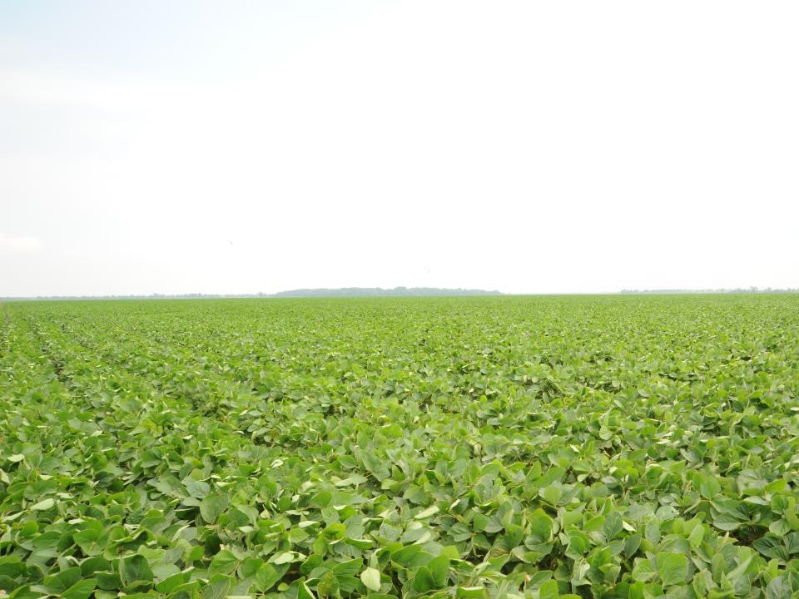
Soybean Insect Update 2014
Neonicotinoid Use in Soybean
Kudzu Bug Update

Slide 2
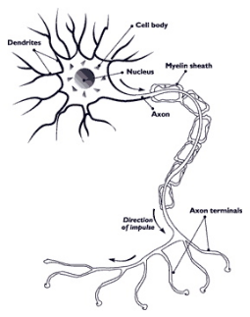
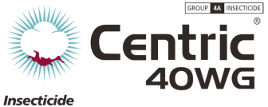
Neonicotinoids and Spinosyns
Nerve toxins
Nicotinic acetylcholine
receptor agonists (synaptic)
Mode of action (4A)
similar to nicotine (4B)

Slide 3
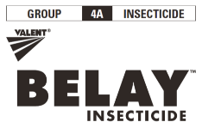
Neonicotinoids
Not widely effective (but are selective)
Good for
Aphids
Beetles
Moths/butterflies
Safer for humans
Cause insect paralysis and death within hours

Slide 4
Neonicotinoids
clothianidin
dinotefuran
imidacloprid
thiamethoxam
acetamiprid
others
Poncho, NipsIt, Belay
Safari
Gaucho, Admire Pro
Cruiser, Avicta, Centric
Assail

Slide 5
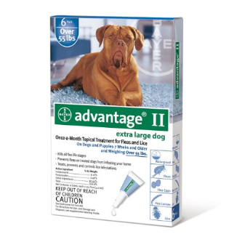
Where do we use neonicotinoids in field crops?
Seed treatments
Cotton (100%)
Corn (100%)
Soybean (>30%)
Wheat (?)
Foliar sprays
Straight (Admire Pro, Belay, Centric, etc.)
Pre-mix (Brigadier, Endigo, Justice, Leverage 360, Swagger, Triple Crown, etc.)

Slide 6
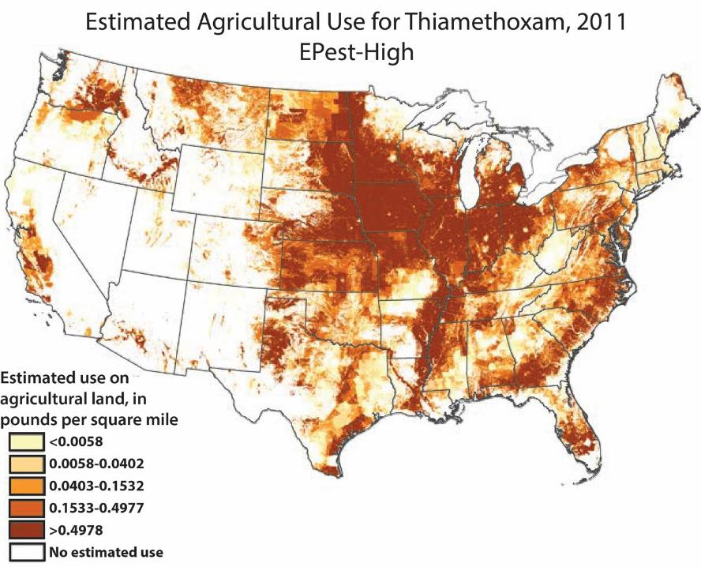
Source: USGS National Water Quality
Assessment Program

Slide 7
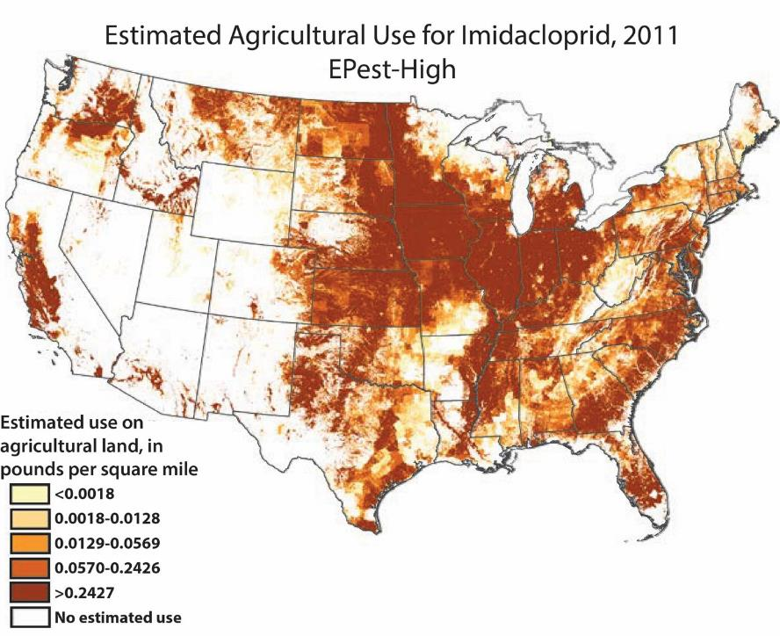

Slide 8
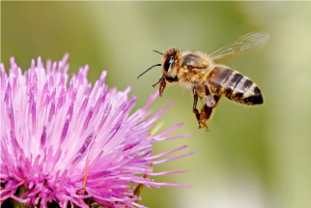
Neonicotinoid Concerns
Persistent in environment
Possibly for months
Not very toxic for aquatic organisms, birds, etc.
BUT

Slide 9
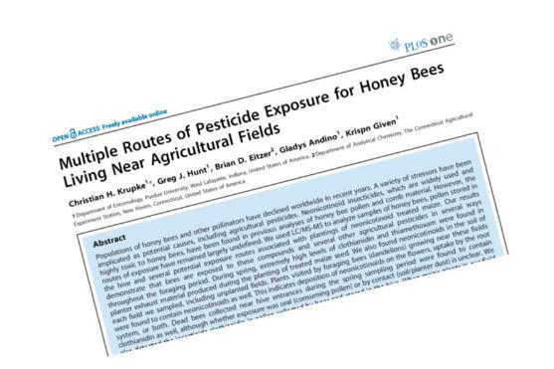
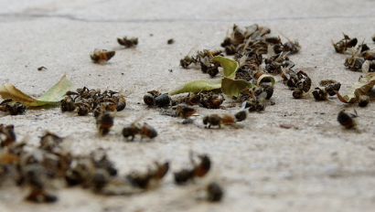
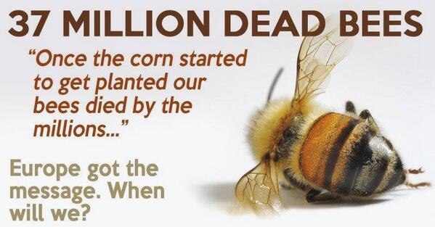
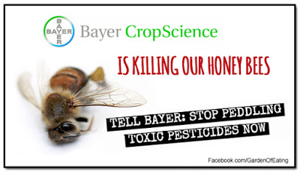
Is this a real concern?

Slide 10
Questions
What concentrations of neonicotinoid change bee behavior?
Minimal effects up to 20 ng/g
Highest detected in corn pollen is 7 ng/g, most much lower
What is the likelihood that bees will be exposed to neonicotinoids under average realistic conditions
Not likely in Midsouth field crops (Stewart et al. 2014)
Do Midwestern results apply across the US?
Likely not

Slide 11
Pollinator Protection:
New Pesticide Labels

Slide 13
Directions For Use –
For Food Crops & Commercially Grown Ornamentals Not Under
Contract for Pollination Services but are Attractive to Pollinators
Do not apply this product while bees are foraging. Do not apply this product until flowering is complete and all petals have fallen unless one of the following conditions has been met.
The application is made to the target site after sunset
The application is made to the target site when temperatures are below 55˚F
The application is made in accordance with a government-initiated public health response

Slide 14
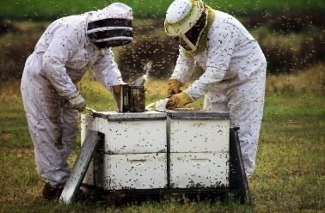
Directions For Use –
For Food Crops & Commercially Grown Ornamentals Not Under
Contract for Pollination Services but are Attractive to Pollinators
The application is made in accordance with an active state-administered apiary registry program where beekeepers are notified no less than 48-hours prior to the time of the planned application so that the bees can be removed, covered or otherwise protected prior to spraying
The application is made due to an imminent threat of significant crop loss and a documented determination consistent with an IPM plan or predetermined economic threshold is met. Every effort should be made to notify beekeepers no less than 48 hours prior to the time of the planned application so that the bees can be removed, covered, or otherwise protected prior to spraying.

Slide 15
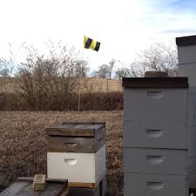
Farmer/Beekeeper Communications
Mississippi’s “Bee Aware” Flag
Part of a larger statewide effort in MS to foster communication
Hive and Flag Placement
GPS
Notify Ground and Aerial Applicators of Hive Locations
Timing of Applications

Slide 16
Pollinator Stewardship Task Force
NC Pollinator Stewardship Task Force
- NC Farm Bureau - NCSU
- NCDA&CS - Commodity Groups
- Commercial Beekeepers
Potential work:
Pollinator Protection Plan
Flags
Mapping

Slide 17
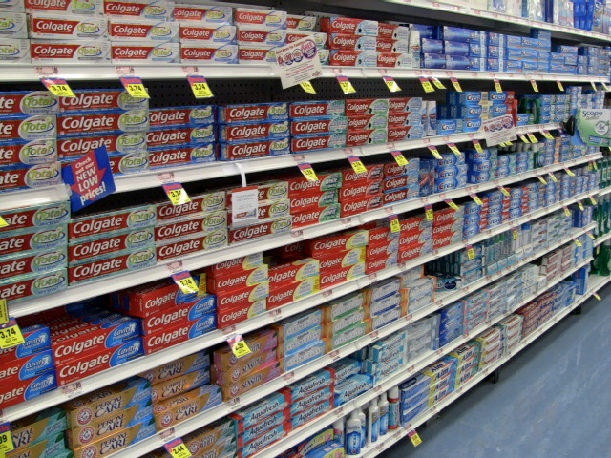
Commercially Available Insecticidal Seed Treatments
Trade Name | Active Ingredients |  |  | Cotton rates per seed
 | Thrips Insecticide* |  | Additional
 | Name | Recommended rate per seed
Acceleron | imidacloprid | 0.07-0.23 mg | fluxapyroxad, mefenoxam, metalaxyl | 0.375 mg
Cruiser 5FSª | thiamethoxam | 0.08-0.15 mg |  | 0.375 mg
CruiserMaxxª | thiamethoxam | 0.16-0.48 mg | mefonoxam, fludioxinil | 0.375 mg
CruiserMaxx Advancedª | thiamethoxam | 0.08 mg | mefonoxam, fludioxinil | 0.375 mg
Inovate | clothianidin | 0.075 mg | metalaxyl, ipconazole
IST-Gaucho^{b} | imidacloprid | 0.07-0.23 mg |  | 0.375 mg
Poncho/VOTiVO | clothianidin | 0.13 mg (clothianidin) | Bacillus firmus I-1582 | 0.424 mg
ªClariva Complete Beans seed treatment with CruiserMaxx Beans (insecticide/fungicide) + Clariva pn (nematicide) +
Vibrance (fungicide). CruiserMaxx Beans is seed treatment with one of the following: 1) CruiserMaxx alone, 2)
CruiserMaxx Advanced + Apron XL (fungicide), 3) Cruiser 5 FS insecticide + Maxim 4FS + Apron XL (fungicides), or 4)
Cruiser 5FS + ApronMaxx (fungicide)
^{b}Trilex 6000 seed treatment with Gaucho (insecticide) + Trilex + Yield Shield + Allegiance + Celgard (fungicides)

Slide 18
Insecticide Seed Treatment Adoption in Beans
Year | Mississippi | North Carolina
2004 | 0% | -
2005 | 0% | -
2006 | 0% | -
2007 | 2% | -
2008 | 50% | -
2009 | 65% | -
2010 | 70% | -
2011 | 75% | 12%
2012 | 85% | 15%
2013 | 90% | 29%
2014 | ? | 30%

Slide 19
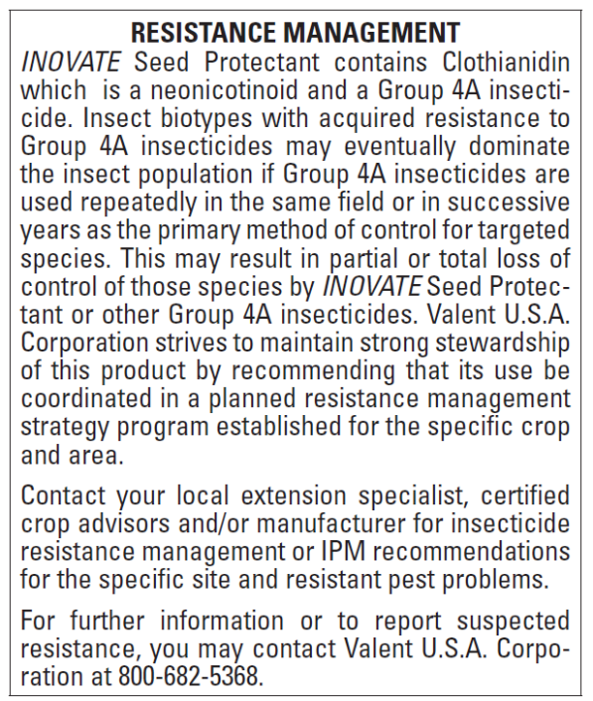

Slide 20
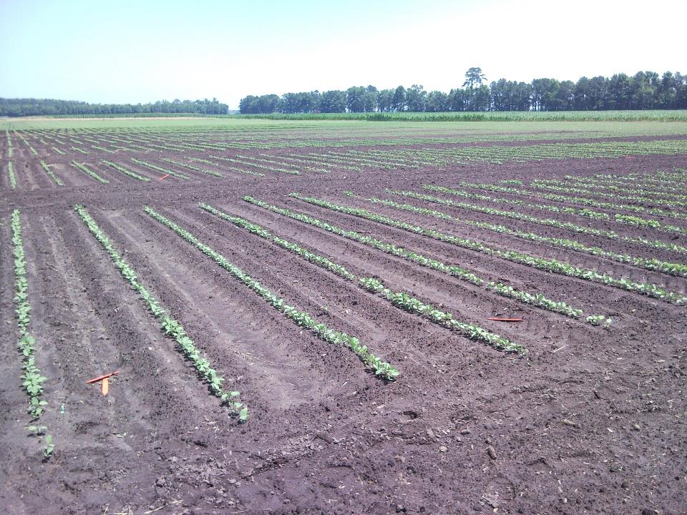
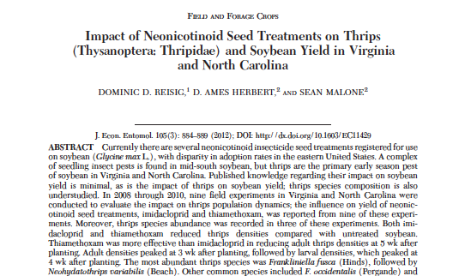
Soybean Seed Treatments
As of 2014 in Virginia and North Carolina
18 seed treatment tests
5 foliar treatment tests
NO YIELD ADVANTAGE
It is not worth using an insecticidal seed treatment

Slide 21
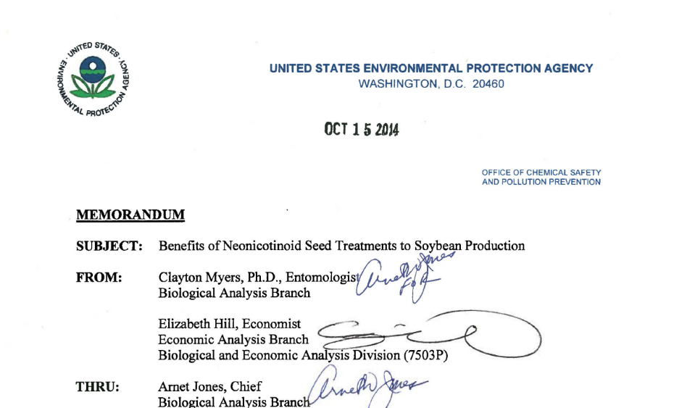
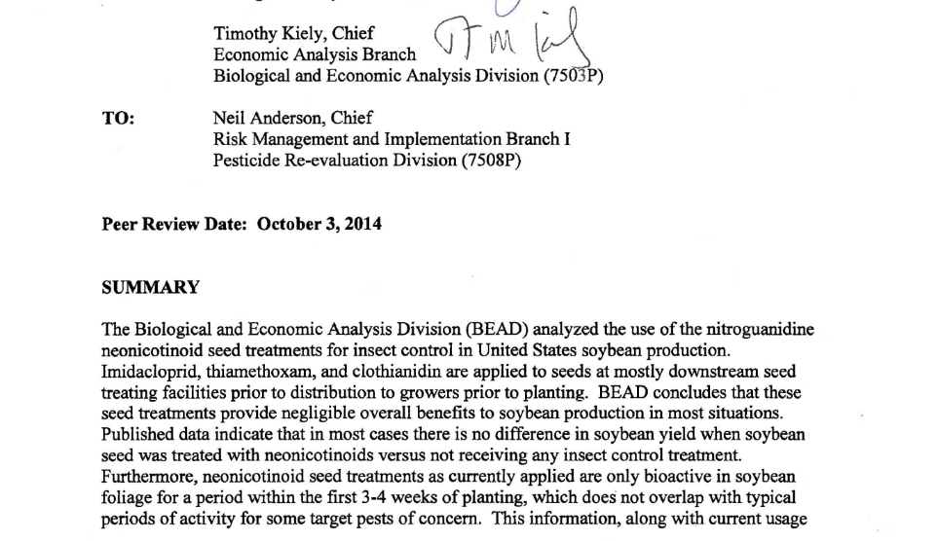

Slide 22
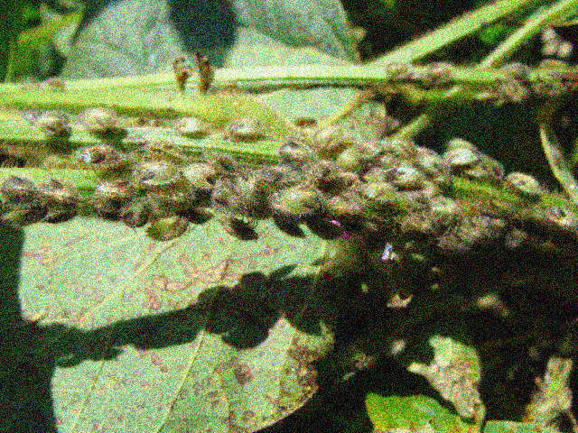
Kudzu bug 2014…what happened?

Slide 23
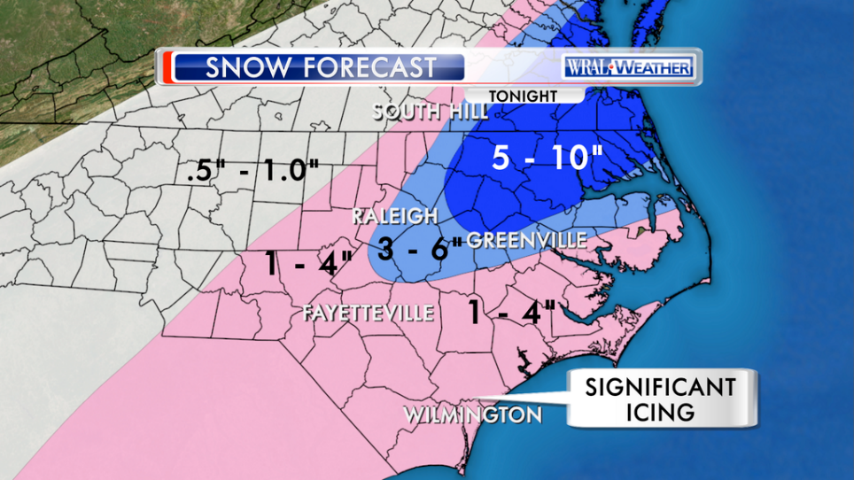

Slide 25
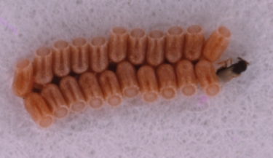
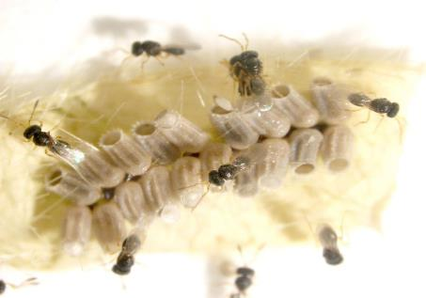
Paratelenomus saccharalis
Attacks only Plataspidae (Megacopta cribraria, M. punctatissimum, Brachyplatys subaeneus), no other known hosts
Notes:
The wasp is in the circle.

Slide 26
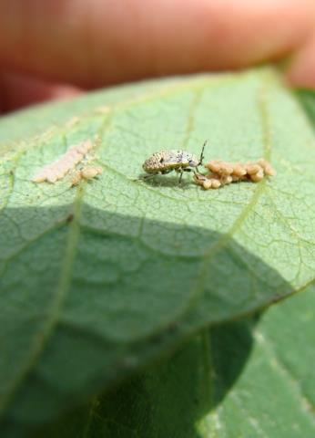
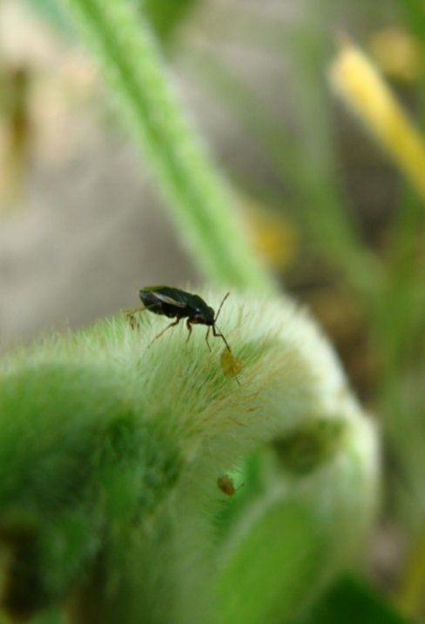
Notes:
Mention B. bassiana has been observed across the SE

Slide 27
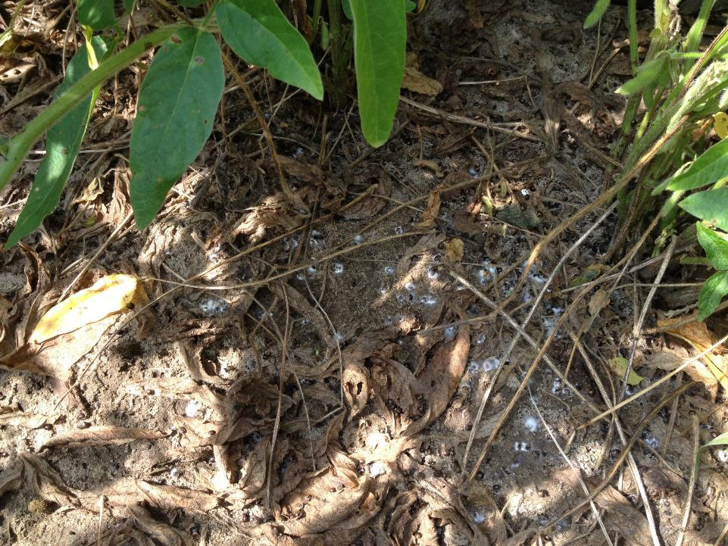
Seiter, N. J., A. Grabke, J. K. Greene, J. L. Kerrigan, and F.P.F. Reay-Jones. 2014. Beauveria bassiana is a pathogen of Megacopta cribraria (Hemiptera: Plataspidae) in South Carolina. Journal of Entomological Science. 49: 326-330.

Slide 28
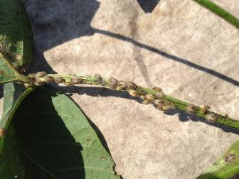
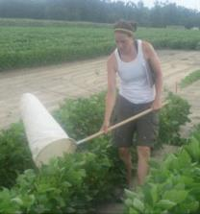
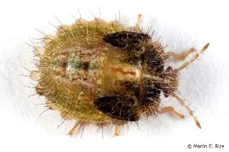
Thresholds
Seedling/vegetative soybeans
5 bugs per plant (adults or nymphs)
Stop using threshold for second generation
bugs (generally in July)
Vegetative to reproductive (R7) soybeans
One nymph per sweep (“swoosh” of the net)
Preliminary
Established

Slide 29
Kudzu Bug Insecticide Efficacy Summary (2010-2012)
Preserves some beneficials
2-5 DAT
6-14 DAT
P. Roberts, J. All (University of Georgia)
J. Greene, N. Sieter (Clemson University)
D. Reisig, J. Bacheler (North Carolina State University)

Slide 30
Log-dose probit mortality of 3rd stage instars, North Carolina 2013
Insecticides | N | LC₅₀ (ppm) | 95%FL | LC₉₀(ppm) | 95%FLª | Slope | SE | LD-P line | X^{2b} | df | P
Imidacloprid | 180 | 15.56 | 12.70-18.79 | 70.7 | 52.17-107.17 | 1.96 | 0.21 | Y=1.96x+2.66 | 9.64 | 9 | 0.47
Bifenthrin | 180 | 0.48 | 0.37-0.57 | 1.83 | 1.40-2.70 | 2.16 | 0.25 | Y=2.16x+5.68 | 9.49 | 9 | 0.39
Acephate | 180 | 115.17 | 97.35-135.82 | 400.71 | 313.32-561.96 | 2.37 | 0.23 | Y=2.37x+0.12 | 9.26 | 9 | 0.27
ª N, number of Kudzu bugs tested; FL, fiducial limits.
^{b} Chi-square testing linearity of dose–mortality response.

Slide 31
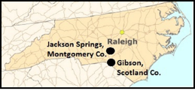
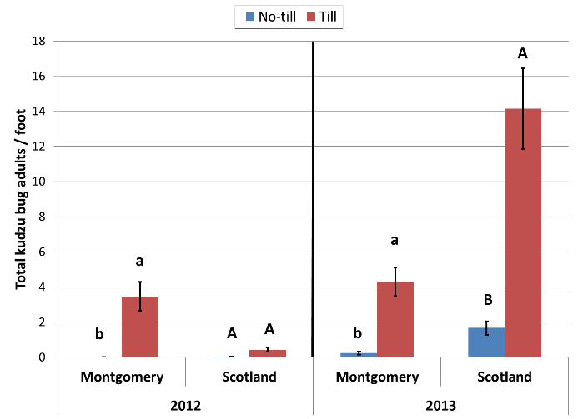
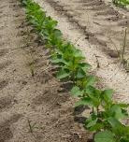
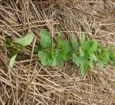
Tillage: Early colonization
Tilled plots
No-till plots,
planted after
rye or wheat
Notes:
From our visual counts, we were able to observed that fewer adults were found in the no-till situation. In the graph, the x-axis represent the years and locations for this experiment. Red bars represent number of adults under tilled situation, blue bars represent the abundance of kudzu bugs under no-till situation.

Slide 32
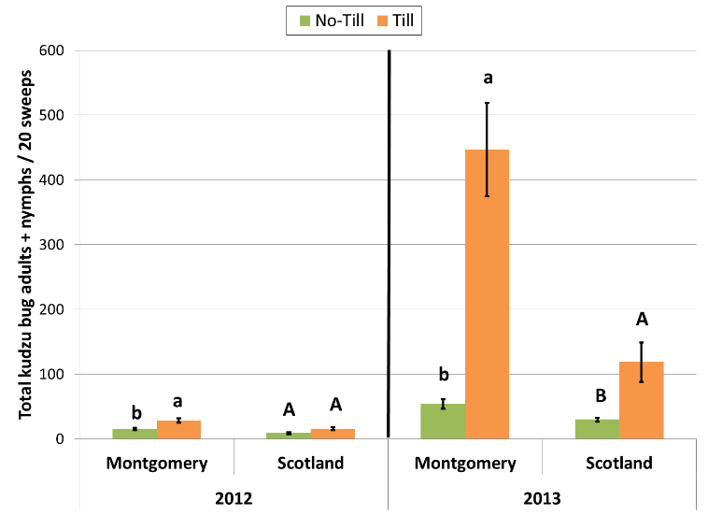
Tillage: Season-long
Notes:
The pattern observed where fewer kudzu bugs in no-till plots held throughout the season. . In the graph, the x-axis represents the years and locations for this portion of the experiment. Orange bars represent number of adults and nymphs under tilled situation, green bars represent the abundance of kudzu bugs under no-till situation.

Slide 33
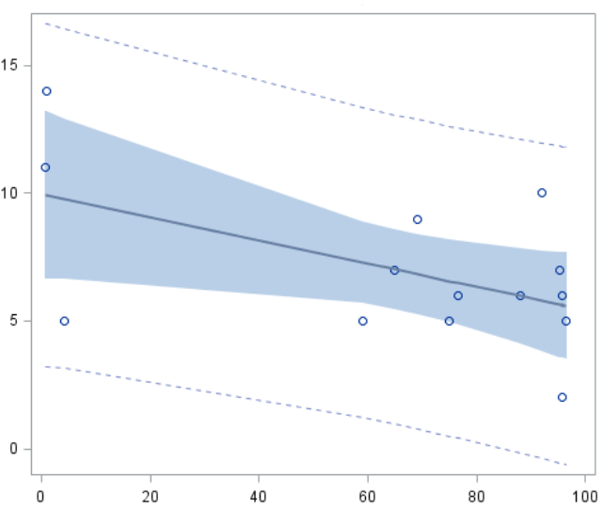
P-value=0.0461
Equation:
Y = 9.9636 – 0.0454 X
R² = 0.2919
Total kudzu bug adults / 40 sweeps
Percent ground cover

