Slide 1
 | Droplet Size Standardization*
 | Category | Symbol | Color Code | Approximate Dv0.5 (VMD) (microns)
 | Extremely Fine | XF | Purple | ≈50
 | Very Fine | VF | Red | <136
 | Fine | F | Orange | 136-177
 | Medium | M | Yellow | 177-218
 | Coarse | C | Blue | 218-349
 | Very Coarse | VC | Green | 349-428
 | Extremely Coarse | XC | White | 428-622
 | Ultra-Coarse | UC | Black | >622
 | * ASABE Standard S-572.1
Notes:
Droplet size categories have been standardized. There are eight categories, ranging from extremely fine to ultra coarse. The requirement on these new auxin herbicides is that we use nozzles that produce extremely coarse or ultra coarse droplets, or droplets with a VMD (volume median diameter) of about 450 microns or larger.

Slide 2
Nozzle Selection
Labels of new auxin products refer users to websites that specify the nozzles that MUST be used; requirement is to avoid nozzles that produce small droplets subject to drift
Websites listed on product labels
Notes:
Labels for the new auxin products will refer the user to a website that lists the nozzles approved for application of that specific product. Note the slide says nozzles that “must be used.” That is enforceable language; failure to use the recommended nozzles means you are out of compliance with the label. Specific nozzles are recommended to avoid production of small droplets that are subject to drift.

Slide 3
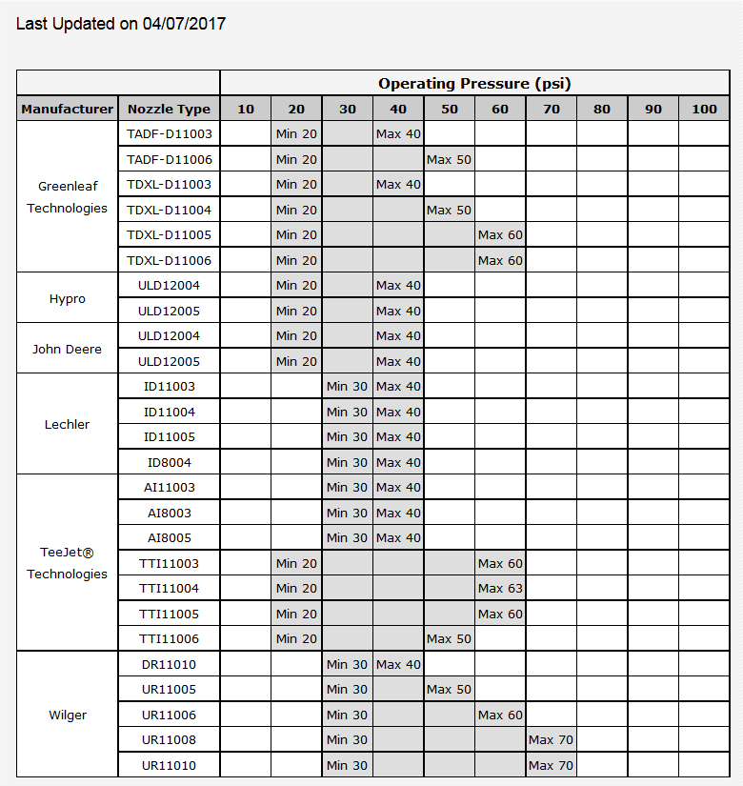
Approved
nozzles
for XtendiMax
or Fexapan
www.xtendimaxapplicationrequirements.com
Notes:
The websites for XtendiMax and Fexapan currently list 26 specific nozzles and the minimum and maximum operating pressures.

Slide 4
Approved nozzles for Engenia*
TTI 11003
TTI 11004
TTI 11005
ULD 120-04**
ULD 120-05**
DR 110-10
UR 110-06
UR 110-08
UR 110-10
* www.engeniatankmix.com
** ULD Nozzles must not be used over 40 PSI
Notes:
The website for Engenia currently has 9 approved nozzles.

Slide 5
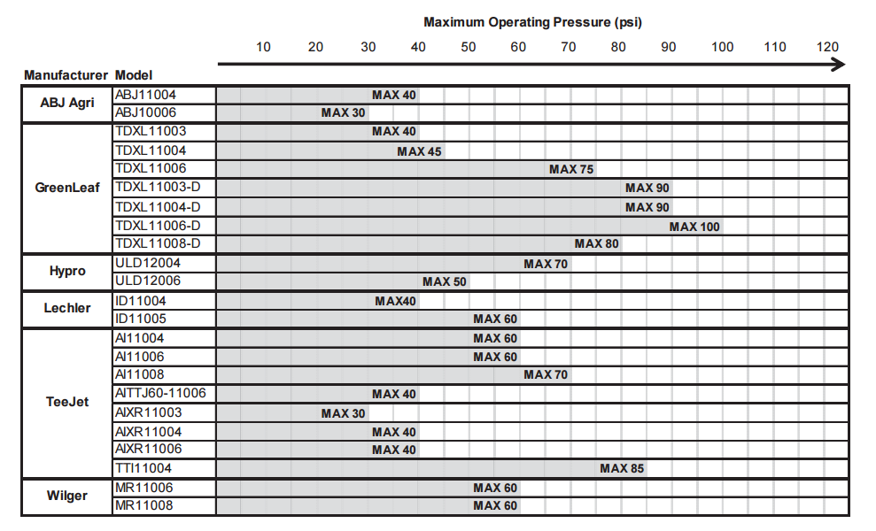
Enlist Duo
Notes:
The Enlist Duo label lists 23 approved nozzles and operating pressures.

Slide 6
Nozzle Selection
Labels of new auxin products refer users to websites that specify the nozzles that MUST be used; requirement is to avoid nozzles that produce small droplets subject to drift
Websites listed on product labels
Notes:
Again, the labels or websites specify nozzles that must be used. It is not optional.

Slide 7
Droplet size, Coverage, Weed Control
Notes:
Nozzles are on the approved lists because they produce large droplets that are less susceptible to drifting. But, large droplets means fewer droplets per unit area, and hence less effective coverage. Will that adversely affect weed control? Small droplets, and the associated better coverage, are important with contact-type herbicides. However, the auxin products under consideration translocate within plants. Coverage is less critical with translocated herbicides. Extensive research has shown that the auxin products work fine with the approved nozzles.

Slide 8
Sprayer Speed
No auxin application by airplane
No application by ground rig trying to be an airplane
Slide courtesy of Stanley Culpepper
Notes:
The new auxin herbicides will NOT be registered for aerial application on cotton or soybeans. That is just common sense. And, there are restrictions on speed of ground rigs.

Slide 9
Sprayer Speed
Speed restrictions on labels of Engenia, XtendiMax, Fexapan:
Do not exceed 15 MPH
Significance: Faster speeds increase drift potential
Decreasing boom stability
Greater shear = smaller droplets
Increasing air turbulence
No restrictions on Enlist Duo label
Notes:
Labels for Engenia, XtendiMax, and Fexapan restrict sprayer speed to a maximum of 15 MPH. They do that because sprayer speed can affect drift. When driving fast, there is more bounce on the boom, meaning boom height during the bounce is greater than you intend. Second, the additional shear on the fan as it exits the nozzle is greater with higher travel speeds, and that can cause smaller droplets. And third, when one is driving fast, there is greater turbulence behind the sprayer. The spray cloud tends to swirl, meaning droplets are suspended in the air for a longer time. The longer a droplet is suspended in the air, the greater the potential to drift. There are no travel speed restrictions on the Enlist Duo label, but common sense needs to prevail.

Slide 10
Sources of Off-Target Deposition
Vapor drift
Spray drift
Nozzle type Wind speed
Spray pressure Land terrain
Sprayer speed Humidity
Boom height
Spray volume
Tank mixes; adjuvants
Buffer areas
Sprayer contamination
Notes:
As you would expect, boom height affects spray drift.

Slide 11
Labels of dicamba-containing products will specify a maximum boom height of 24 inches above canopy or target
Enlist Duo label says to use the minimum boom height based upon the nozzle manufacturer’s specifications
Significance: greater boom height = greater drift potential
Boom Height
Notes:
Labels for the new dicamba-containing products specify a maximum boom height of 24 inches above the canopy or target. The Enlist Duo label just says to use minimum boom height based upon nozzle manufacturer’s specifications. With a typical 18-inch nozzle spacing, 24 inches would be a good guideline there. The significance is that greater boom height equals greater drift potential. The higher the boom, the longer it takes the droplets to reach the target, which in turn means they are more subject to being moved by wind.

Slide 12
Sources of Off-Target Deposition
Vapor drift
Spray drift
Nozzle type Wind speed
Spray pressure Land terrain
Sprayer speed Humidity
Boom height
Spray volume
Tank mixes; adjuvants
Buffer areas
Sprayer contamination
Notes:
Land terrain can have an impact in two ways.

Slide 13
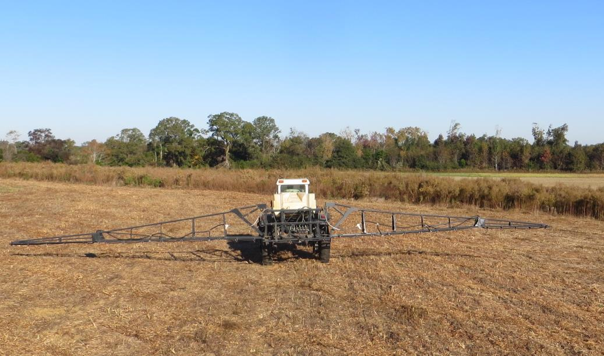
22”
38”
58”
Slide courtesy of Stanley Culpepper
Notes:
Unless you have automatic height control on the boom sections, maintaining the correct boom height is a problem on sloping land. You can easily see that in this slide. Boom height is correct on the up-slope, but down-slope it is pretty high. On the right-hand side, it will take the droplets longer to reach the target, and the longer the droplets are in the air, the more chance for the wind to move them.

Slide 14
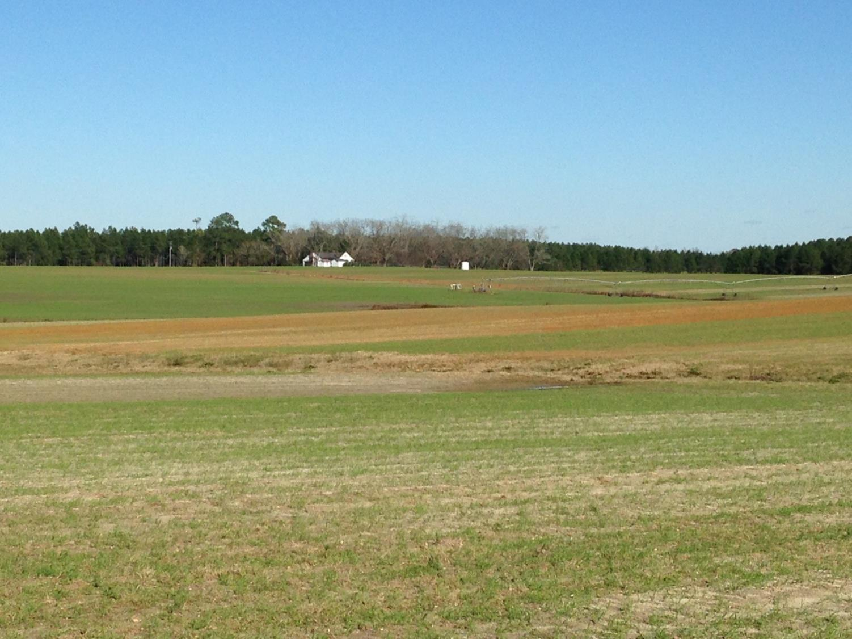
Land Terrain
Label Statement
Local terrain can influence wind patterns.
Every applicator must be familiar with local wind patterns and how they affect drift.
Slide courtesy of Stanley Culpepper
Notes:
There can be another impact of land terrain. Herbicide drift will tend to follow the depressions in the landscape. That is why these new auxin labels have the statement “Local terrain can influence wind patterns. Every applicator must be familiar with local wind patterns and how they affect drift”. There is nothing you can do about the terrain, but if there is something sensitive downwind, you might want to back off a little more around the draws.

Slide 15
Sources of Off-Target Deposition
Vapor drift
Spray drift
Nozzle type Wind speed
Spray pressure Land terrain
Sprayer speed Humidity
Boom height
Spray volume
Tank mixes; adjuvants
Buffer areas
Sprayer contamination
Notes:
Wind speed is obviously a critical factor affecting drift, and one that applicators need to carefully watch.

Slide 16
Wind Speed
Labels of auxin-containing herbicides registered for Enlist and Xtend crops will specify application during specific wind speeds
Winds 3 to 10 MPH preferred
Do not spray if wind < 3 MPH* or > 15 MPH
NC 24(c) labels specify max wind speed of 10 MPH
* Engenia label allows < 3 MPH if applicator ensures temperature inversion not present.
Notes:
Labels of the new auxin products have specific wind speeds for application. The labels state that winds of 3 to 10 MPH are preferred. And, they say do not spray if the wind is less than 3 MPH or greater than 15 MPH. Note that in NC, our 24C labels will specify a maximum of 10 MPH. The Engenia label will allow application at winds less than 3 MPH but only if the applicator ensures a temperature inversion is not present.

Slide 17
Wind Speed
Labels of auxin-containing herbicides registered for Enlist and Xtend crops will specify application during specific wind speeds
Why a minimum wind speed?
light winds unpredictable, variable in direction
greater risk of thermal inversion
Notes:
Why is there a minimum wind speed? Light winds are unpredictable and variable in direction. With light winds, it can be hard to tell for sure which way the wind is blowing. And, with calm or near calm winds, there is a greater risk of having a thermal inversion.

Slide 18
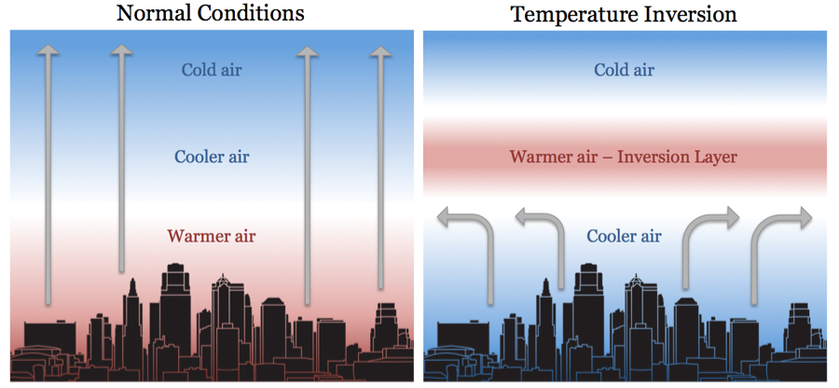
Under normal conditions, warm air near ground rises and mixes with cooler air above. Spray droplets or vapors disperse.
Under an inversion, the warm air layer acts like a ceiling. Normal mixing does not take place.
Notes:
Under normal atmospheric conditions, the air is warmest at the ground and decreases in temperature as you go up in altitude. Warm air rises, so, there is mixing of the air. That disperses spray droplets or vapors upward. With an inversion, a layer of warmer air is trapped between two layers of cooler air. That inversion layer acts like a ceiling. Things rise, hit the ceiling, and move laterally. The normal mixing in the air does not occur.

Slide 19
Thermal Inversions
Common on nights with limited cloud cover and light-to-no wind
Begin to form as the sun sets and often continue into the morning before surface warming
Presence can be indicated by ground fog or smoke not rising
Typically dissipate with increased winds or when surface air begins to warm (3°F from morning low)
Notes:
Thermal inversions are common on nights with limited cloud cover and light to no wind. They can start forming at sun set and last through the night until the temperature starts rising in the morning. A good indicator of an inversion is a layer of ground fog, such as in this picture, or smoke not rising. Inversions dissipate when the wind increases or when the temperature rises about 3 degrees from the morning low.

Slide 20
Wind Speed
Labels of auxin-containing herbicides registered for Enlist and Xtend crops will specify application during specific wind speeds
Why a max speed?
Greater wind = greater drift potential
Notes:
The reason for a maximum wind speed is obvious. The greater the wind, the greater the potential for drift and the farther that drift can occur.

Slide 21
Percent of days in May and June with wind less than 10 MPH.ª
ª Source: North Carolina State Climate Office. Wind speed recorded hourly from 2001 through 2015 at Rocky Mount/Wilson Airport. Each bar represents an average of 2687 observations.
Notes:
What are the odds of finding a day when the winds are within the specified range? The data here are from 15 years at the Rocky Mount/Wilson airport, and we are showing the percent of days in May and June when winds are less than 10 MPH at various times during the day. As you know, winds tend to be calmer early in the morning and late in the afternoon, but that is when you need to think about thermal inversions. Winds tend to be higher around noon and early afternoon. This graph is showing that about 70% of the days have winds less than 10 MPH between noon and 4 PM. So you are thinking, I have a pretty good chance of hitting a day calm enough to spray.

Slide 22
Wind speed may change once you start spraying
% of days with wind <10 MPH at noon
% of same days wind stayed < 10 MPH during 1 to 4 PM
Source: North Carolina State Climate Office. Wind speed recorded hourly from 2001 through 2015 at Rocky Mount/Wilson Airport. Each bar represents an average of 901 observations.
Notes:
Keep in mind that wind speed can change during the day. Assume you check the wind at noon and it is less than 10 MPH. You tell your man to start spraying. The red bar shows that for about half of the days when the wind was less than 10 MPH at noon, it got above 10 MPH sometime between 1 and 4 PM, so now we are down to about 45% of the days where you could have sprayed from 10 AM to 4 PM..

Slide 23
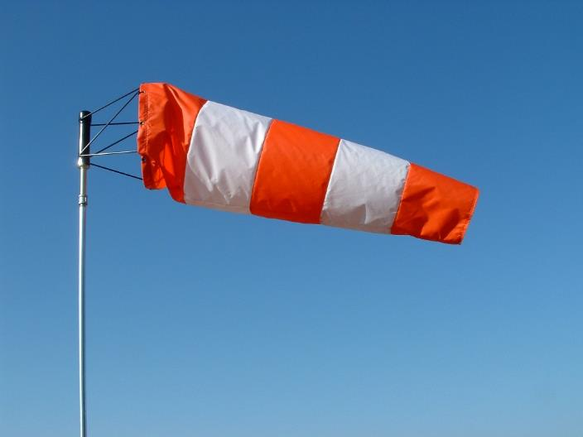
Wind Direction Changes
During the Day
Notes:
Probably more important than wind speed is wind direction, and be aware that wind direction can and does change during the day.

Slide 24
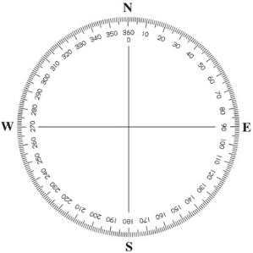
July 18, 2016 Rocky Mt., NC
8 AM
9 AM
10 AM
11 AM
12 PM
1 PM
2 PM
3 PM
4 PM
5 PM
6 PM
7 PM
Notes:
To illustrate how wind direction can change, this is the wind direction by hour on July 18 this past summer. All day long, the wind was consistently from the southwest. So, if there was a sensitive crop to the south of where you were spraying, you should have no problems. The wind would have been away from that sensitive crop all day.

Slide 25
July 19, 2016 Rocky Mt., NC
8 AM
9 AM
10 AM
11 AM
12 PM
1 PM
2 PM
3 PM
4 PM
5 PM
6 PM
7 PM
Notes:
However, the very next day was a different story. At some point during that day, the wind was from every direction on the compass. So, “downwind” depended upon the time of day spraying occurred.

Slide 26
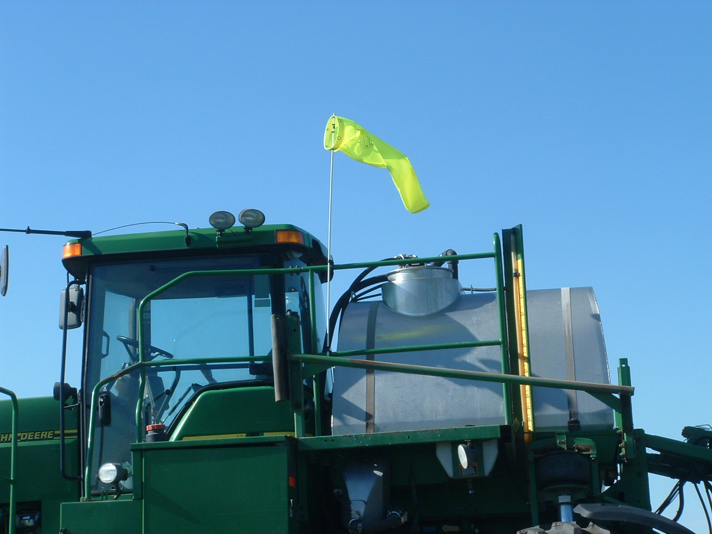
Check wind direction often
when spraying around sensitive crops
Notes:
So, remember, keep a close eye on wind direction.

Slide 27
Sources of Off-Target Deposition
Vapor drift
Spray drift
Nozzle type Wind speed
Spray pressure Land terrain
Sprayer speed Humidity
Boom height
Spray volume
Tank mixes; adjuvants
Buffer areas
Sprayer contamination
Notes:
Spray volume can impact drift, indirectly.

Slide 28
Roundup Ready® Xtend Crop System APPLICATION REQUIREMENTS
Carrier Volume
Minimum carrier volume is 10 GPA
If dense weed infestation exists, consider going to a higher spray volume (i.e. 12-15 GPA)
Slide furnished by Monsanto
Notes:
Labels for the new auxin products will specify a minimum application volume of 10 GPA. Why? By having a minimum spray volume and a maximum ground speed, they are forcing you to use nozzles with a larger orifice, hence making larger droplets.

Slide 29
Sources of Off-Target Deposition
Vapor drift
Spray drift
Nozzle type Wind speed
Spray pressure Land terrain
Sprayer speed Humidity
Boom height
Spray volume
Tank mixes; adjuvants
Buffer areas
Sprayer contamination
Notes:
Humidity can potentially influence droplet size, hence drift.

Slide 30
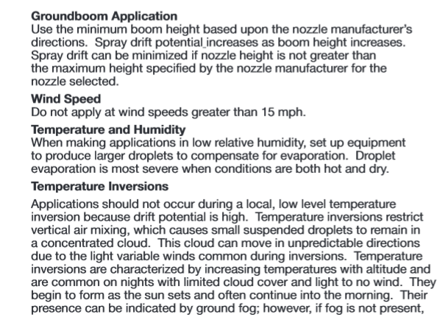
From: Enlist Duo draft label, 10-31-2016
Notes:
The new labels do not have specific humidity ranges, but they will say that under low humidity, set up equipment to produce larger droplets to compensate for evaporation. The reason is that under low humidity, droplets will evaporate somewhat as they travel from the nozzle to the target. This may be of some consequence in Arizona, but with our typical humidities, it is not worth worrying about.

Slide 31
Sources of Off-Target Deposition
Vapor drift
Spray drift
Nozzle type Wind speed
Spray pressure Land terrain
Sprayer speed Humidity
Boom height
Spray volume
Tank mixes; adjuvants
Buffer areas
Sprayer contamination
Notes:
When you tank mix multiple pesticides, there may be an effect on physical properties of the spray solution and hence an effect on droplet size. From the limited data available, it looks like droplet size can increase or decrease, depending on the particular tank mix. The EPA is concerned with mixes that could reduce droplet size and hence increase drift potential.

Slide 32
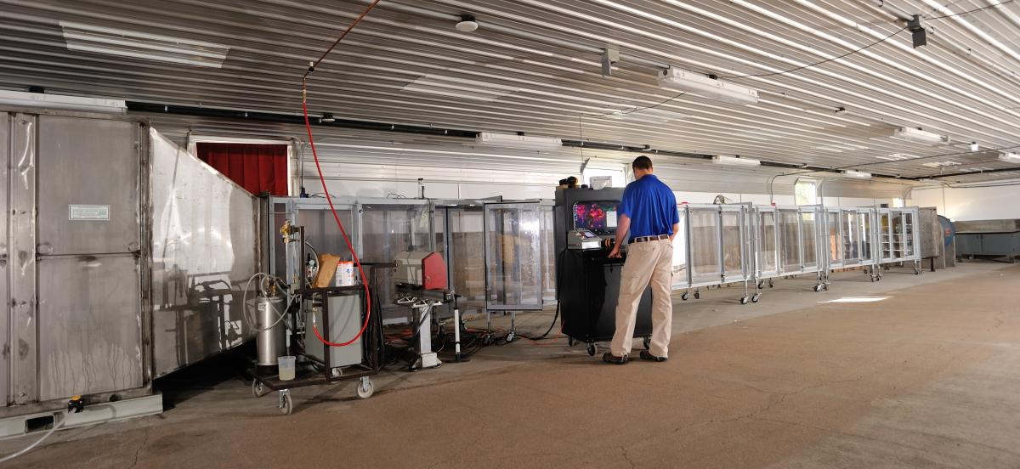
Notes:
For that reason, the EPA is requiring that registrants test every tank mix partner that might go in with these new auxin products to determine the impact on droplet size.

Slide 33
Tank Mixing
EPA requires registrants to test all tank mix partners
Applies to any pesticide, and any adjuvant, including drift reduction agents
Only approved tank mixes allowed
Each label has website specifying approved tank mixes
Notes:
That tank-mix restriction applies to anything added to the tank except water. So, it applies to any other pesticide, and it applies to adjuvants, even drift reduction agents. Only approved tank mixes are allowed. The labels mention websites the user can visit to see approved tank mixes.

Slide 34
Approved Adjuvants for Engenia
AG16098®
Activator® 90
Adept™
AP Simmer
Astonish™
Bomber™
Cerium™ Elite
Choice® Trio
Class Act® Ridion
Coact-XE™
Contrast™
Cornbelt® VaporGard™
Cornbelt® VaporGard™ + DRA
D-W surfactant 90
Elect DX2
Ensure Max™
Fast Break®
FASTRATE
Fixate™ Pro
Foambuster™
FoamGard AG-10™®
FoamGard AG-10™
FS AquaPrime™
FS Attero™
Grounded®
Iconic™
Impetro™
Impetro™ II
Induce®
Intact™
Intact™ Xtra
InterLock®
Jackhammer™ Elite
Kabak™ Plus
Leeway™
Leeway™ II
Lockamba™
Oculus™
Optimus™
Perimeter™
Persist Ultra MSO1
PinPoint Plus™
Rainier-EA™
Spread R™
SudBlaster
Trapline™ Pro
Trapline™ Pro II
Traverse D™
Veracity™ Elite
Veracity™ Elite II
Vertex™
Wheelhouse™ Pro
Notes:
The labels have a lengthy list of approved adjuvants. This is an example from the Engenia website.

Slide 35
Approved Herbicide Tank Mixes with Engenia
Glyphosates*
Buccaneer®
Buccaneer® Plus
Buccaneer® 5 Extra
Cornerstone® 5 Plus
Envy™ Intense
Glyfos® X-Tra
Glystar® Plus
Makaze®
Roundup PowerMax®
Roundup PowerMax® II
Roundup WeatherMax®
Tomahawk 5™
Other Herbicides
Authority® XL
Classic® Herbicide
Firstrate® Herbicide
Metribuzin 75
Outlook®^{1,2}
Prowl® H20
Rowel®
Rowel® FX
Sonic®
Valor® SX
Valor® XLT
Notes:
When the labels were first issued, there were no tank mixes with other herbicides. Since that time, several tank mix partners have been added to the list. This shows the herbicide tank mixes approved with Engenia.

Slide 36
Herbicide Tank Mixes with XtendiMax
Abundit® Edge
Authority® First
Authority® MAXX
Authority® MTZ
Authority® XL
Caparol® 4L
Cleanse™ 2 EC
Cobra®
Dimetric® EXT
Direx® 4L
First Rate®
Gatlin
Honcho® K6™
Intensity®
Intensity One®
Metribuzin 75
Metriclude™
METRICOR® DF
Omni® Brand Metribuzin 75 DF
Prowl® H20
Reflex®
Roundup PowerMAX®
Roundup WeatherMAX®
Rowel™
Rowel™ FX
Section® Three
Select Max®
Staple® LX
Tapout®
TriCor® DF
VAQUERO®
Valor® EZ
Valor® SX
Valor® XLT
Volunteer®
Warrant®
Warrant® Ultra
Products in YELLOW can be tank-mixed only if an approved drift reduction agent is used.
Notes:
And, this shows the currently approved tank mixes with Xtendimax. Even though Xtendimax and Engenia contain the same active ingredient, the approved tank mix partners differ somewhat. For example, Warrant is an approved tank mix with Xtendimax but it is not on the Engenia approved list. Classic was on the Engenia list but is not on the XtendiMax list. Also, it is important to note that with Xtendimax, the tank-mix partners shown here in yellow can be tank mixed with Xtendimax only if a drift reduction agent is used. A similar requirement does not exist for Engenia.

Slide 37
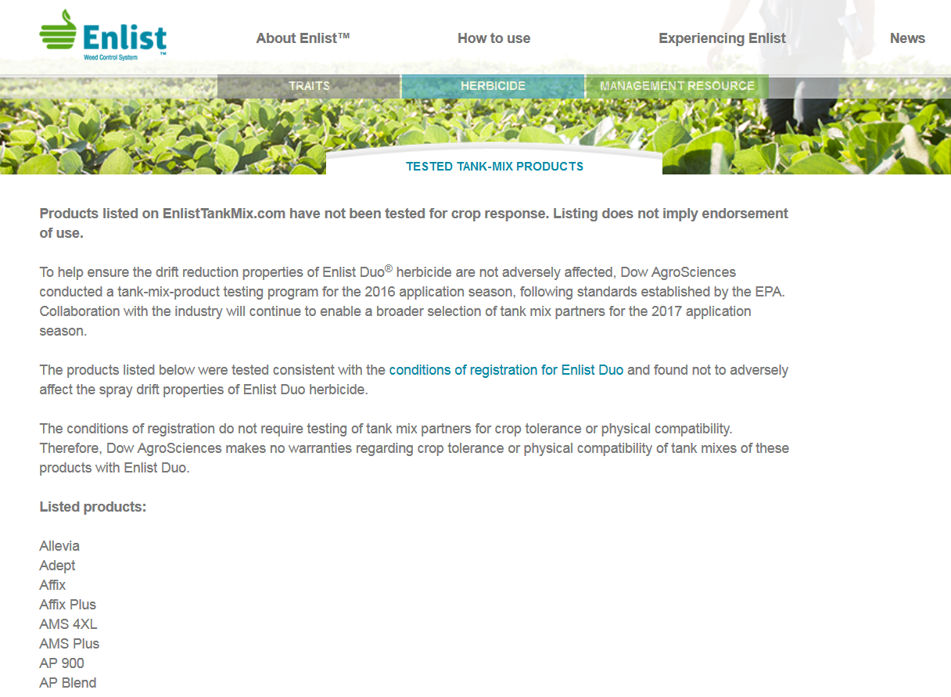
196 products on approved list. Various types and brands of adjuvants, nutritionals, PGRs; no herbicides
Notes:
The Enlist Duo website lists 197 products as approved tank mixes with Enlist Duo, but they are all various kinds of adjuvants, nutritionals, and a few PGRs. There were no herbicides or other pesticides on the list.

Slide 38
Tank Mixing
EPA requires registrants to test all tank mix partners
Applies to any pesticide, and any adjuvant, including drift reduction agents
Only approved tank mixes allowed
Each label has website specifying approved tank mixes
Notes:
I realize you can’t remember what tank mix partners are and are not approved. The main thing to remember is that each label has the address for a website that lists approved tank mixes.

Slide 39
What About Tank Mixes
Not on Approved Lists
EPA considers websites an extension of the label
Use of a tank mix not on approved list would be “use inconsistent with the label”
Notes:
What if you want to make a tank mix that does not appear on the approved list for the auxin herbicide you are using? You are not supposed to do that. The EPA considers the websites an extension of the label, and therefore they must be followed. Use of a tank mix not on the approved list would constitute a violation, a “use inconsistent with the label”.

Slide 40
Dicamba Products
AMS
UAN
Acidifying adjuvants
No AMS restrictions with Enlist Duo.
Notes:
AMS is commonly used with glyphosate. For dicamba products, the label clearly instructs you to not use AMS, UAN, or acidifying adjuvants. Basically these things will cause a low-volatility product like Engenia or XtendiMax to convert to dicamba acid, which is highly volatile. There are not AMS restrictions with Enlist Duo.

Slide 41
Sources of Off-Target Deposition
Vapor drift
Spray drift
Nozzle type Wind speed
Spray pressure Land terrain
Sprayer speed Humidity
Boom height
Spray volume
Tank mixes; adjuvants
Buffer areas
Sprayer contamination
Notes:
Buffers. This is very confusing. The labels for the different auxin products, from different companies, read a little differently concerning buffers. They all refer to a downwind buffer between where you spray and sensitive areas, but sensitive areas are not well defined.

Slide 42
Sensitive Areas
Labels for all herbicides being discussed require a downwind buffer for sensitive areas.
Wind Direction
buffer
Application Area
Unsprayed
Sensitive
Area
Notes:
This part we are sure of. All the labels say an unsprayed buffer is required between the application area and the sensitive area.

Slide 43
Sensitive Areas
Labels for all herbicides being discussed require a downwind buffer for sensitive areas.
What is a sensitive area?
Notes:
So, what is a sensitive area? Again, the labels are unclear. We finally asked EPA what that term means. They basically told us they could not define a sensitive area. But, they told us what a sensitive area is NOT.

Slide 44
Things that can be included in calculation of buffer*
Roads, paved or gravel surfaces.
Planted agricultural fields containing specific crops as listed on the labels (corn, sorghum, small grains, dicamba- or 2,4-D tolerant cotton or soybean, depending upon trait and herbicide sprayed)
Agricultural fields that have been prepared for planting.
Areas covered by the footprint of a man-made structure with walls and/or roof (specific structures listed on some labels).
* EPA says the above are NOT sensitive area.
Notes:
All the labels of the products we are considering today list four things that can be included in the calculation of the buffer. (Read them). EPA basically told us these things are NOT sensitive area.

Slide 45
So, what is a sensitive area?
Known habitat for T&E species
Forested areas
Hedgerows
Water bodies (ponds, lakes, streams, marshes, wetlands, etc)
Notes:
We think sensitive areas pertain to habitat for T&E species. Examples listed. We think any managed area, at least fields and roadsides and lawns, would not be a sensitive area.

Slide 46
What do the labels say concerning sensitive crops?
Enlist Duo, Engenia, Fexapan, and XtendiMax supplemental labels all say do not spray when wind is toward sensitive (or susceptible) crops.
Supplemental labels list a number of susceptible crops.
Home gardens and other residential plants not mentioned.
Additional wording basically saying not to allow contact with any sensitive plant.
Notes:
All the labels and supplemental labels say “do not spray when the wind is toward sensitive crops. They also list a number of susceptible crops. Note that home gardens are not mentioned, but that will be one of our biggest sources of complaints. And, all labels say to avoid contact with sensitive plants.

Slide 47
Adapted from: XtendiMax and Engenia supplemental labels
Wind Direction
110 ft
buffer
XtendiMax
Application Area
Unsprayed
Sensitive
Area
Notes:
For the dicamba products, if the sensitive area, woods for example, is immediately adjacent to the field, that means a 110 ft unsprayed buffer in the field.

Slide 48
Adapted from: XtendiMax and Engenia supplemental labels
Wind Direction
110 ft
buffer
90 ft
XtendiMax
Application Area
Unsprayed
Sensitive
Area
20-ft road
Notes:
But some things can be included as part of the buffer. So, for example, if there was 20-ft road between the field and the woods, that road can be part of the buffer, and you would have to leave only 90 feet unsprayed in the field.

Slide 49
Adapted from: Enlist Duo label
Wind Direction
30 ft
buffer
Enlist Duo
Application Area
Unsprayed
Sensitive
Area
Notes:
Enlist Duo has a 30-foot downwind, in-crop buffer to sensitive areas.

Slide 50
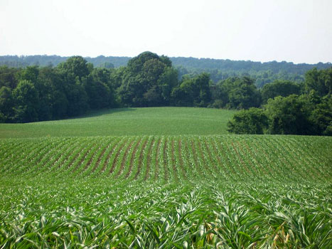
Notes:
In much of North Carolina, we have irregularly shaped fields with woods jutting in and out. Compliance with the sensitive-area buffer will be difficult.

Slide 51
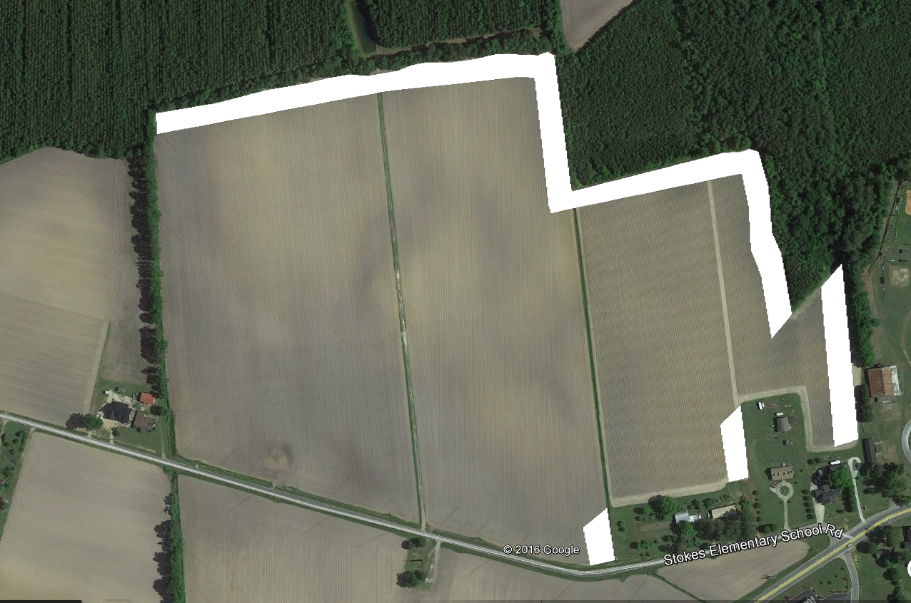
Downwind buffer for “sensitive area”
Application site
Wind
Notes:
The white areas on this map represent the downwind buffer if wind from southwest. Fields are generally rectangular, so leaving the unsprayed buffer would not be too hard to do.

Slide 52
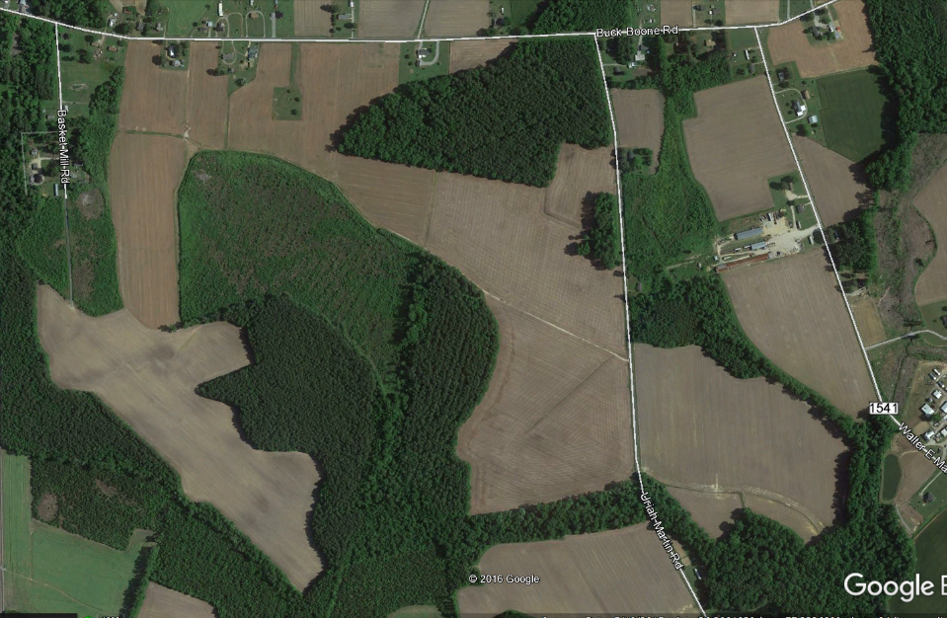
110 ft buffer downwind
~16% of land area in buffer
362-acre farm
Wind
Notes:
But here is a pretty typical farm in much of NC. The fields are shaped like pieces of a jigsaw puzzle and woods are jutting in everywhere. If you assume all the fields are planted to either an Xtend crop, or the fields not planted to an Xtend crop are planted to a dicamba-tolerant crop, then the yellow shows the 110-ft downwind buffer if the wind was from due west. 16% of the total field area could not be sprayed. And, even with the auto-everything some of you have on your sprayers, this is still going to be difficult to do.

