Slide 1
FECAL EGG COUNT
Michelle South
Area Extension Agent, Agriculture - Livestock

Slide 2
Fecal Egg Count
System that looks at type of parasite and quantity
Helps determine which parasites to treat
Better strategy for avoiding parasite resistance
Easy and cheap
Extension Agent can help
M.C. South, 2018

Slide 3
Fecal Egg Count Supplies
Gloves
Ziploc Baggies
Sharpie
Cooler
Large gallon Baggie
Gram Scale
Plastic Cups
Beaker or syringe (50mL)
Fecal Flotation Fluid
Spoons
Strainer (Fine)
McMaster Slides
1ml syringe or pipet
Compound Microscope
M.C. South, 2018

Slide 4
FECAL EGG COUNT PROCESS
STEP 1
Restrain animal before collection
Collect FRESH manure from the animal
Goats → 10 Pellets
Cattle → Handful
Horses → Two large Pellets
Manure should be taken from inside animal
Label baggies with animal ID
Equipment
Gloves
Lubricant
Plastic reusable baggie
Permanent Marker
M.C. South, 2018

Slide 5
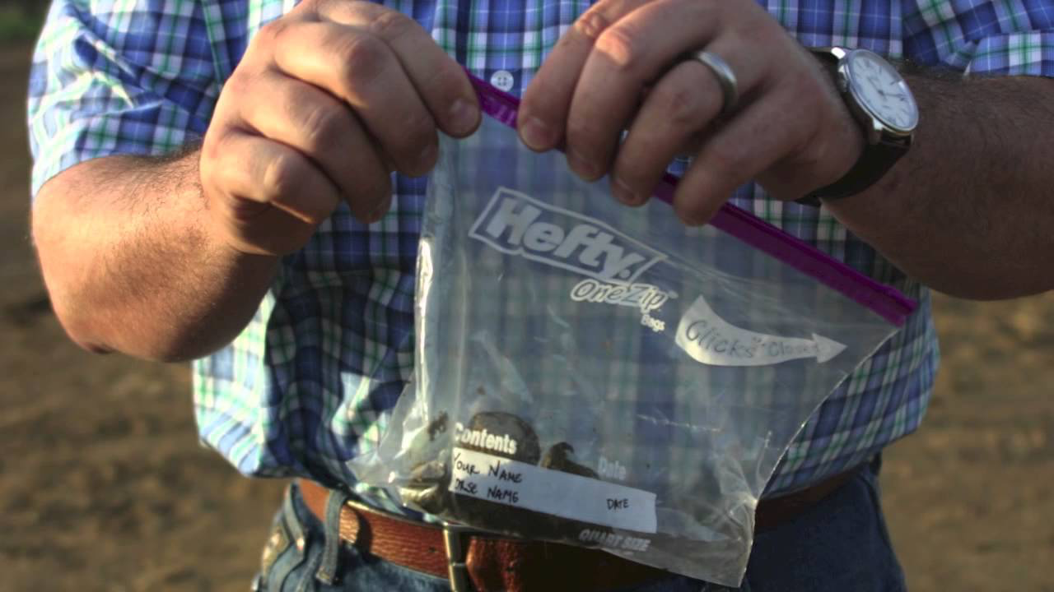
https://www.youtube.com/watch?v=z2fMhzrHCqw
M.C. South, 2018

Slide 6
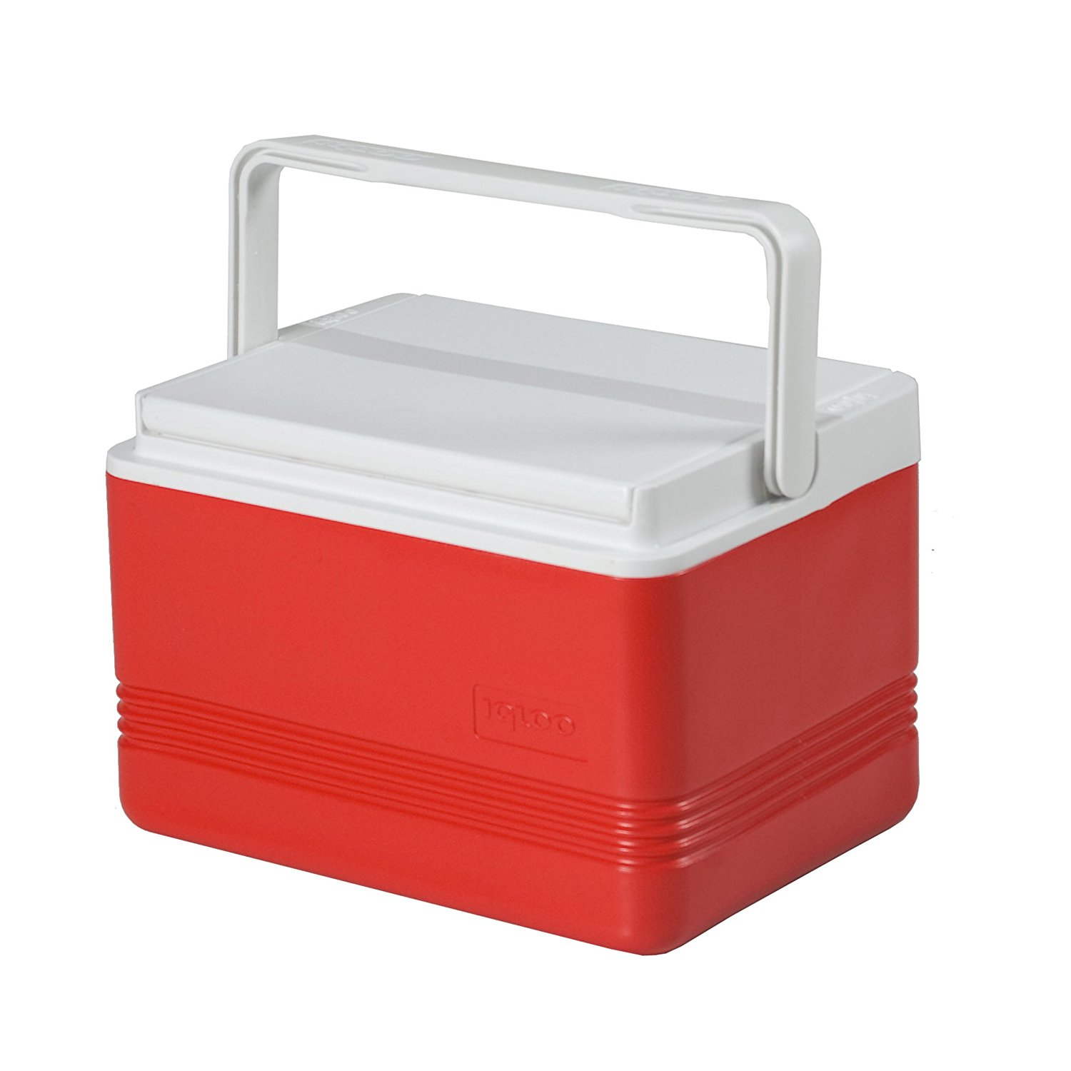
FECAL EGG COUNT PROCESS
STEP 2
Once collected → Store in fridge or cooler
Best to collect the same day as count
https://www.amazon.com/Igloo-Island-Breeze-Cooler-9-Quart/dp/B004L4QA8M
M.C. South, 2018

Slide 7
FECAL EGG COUNT PROCESS
STEP 3
Weigh out 2 grams of manure in cup
Pour 28 mL into cup or draw up 28 mL in syringe
Mix thoroughly until all pellets or manure have disintegrated
Let Sit for ~ 5 min
Mix again
Pour Mixture through strainer into another cup
Separating the large particles
M.C. South, 2018

Slide 8
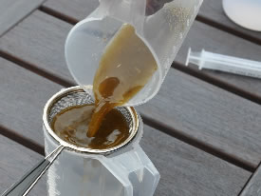
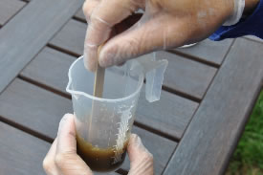
M.C. South, 2018
https://www.horsetalk.co.nz/2013/01/18/doing-a-fecal-egg-count

Slide 9
FECAL EGG COUNT PROCESS
STEP 4
Using the 1mL pipet or Syringe draw up 1mL of fluid
Immediately dispense fluid into both chambers of the McMaster slide
Place slide on stage of microscope under the 4x lens
Move to 10x len
Focus lens
Let slide sit for ~ 2mins to bring eggs to surface
M.C. South, 2018

Slide 10
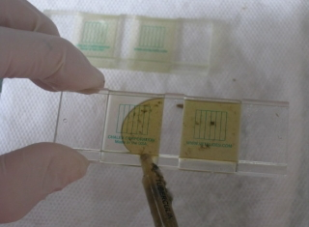
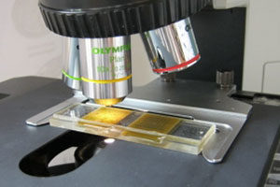
https://easywormer.com.au/pages/fecal-egg-counts
http://homesteadvet.net/large-animals/equine-medicine/fecal-egg-count
M.C. South, 2018

Slide 11
FECAL EGG COUNT PROCESS
STEP 5
Start on Bottom Right Side Corner and scroll stage upward, counting all eggs in that column.
When reach top of column, scroll downward on second column and count all eggs
Repeat process on all columns in first grid
Write down number of eggs in first grid
Repeat process in second grid
Write down number of eggs in second grid
Be sure to write down the quantity of different types of eggs. Want to get count of each type
M.C. South, 2018

Slide 12
M.C. South, 2018

Slide 13
http://mdgoattest.blogspot.com/2016/07/70-percent-haemonchus.html
M.C. South, 2018

Slide 14
https://en.wikipedia.org/wiki/Haemonchus_contortus
M.C. South, 2018

Slide 15
FECAL EGG COUNT PROCESS
STEP 6
Add egg count totals of both grids together
Times total of both grids combined by 50 to get eggs per gram count
Use this count to determine if animals should be treated
(Grid 1 + Grid 2) x 50 = eggs per gram (EPG)
M.C. South, 2018

Slide 16
FECAL EGG COUNT REDUCTION TEST (FECRT)
Step 1 → do a FEC
Step 2 →Deworm
Step 3 →Wait 14 days
Step 4 → do a FEC
Step 5 → Calculate % loss
If less than 90% of EPG was lost then change anti-parasitic
M.C. South, 2018

Slide 17
FECRT
M.C. South, 2018

Slide 19
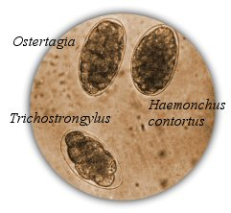
Coccidia
https://www.goatbiology.com/parasites.html
https://goatslikepaper.weebly.com/home/goat-diseases-1-coccidiosis
M.C. South, 2018

Slide 20
When Should You Treat??
Liver Flukes → Any Eggs Seen or Symptoms Noticed
Tapeworms → Any Eggs Seen or Symptoms Noticed
Brown Stomach Worm → Any Eggs Confirmed or Symptoms Noticed
Barber Pole Worm → Common Suggestion WAS >500 Eggs
UPDATED…
Dry Does/Bucks/Dry Ewes/Rams/Wethers → > 2,000 Eggs
Lactating Ewe/Lactating Does/ Young Stock → > 1,000 Eggs
Lactating DAIRY Does/Ewes → >750 Eggs
Cooperative Extension Program, University of Arkansas at Pine Bluff: Animal Science. Fecal Egg Counting for Sheep and Goat Producers. Http://www.uaex.edu/publications/pdf/fsa-9608.pdf . Accessed on February 20, 2018.
M.C. South, 2018

Slide 21
REFERENCES
Cooperative Extension Program, University of Arkansas at Pine Bluff: Animal Science. Fecal Egg Counting for Sheep and Goat Producers. Http://www.uaex.edu/publications/pdf/fsa-9608.pdf . Accessed on February 20, 2018
Improving Small Ruminant Parasite Control in New England: USDA Sustainable Agriculture Research and Education Program (LNE10-300). How To Do The Modified McMaster Fecal Egg Counting Procedure. https://web.uri.edu/sheepngoat/files/McMaster-Test_Final3.pdf. Accessed on February 16, 2018.
M.C. South, 2018

Slide 22
CONTACT
Michelle South
North Carolina Cooperative Extension
Area Extension Agent
Agriculture – Livestock
828-387-5748
mcsouth@ncsu.edu

