Slide 1
Handwashing matters
Dr. Ben Chapman and Katie Overbey
North Carolina State University
Feb 26, 2015

Slide 2
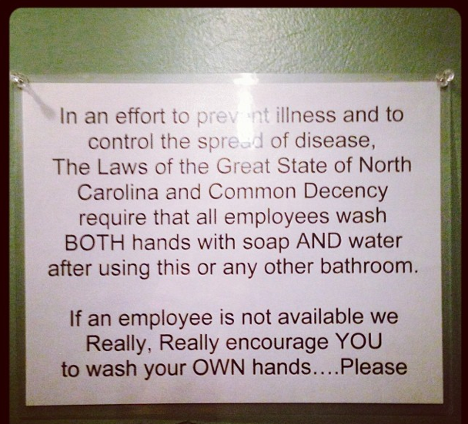

Slide 3
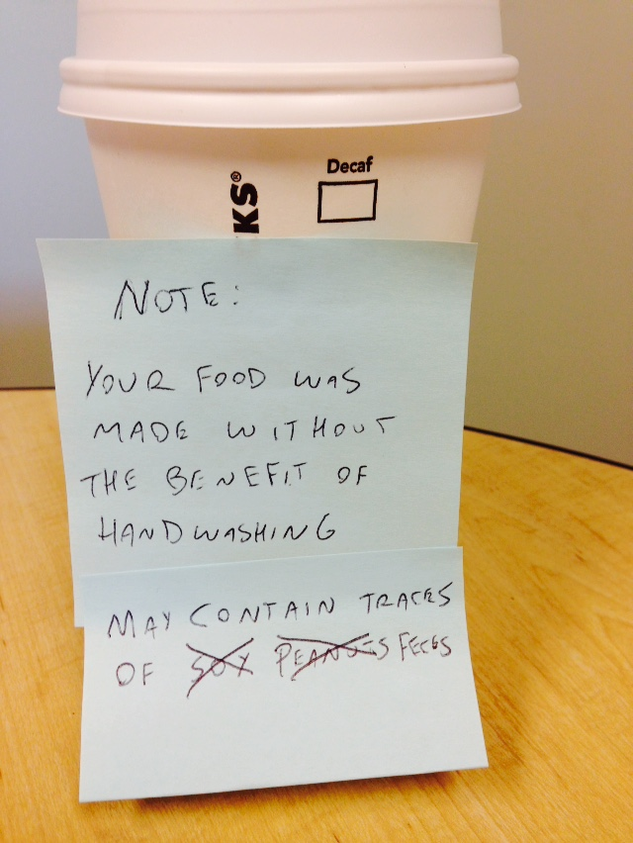

Slide 4
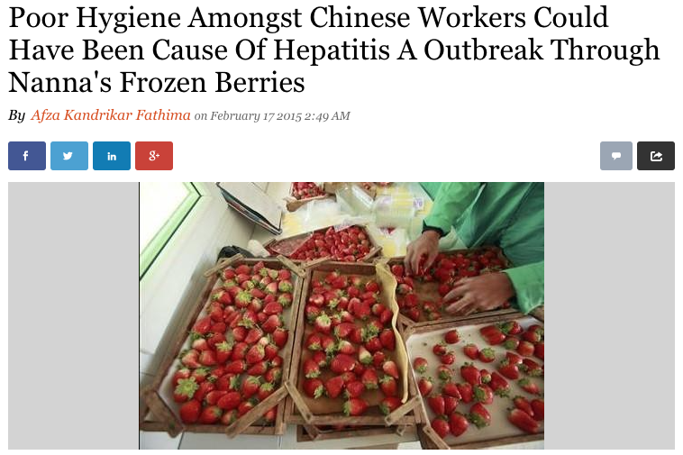

Slide 5
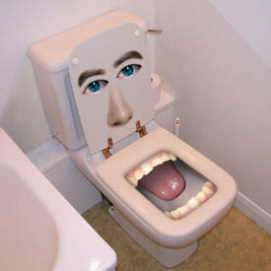
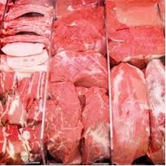
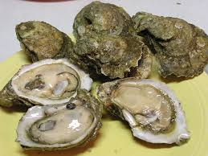
Sources of pathogens on hands
Toilet
Hepatitis A, norovirus, Shigella, Giardia, Salmonella
Source: Human feces has 10^7 pathogens per gram
Food
Salmonella, E. coli, Campylobacter, Vibrio
The food surface has at most 20,000 pathogens per ml

Slide 6
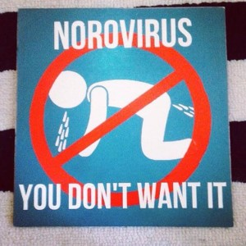
Why is good hand washing important?
In 89% of outbreaks caused by contamination from food handling - pathogens were transferred by workers hands
Many foodborne diseases are spread by contaminated hands
Salmonella: ~1 million cases per year, leading cause of deaths from foodborne illnesses
Norovirus: Over 5 million cases per year, leading cause of foodborne illness and leading viral cause of foodborne hospitalizations and deaths
Notes:
Generally, hospitalizations are low and deaths are rare, but certain populations, including children, can be more susceptible to these diseases and the more extreme outcomes

Slide 7
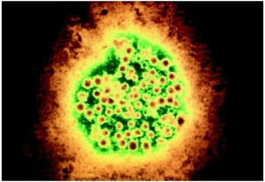
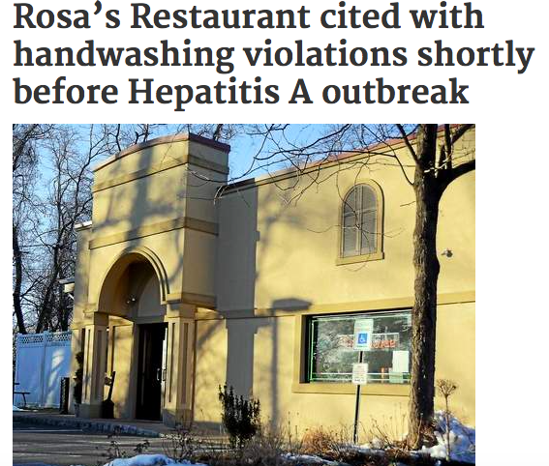
Rosa’s Restaurant and Catering
Ill food handler
3 post-virus exposure cases
Individuals did not take vaccination warnings serious
But… handwashing

Slide 8
Handwashing and food handlers: International
Japanese Bread maker Hofuku linked to over 1,000 ill children in Hamamatsu
Handwashing issues within the bakery firm
HuNov isolated from a restroom with same genome

Slide 9
The Problem of Foodborne Illness
Approximately 48 million new cases of food-related illness each year in the US
Resulting in about 3,000 deaths and 127,000 hospitalizations
Hall et al. 2012. Emerg. Inf. Dis. 18(10):1566-73

Slide 10
Just ill food handlers?
23 restaurant-associated salmonellosis outbreaks that occurred in Minnesota from 1995 through 2003 were reviewed
Sixty-four (53%) of 121 Salmonella-positive foodworkers reported not having had a recent gastrointestinal illness.
Medus C, Smith KE, Bender JB, Besser JM, Hedberg CW. Salmonella Outbreaks in Restaurants in Minnesota, 1995-2003: Evaluation of the Role of Infected Foodworkers. J Food Protection 2006; 69(8):1870-8.

Slide 11
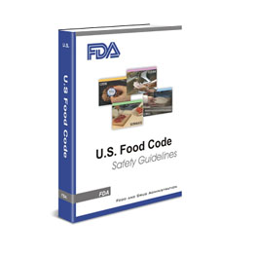
Hand washing requirements in the FDA model Food Code
The FDA Food Code requires all employees working with food to follow specific hand washing procedures

Slide 12
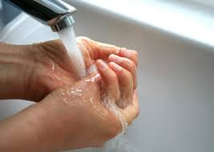
Step 1: Rinse
Rinse hands under clean, running water
Wash off any large particles that could inhibit effectiveness of disinfection steps, if used
Water temperature does not matter for pathogen removal
Plays other roles (loosening soil, preference)
(Boyce & Pittet, 2002; Michaels et al., 2002)
Notes:
Talk about how temperature doesn;’t matter, a study was done that found that different temperatures (ranging from 40 F to 120 F) had no discernable impact on the reduction of microbes or contaminants on hands

Slide 13
Step 2: Soap
Apply hand soap
Soap makes it easier to rinse off things, likes fats and oils, because it makes them more soluble in water
Soap has better activity at warmer
(Boyce & Pittet, 2002)
Notes:
Regular soap versus antimicrobial soap is not important, antimicrobial soaps have been found to be only marginally more effective than regular soaps (and will talk about why in a second); liquid soap is preferable

Slide 14
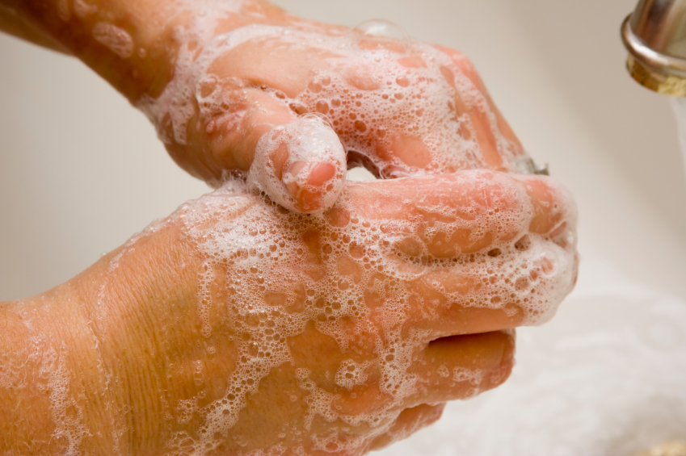
Step 3: Scrub
Rub together for 10 to 15 seconds, pay particular attention to fingernails
Mechanical removal of contaminants and microbes from hands is crucial in proper hand hygiene
Scrubbing physically gets rid of these (and a nail brush helps)
It is important to be thorough around fingernails, as it has been found that these harbor very high amounts of organisms
(Lin et al., 2003; Price P., 1938)

Slide 15
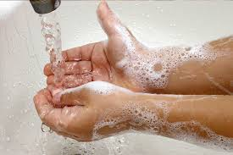
Step 4: Rinse
Thoroughly rinse hands under clean, running water
This aids in the mechanical removal of microbes and contaminants from your hands
(Boyce & Pittet, 2002; Michaels et al., 2002)

Slide 16
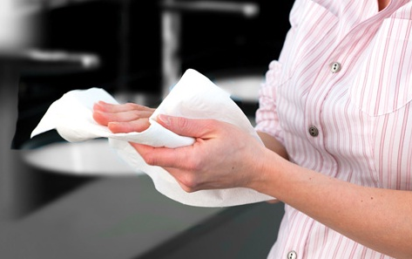
Step 5: Dry
Rinse hands under clean, running water
Mechanical drying is the last step in physically removing microbes and contaminants from hands – 1 log reduction
Disposable paper towels are desirable as they dry efficiently, remove bacteria effectively, and can cause less contamination in the washroom
(Huang, Ma, & Stack, 2012)

Slide 17
Reduction of Microbes from Hand Washing
Proper hand washing has been found to reduce microbes on hands between 99 and 99.9%
It is estimated that the microbial population on hands ranges from 40,000 and 4,600,000
This could leave anywhere between 100 to 5,000 microbes behind
(Boyce & Pittet, 2002; FDA, 2009; Green et al., 2007)
Notes:
Not all of these microbes are going to be disease causing, but some diseases need as few as ten particles to infect. Take home message: wash your hands but also be cautious of what you touch with bare hands *Note: this is only if proper technique is followed, literature has found that glove use without hand washing is not effective

Slide 18
The double handwash w/nail brush (from Pete Snyder)

Slide 19
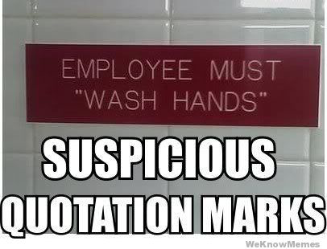
Handwashing compliance
It is known that hand washing compliance tends to be very poor, around 40%
One study found that 73% of restaurant workers failed to use proper hand washing
Other have found similar results, with about 30% of food handlers displaying correct hand washing practices
(Green et al., 2007; Voss & Widmer, 1997)

Slide 20
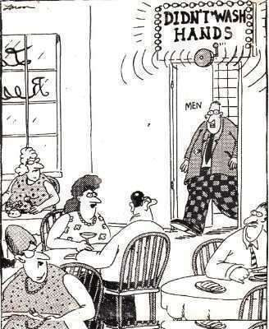
Common Barriers to Handwashing Compliance
Staff are busy
Gloves are being worn
Don’t have the tools (no or too few stations, no soap)
Poor location of hand sinks
Lack of values over the practice
Lack of knowledge of consequences
(Green et al., 2007; Naikoba & Hayward, 2001)
Notes:
Gloves: workers who wear gloves do not always remove them and wash hands as they should

Slide 21
Hand hygiene programs (healthcare)
reinforcement of hand hygiene messages;
knowledge of health care workers' perceived importance of hand hygiene and its role in prevention of healthcare-associated infections;
monitoring and feedback of hand hygiene practices;
practical education tools;
role-modeling by senior staff;
and supportive infrastructure and management.
Mathai E, Allegranzi B, Seto WH, et al. Educating healthcare workers to optimal hand hygiene practices: addressing the need. Infection. 2010;38(5):349–56.

Slide 22
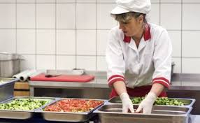
Addressing barriers to handwashing
Evaluate food preparation activities and the frequency of needed hand washing
Ensure that shifts are staffed appropriately to handle the workload

Slide 23
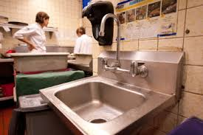
Addressing barriers to handwashing
Provide multiple hand sinks for workers, that are well stocked with soap and paper towels
Hand sinks should be in work space, in workers sight while they are working
Should be convenient

Slide 24
How to address barriers to hand washing
Food safety training is crucial, but one time training is only marginally effective
Remind (keep it fresh)
Regularly providing workers feedback on hand washing practices

Slide 25
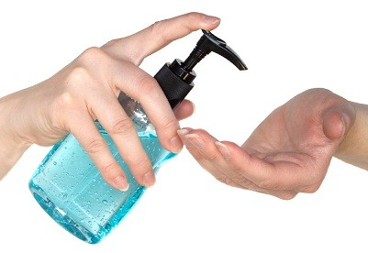
Hand Sanitizers: Fact or Fiction?
The composition matters
Fact
For most pathogens a hand sanitizer with an alcohol concentration of at least 60% is needed
(Boyce & Pittet, 2002; FDA, 1994)

Slide 26
Hand Sanitizers: Fact or Fiction?
Can prevent disease caused by all agents
Fiction
Most hand sanitizer is not effective for all agents of disease, especially Norovirus
(Liu, Yuen, Hsiao, Jaykus, & Moe, 2010)

Slide 27
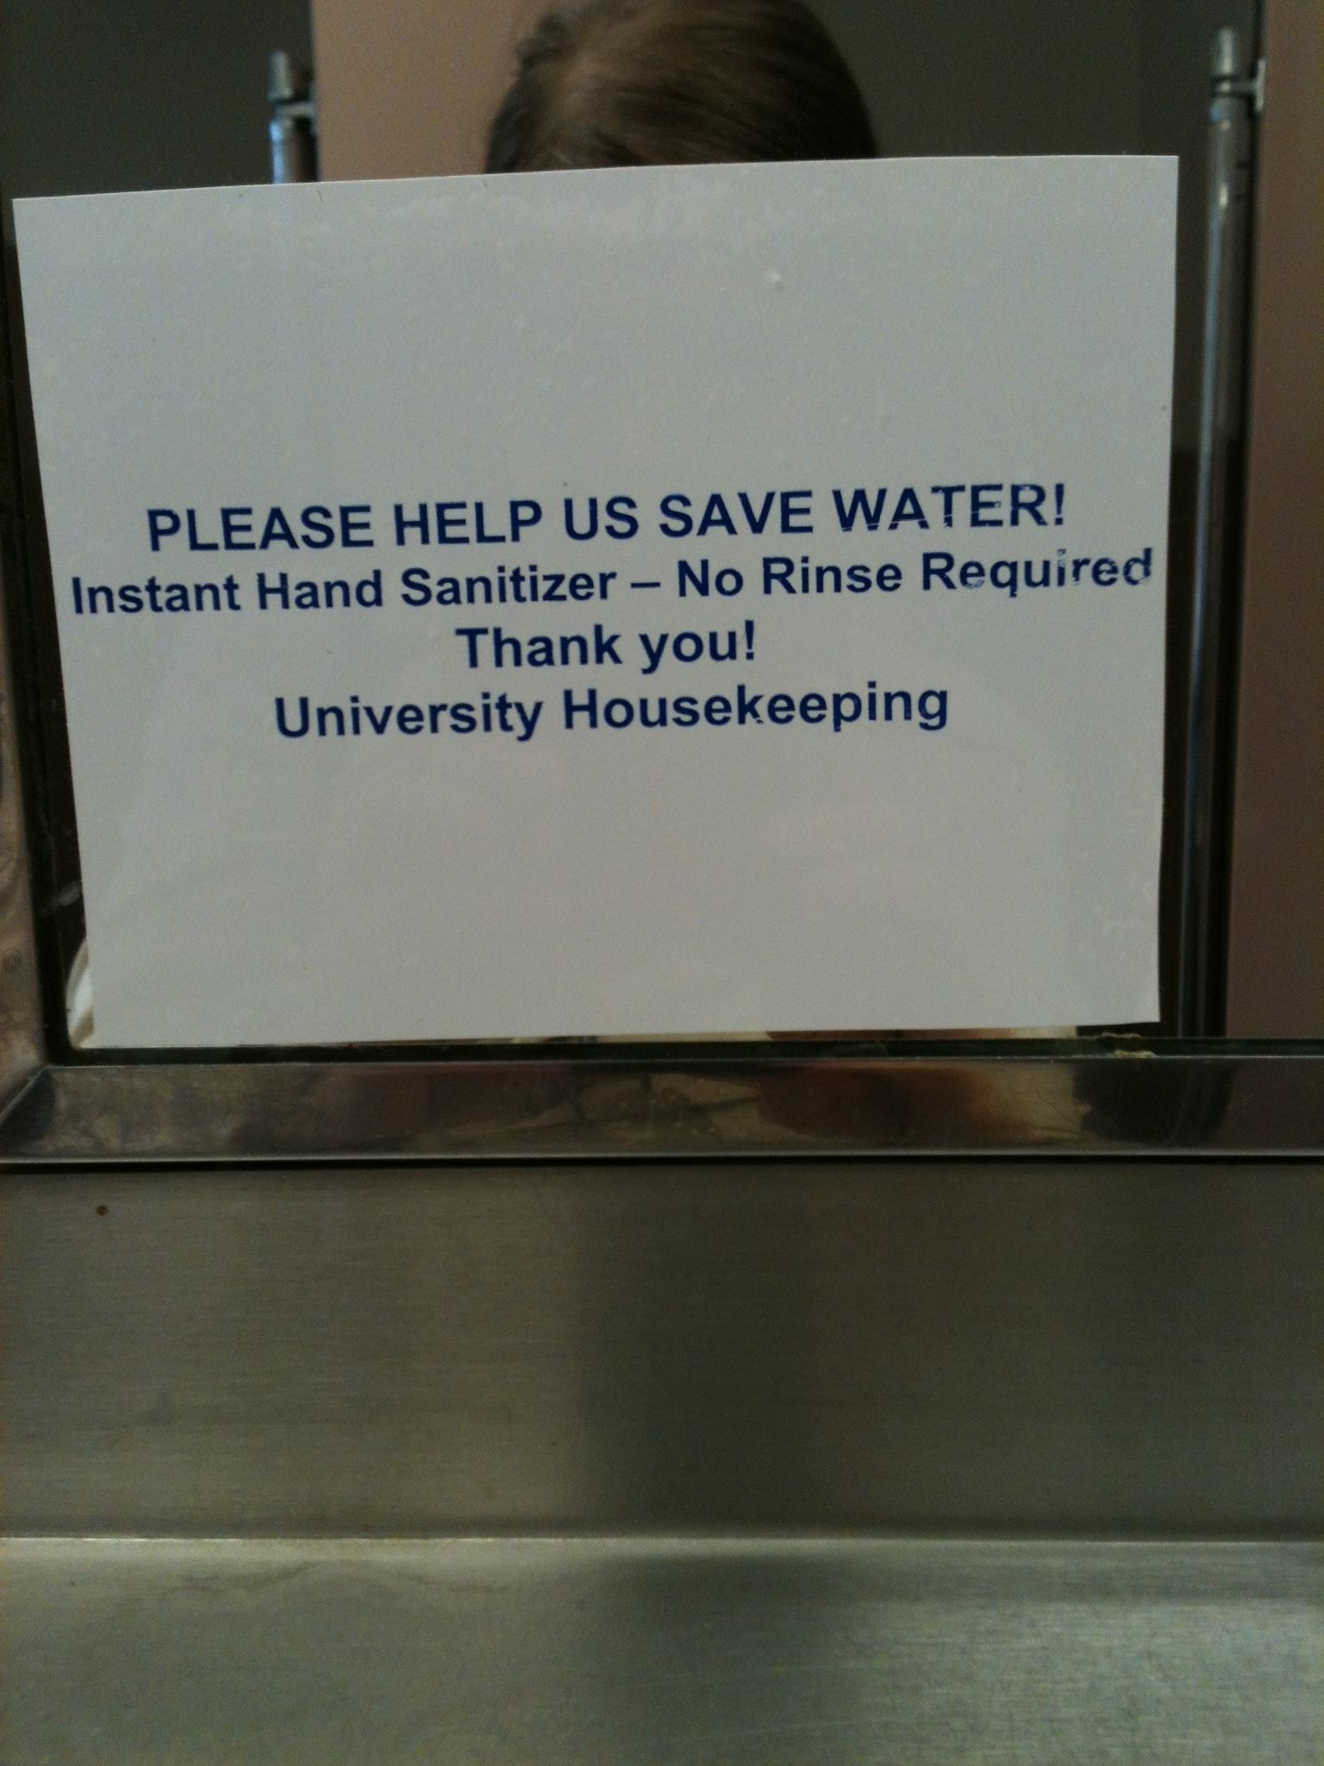

Slide 28
Dr. Ben Chapman
benjamin_chapman@ncsu.edu
Follow me on twitter @benjaminchapman
919 809 3205
foodsafetyinfosheets.org
foodsafetytalk.com
barfblog.com

